Slide 1
Exploring Britain
Boating
Chapter 1
London to Oxford
13th July to 11th September 2009

Slide 2
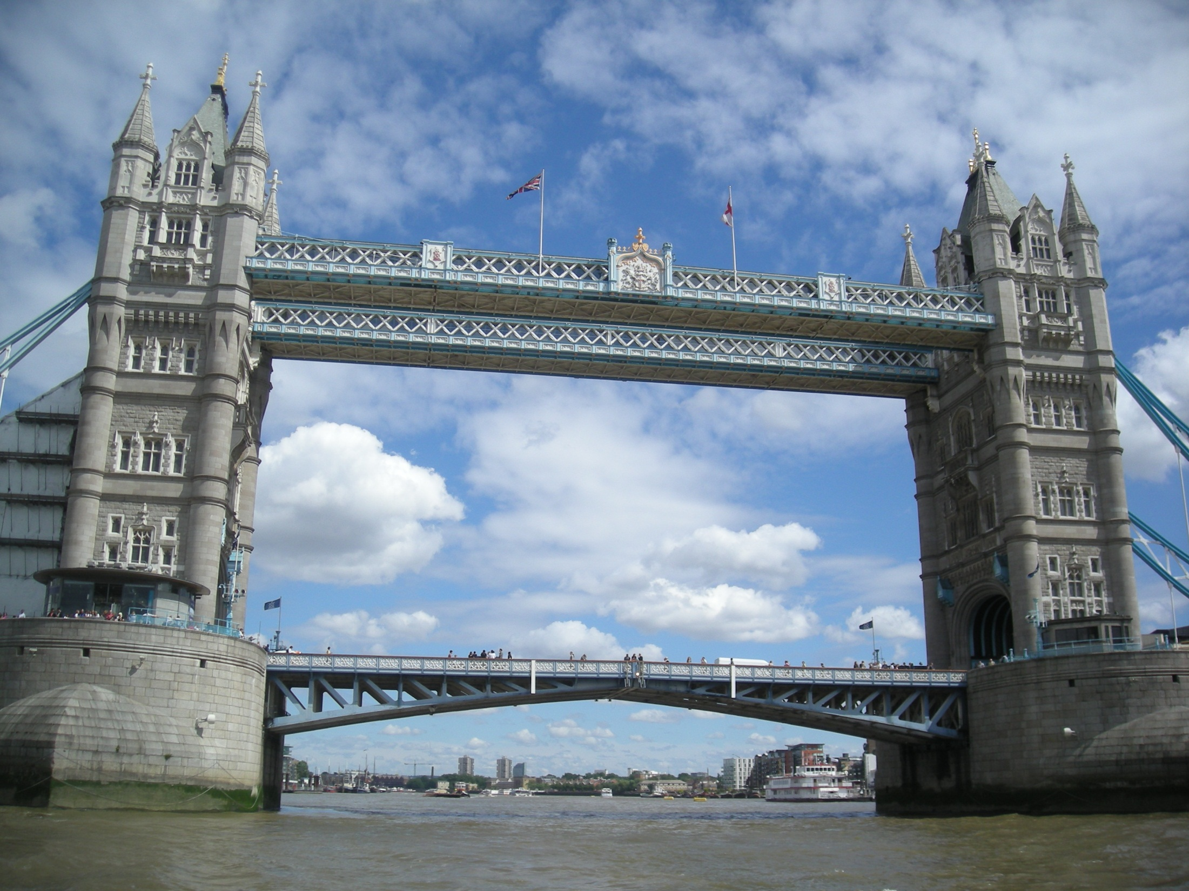
Narrowboats President and Kildare are in London.

Slide 3
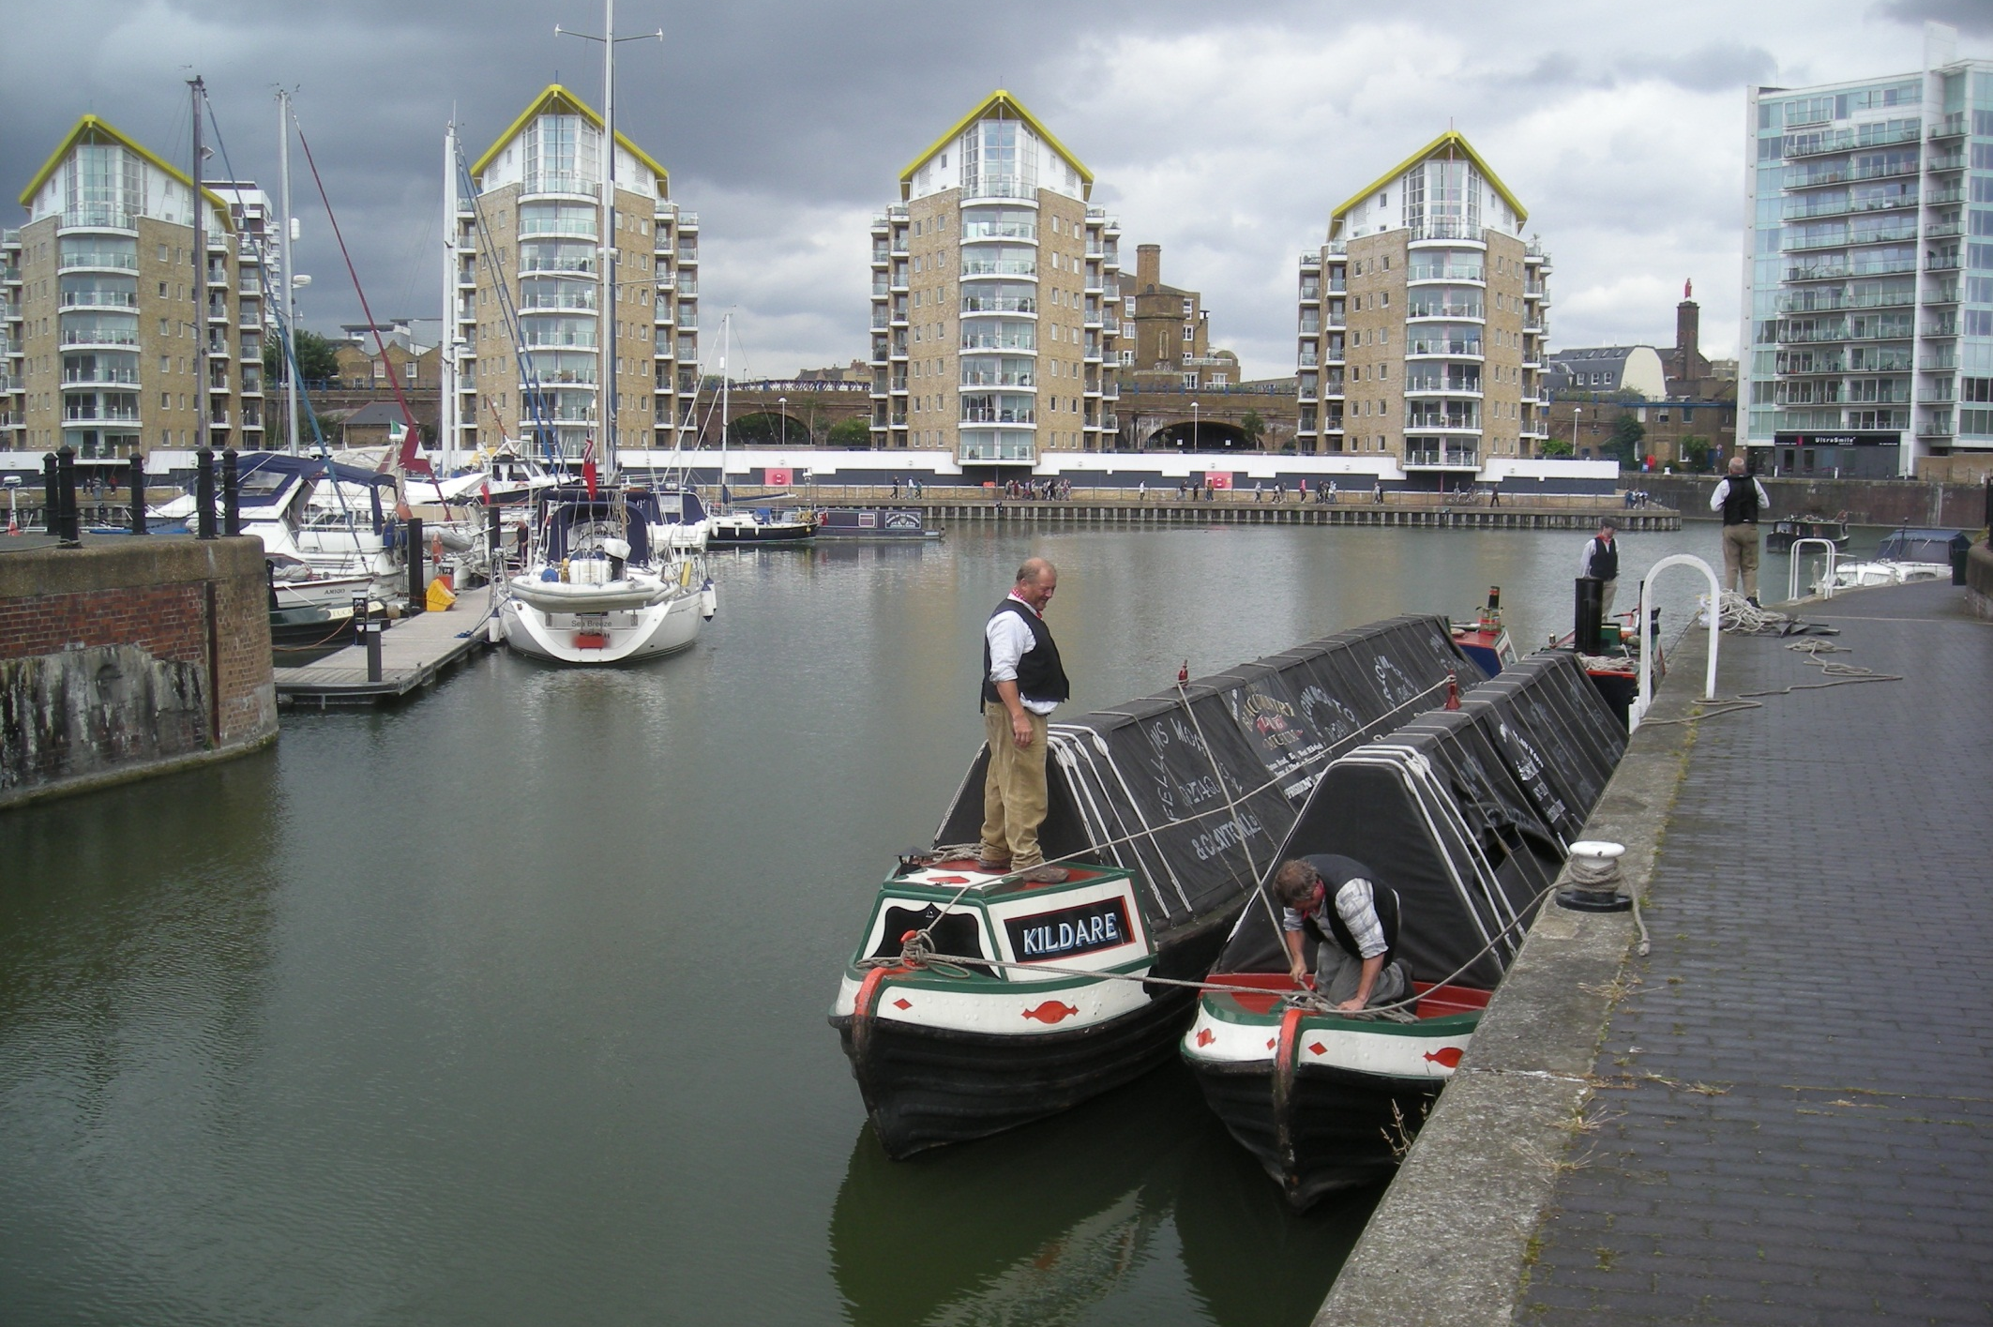
This is Limehouse Basin, London’s premiere canal dock, as the boats are roped together for the rigors of the Thames Tideway.

Slide 4
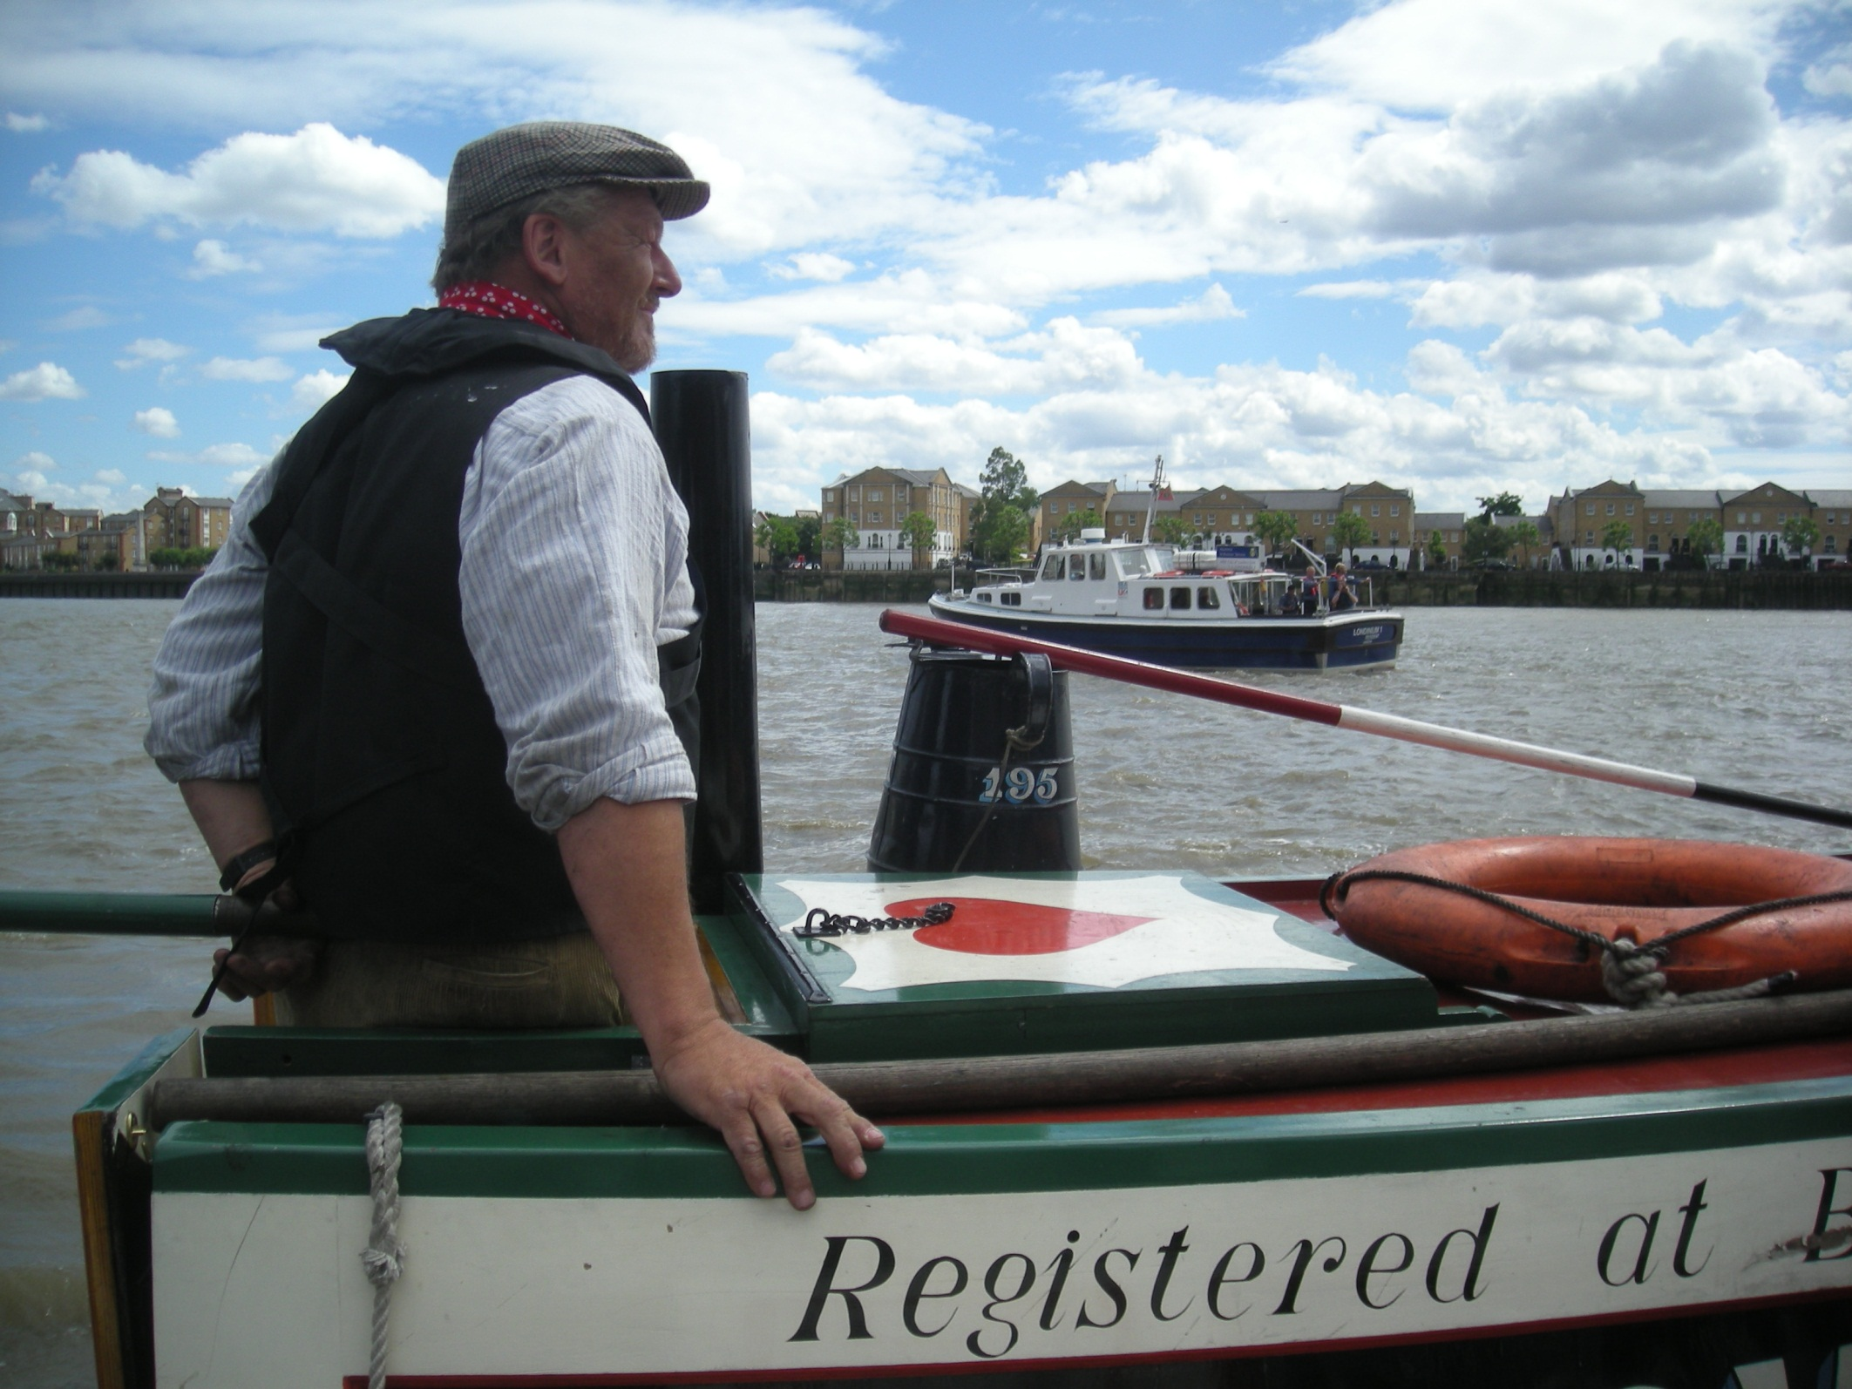
Bob is at the tiller as we head out of Limehouse Lock into the fast moving water of the tidal Thames.

Slide 5
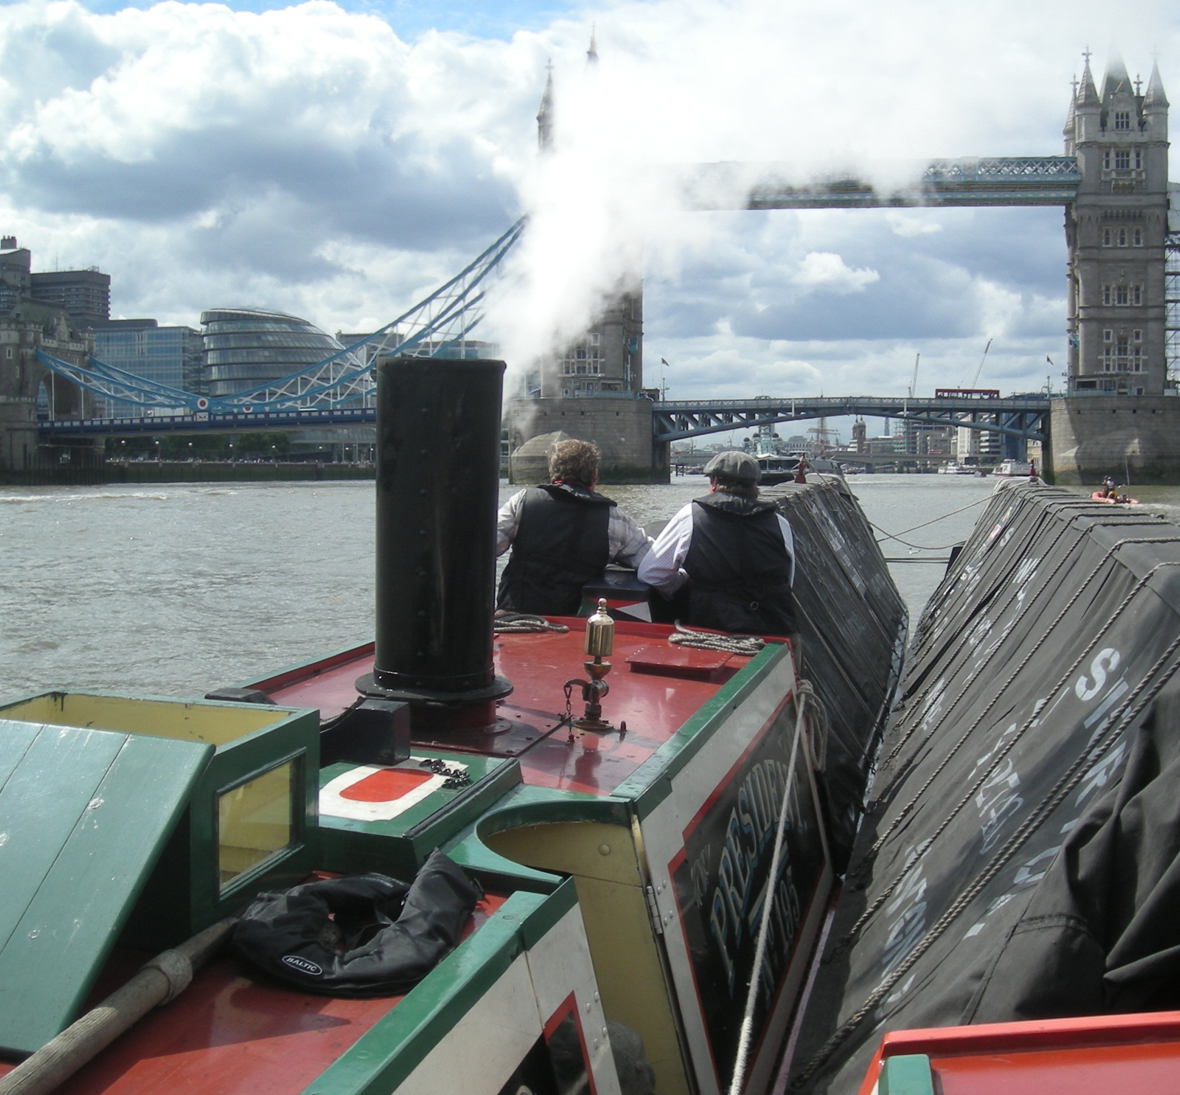
President is the Black Country Museum’s steam powered narrowboat and is a fantastic sight heading for Tower Bridge.

Slide 6
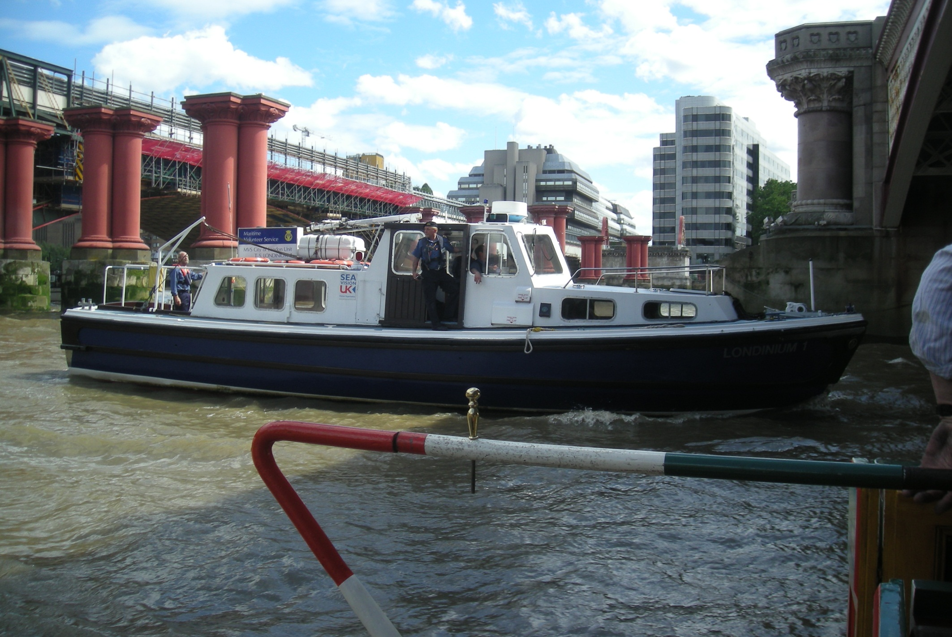
We are being escorted by Londinium 1 of the Maritime
Volunteer Service, seen here passing Blackfriars Bridge.

Slide 7
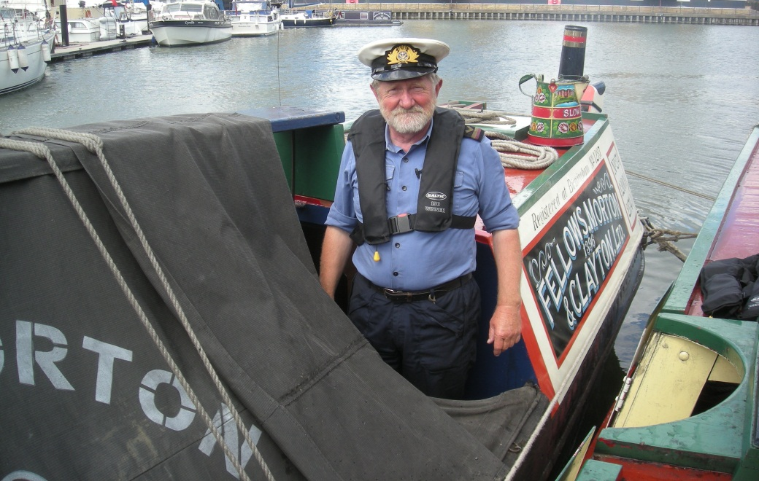
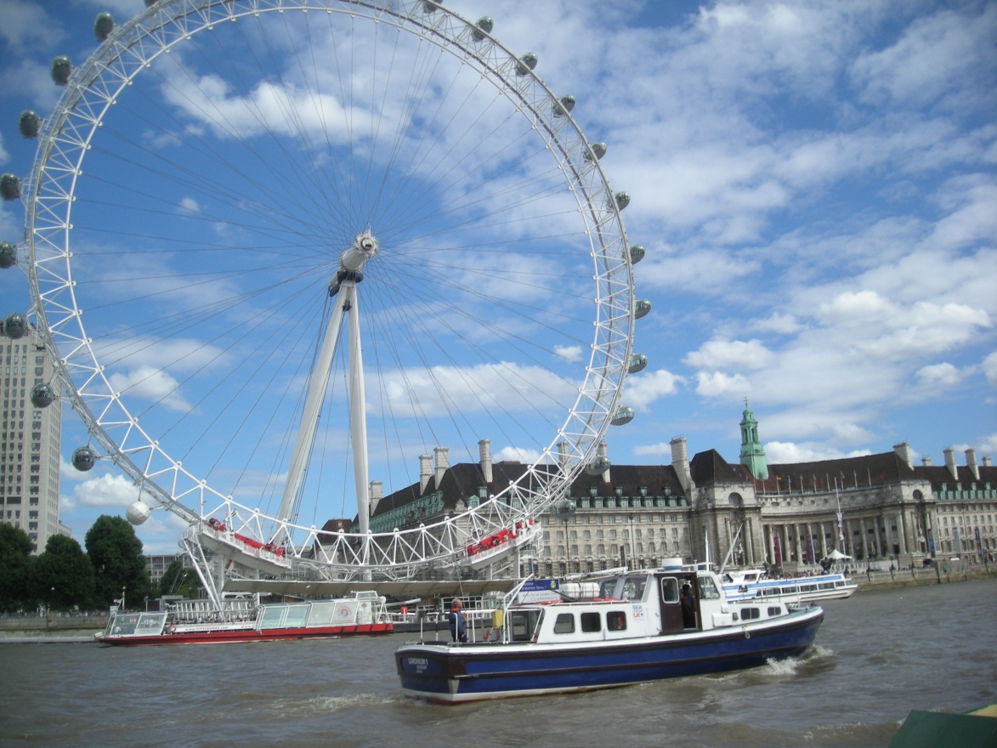
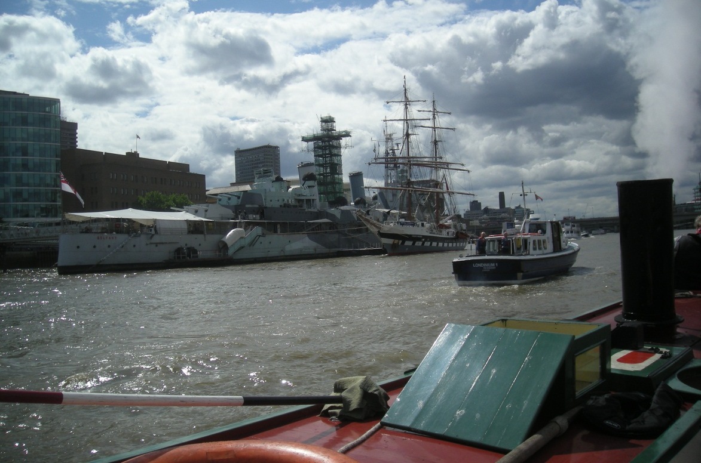
The MVS escort boat was organised by Eddie.
As well as being one of President’s regular crew Eddie is also an MVS officer.

Slide 8
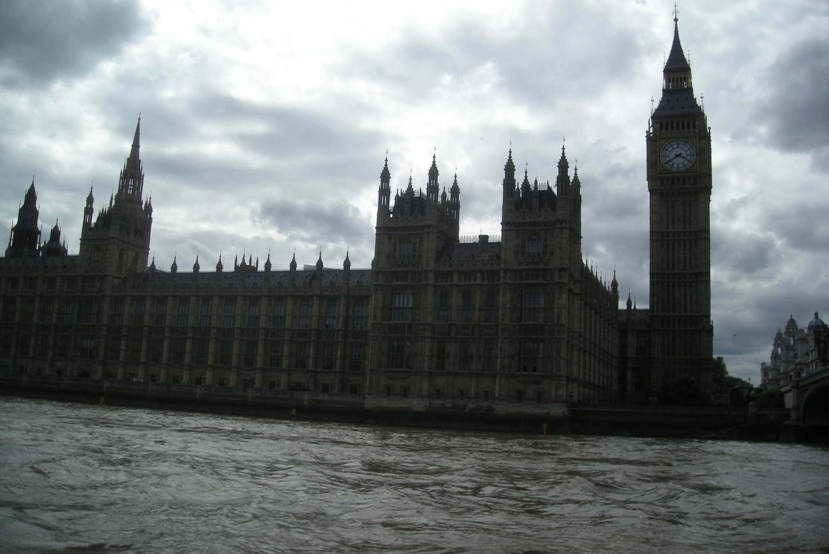
The Houses of Parliament next, best seen from the river, a view assisted by a wide exclusion zone.

Slide 9
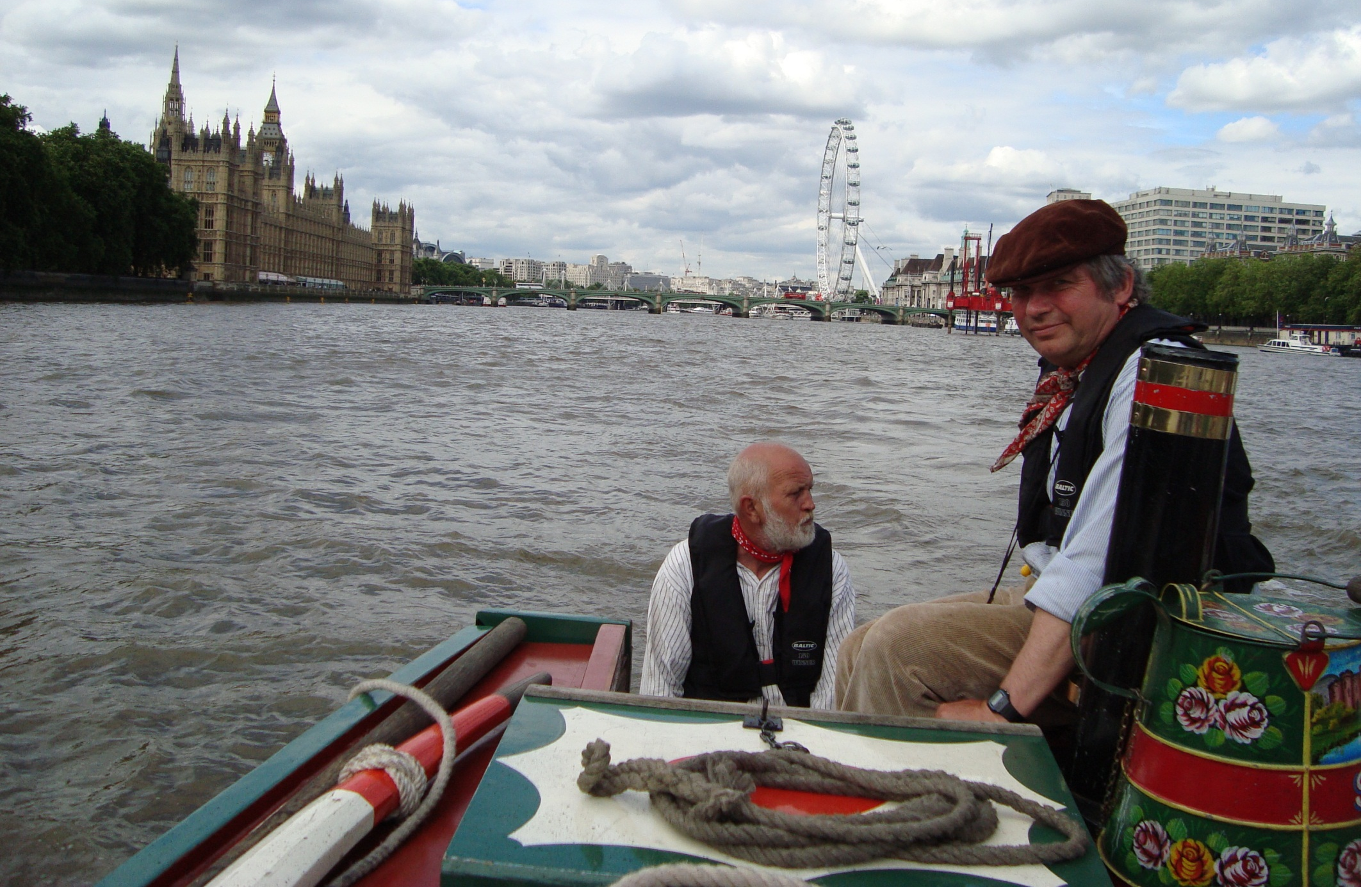
A stern view together with Alan. Alan is no stranger to London having been a trombonist with the mounted Lifeguards.

Slide 10
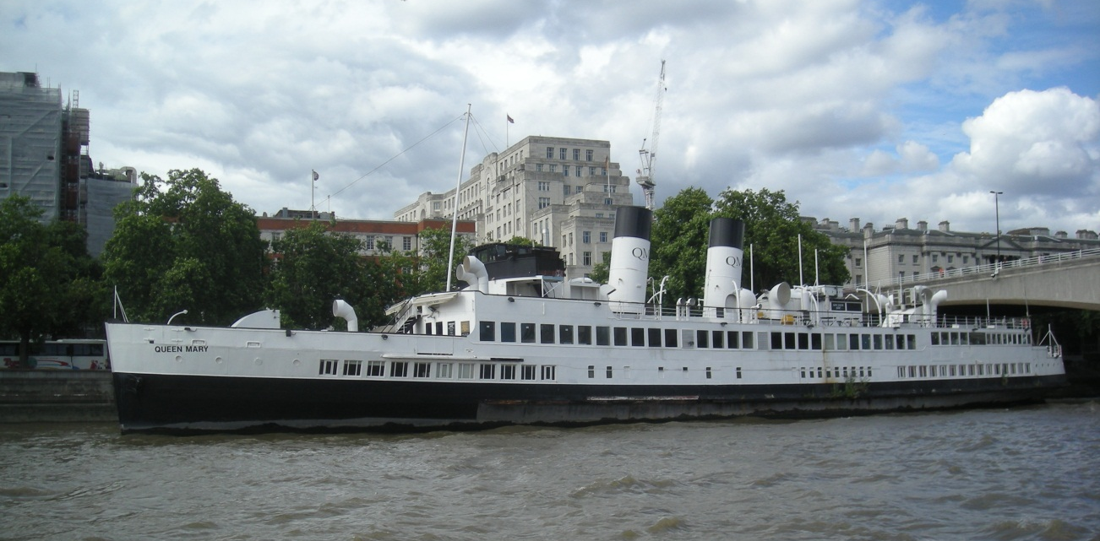
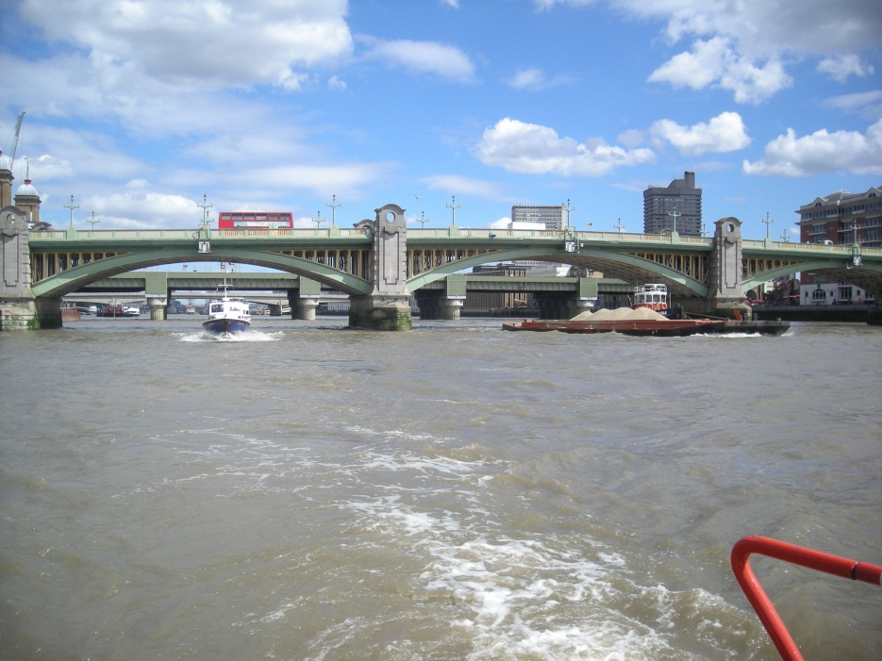
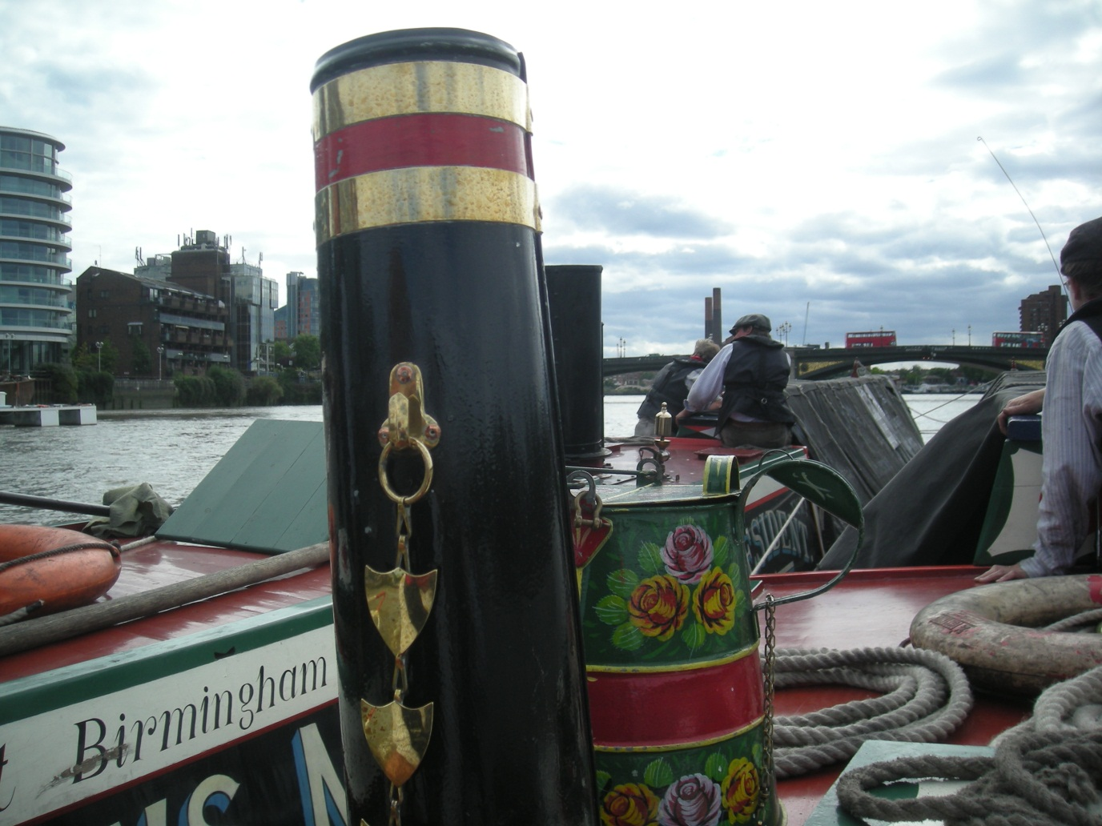
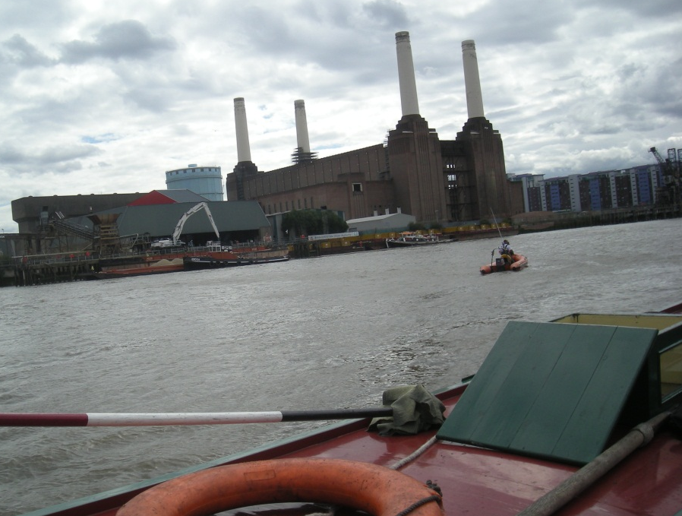
More river views as we speed upstream, assisted by the tide.

Slide 11
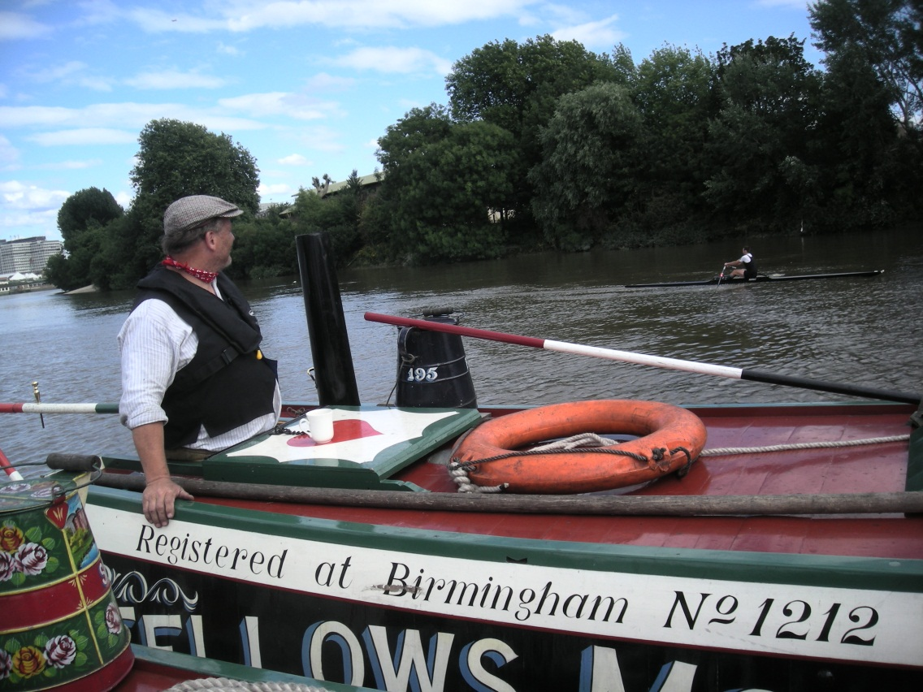
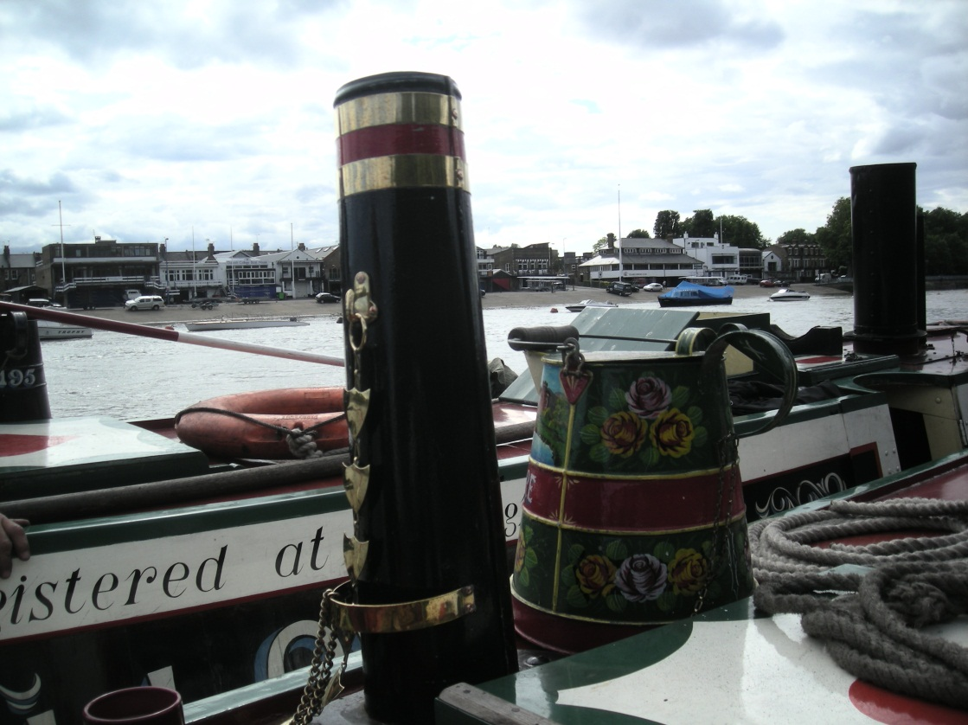
Quite a contrast here as rowers replace commercial traffic on these quieter reaches.
The boat race course now between Putney and Chiswick.

Slide 12
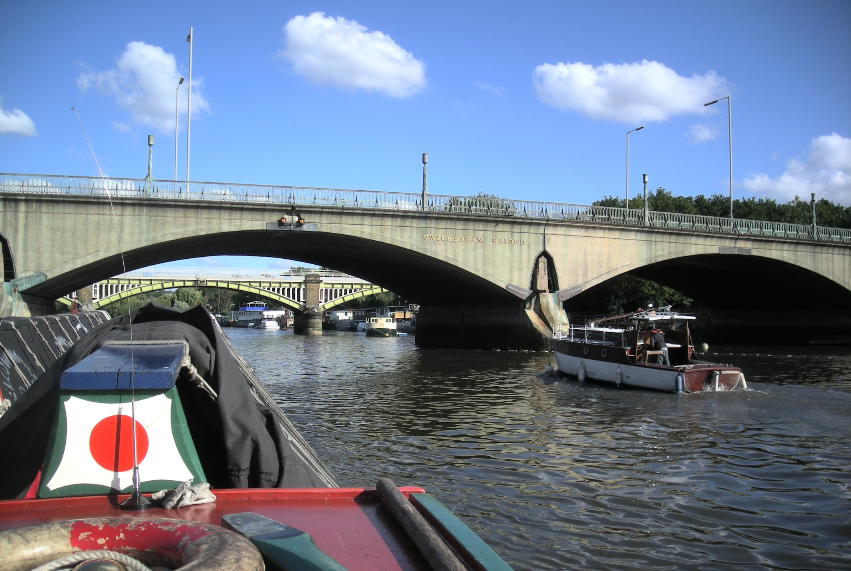
Twickenham Bridge as Quisisana passes by, one of the Dunkirk little ships and, like us, off to the Henley Traditional Boat Rally.

Slide 13
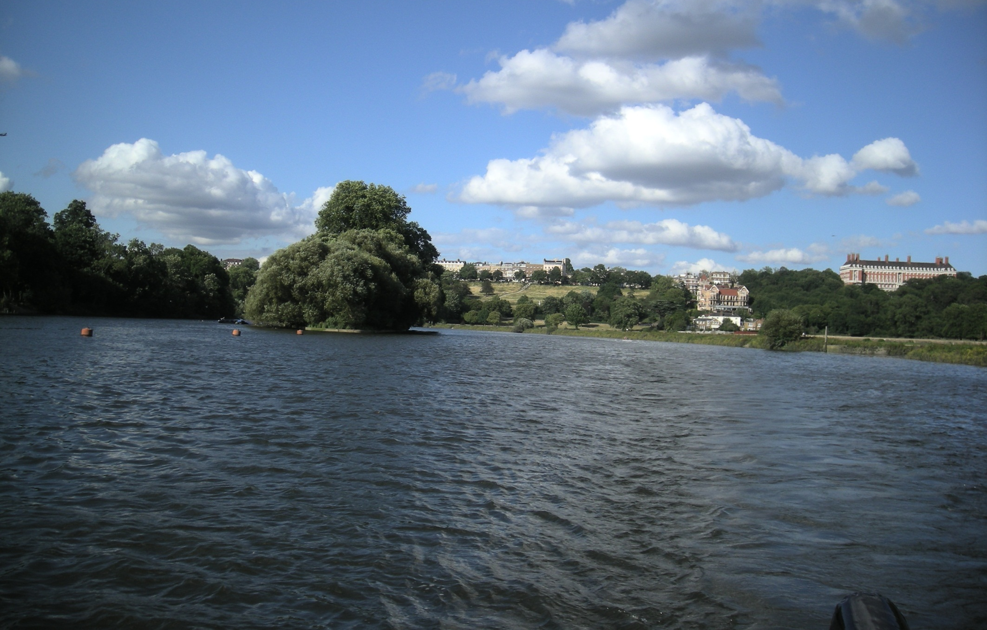
The Thames changes continuously and is a pleasure to cruise. This splendour is in Richmond, just before Eel Pie Island.

Slide 14
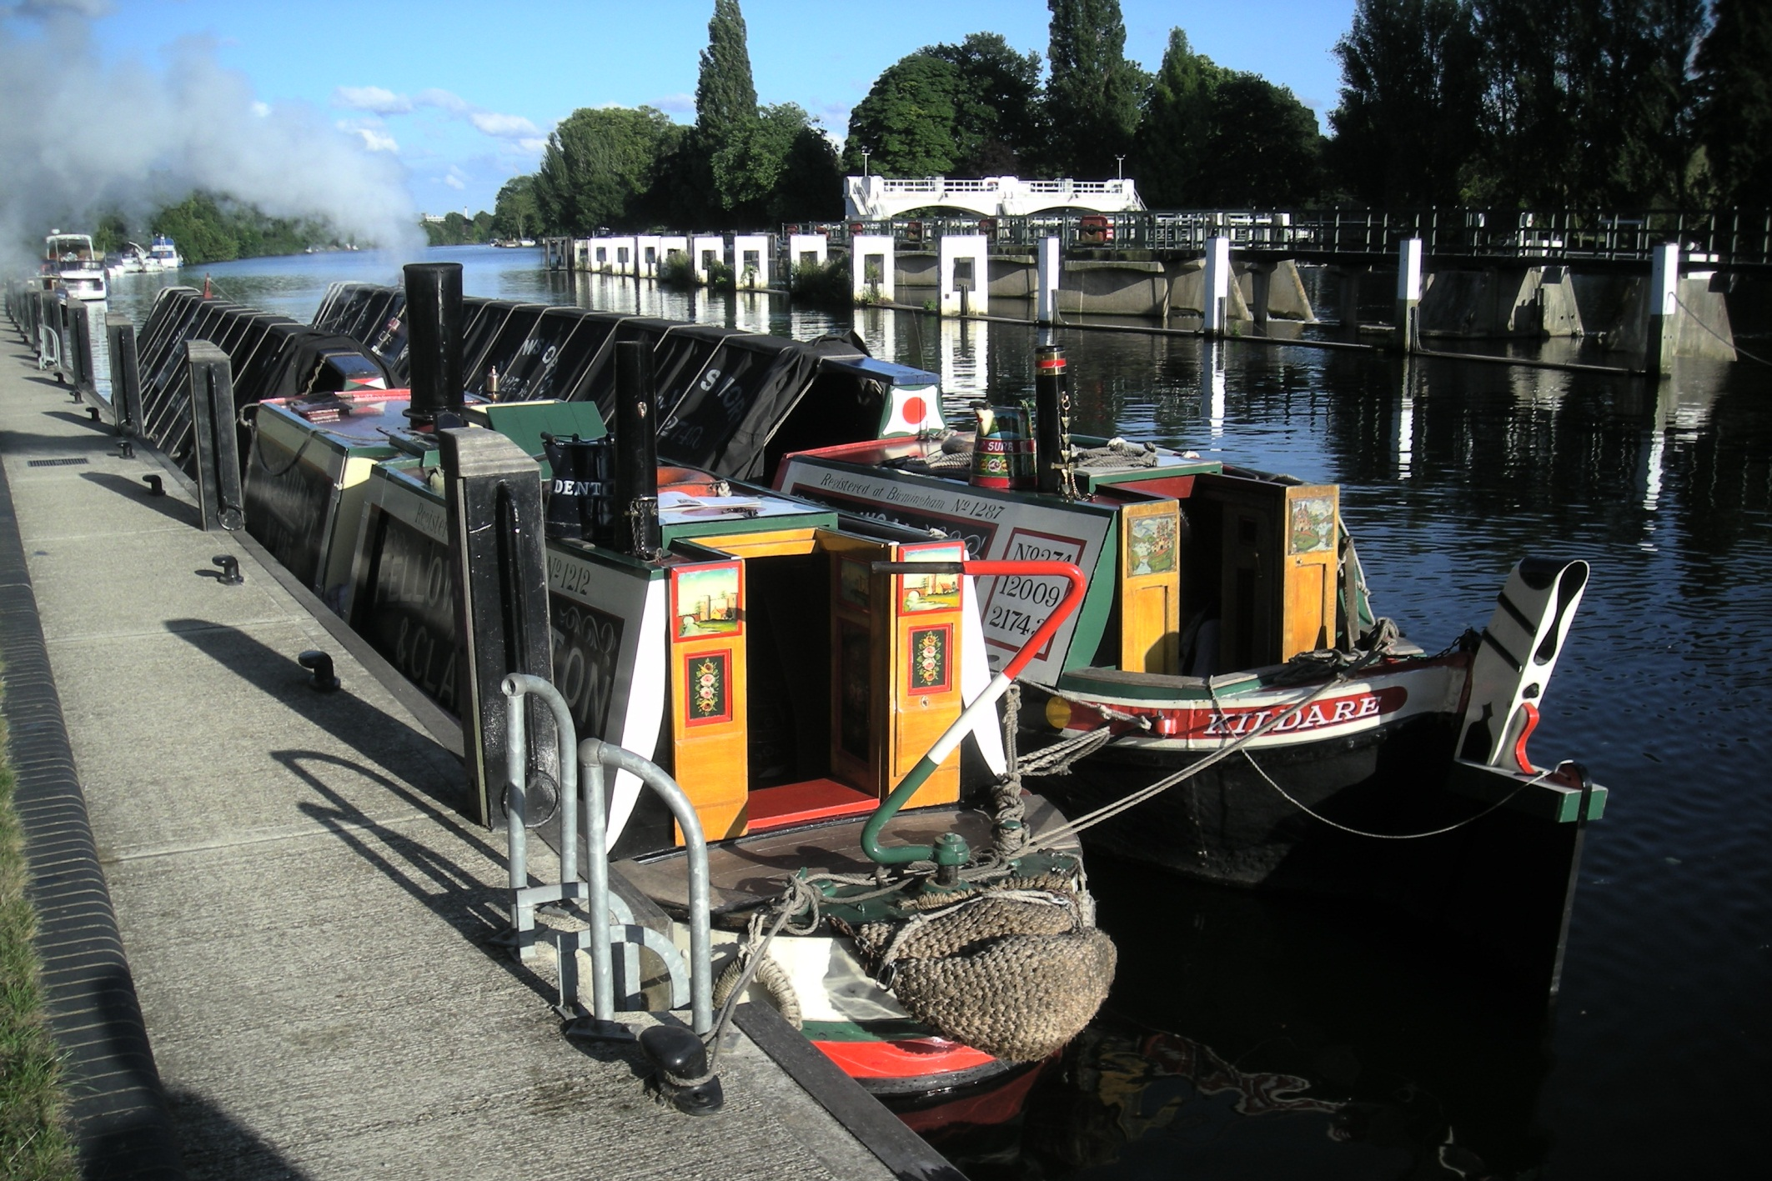
Our overnight mooring above Teddington Lock as we enter the completely different world of the non-tidal Thames.

Slide 15
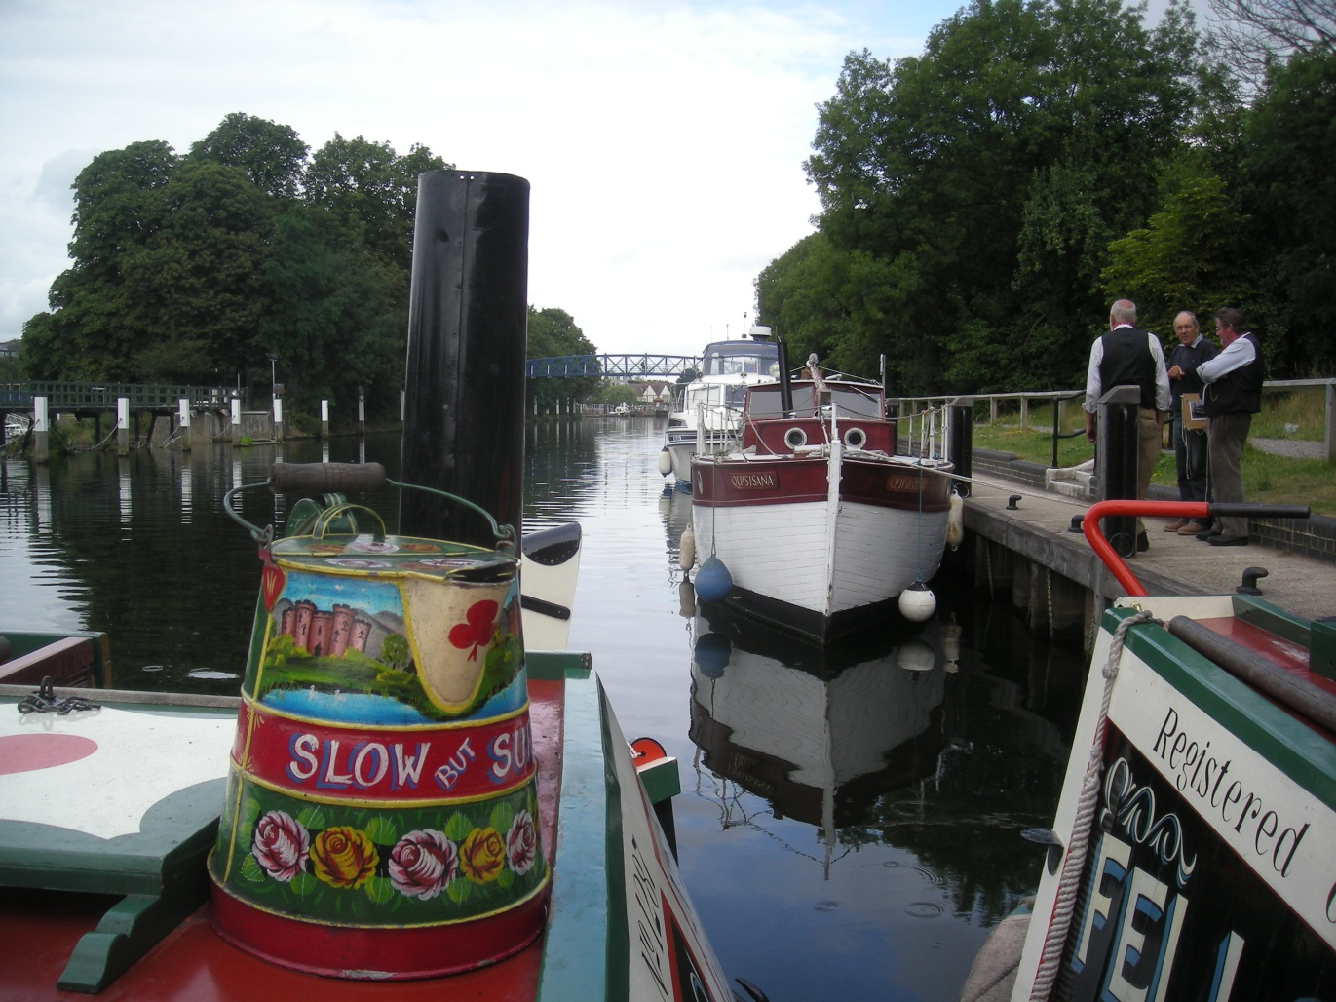
Quisisana was moored here too, the only Dunkirk little ship actually photographed in action. A plaque on Teddington Lock records the feat of the local boatyard in assembling 100 local river craft for Dunkirk. An astonishing 338,000 retreating troops were rescued from the beaches.

Slide 16
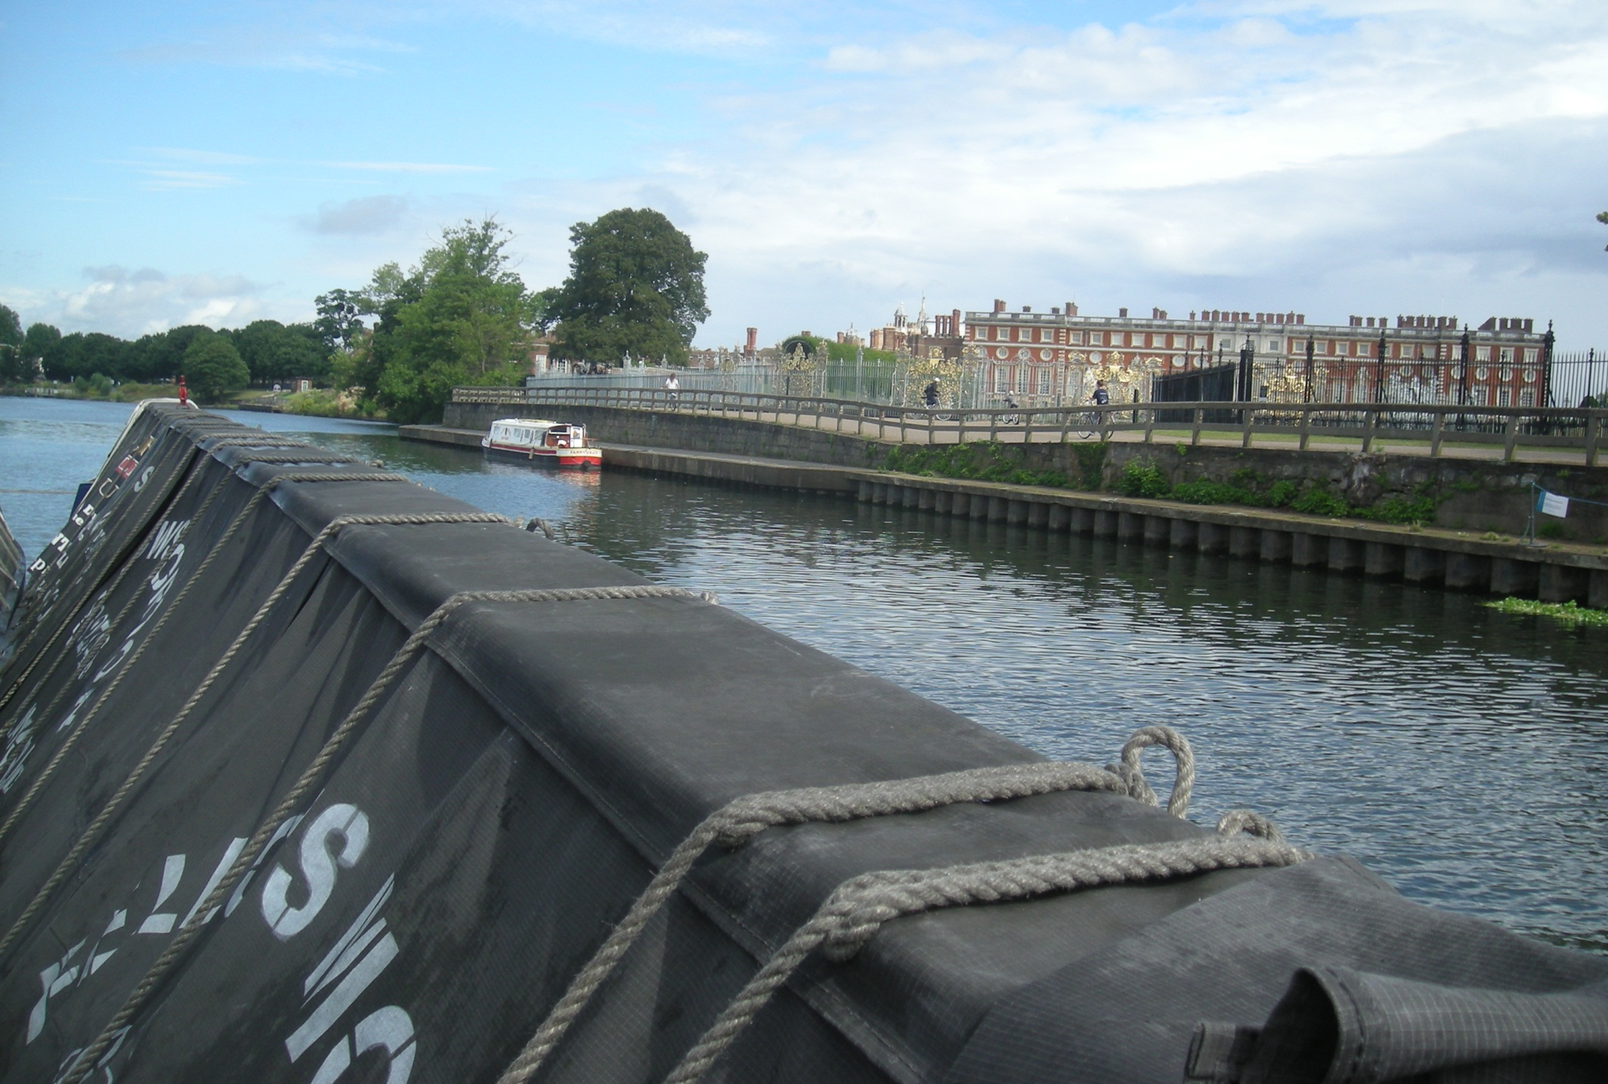
Early the following morning sees us passing the Thames landmark of Hampton Court Palace.

Slide 17
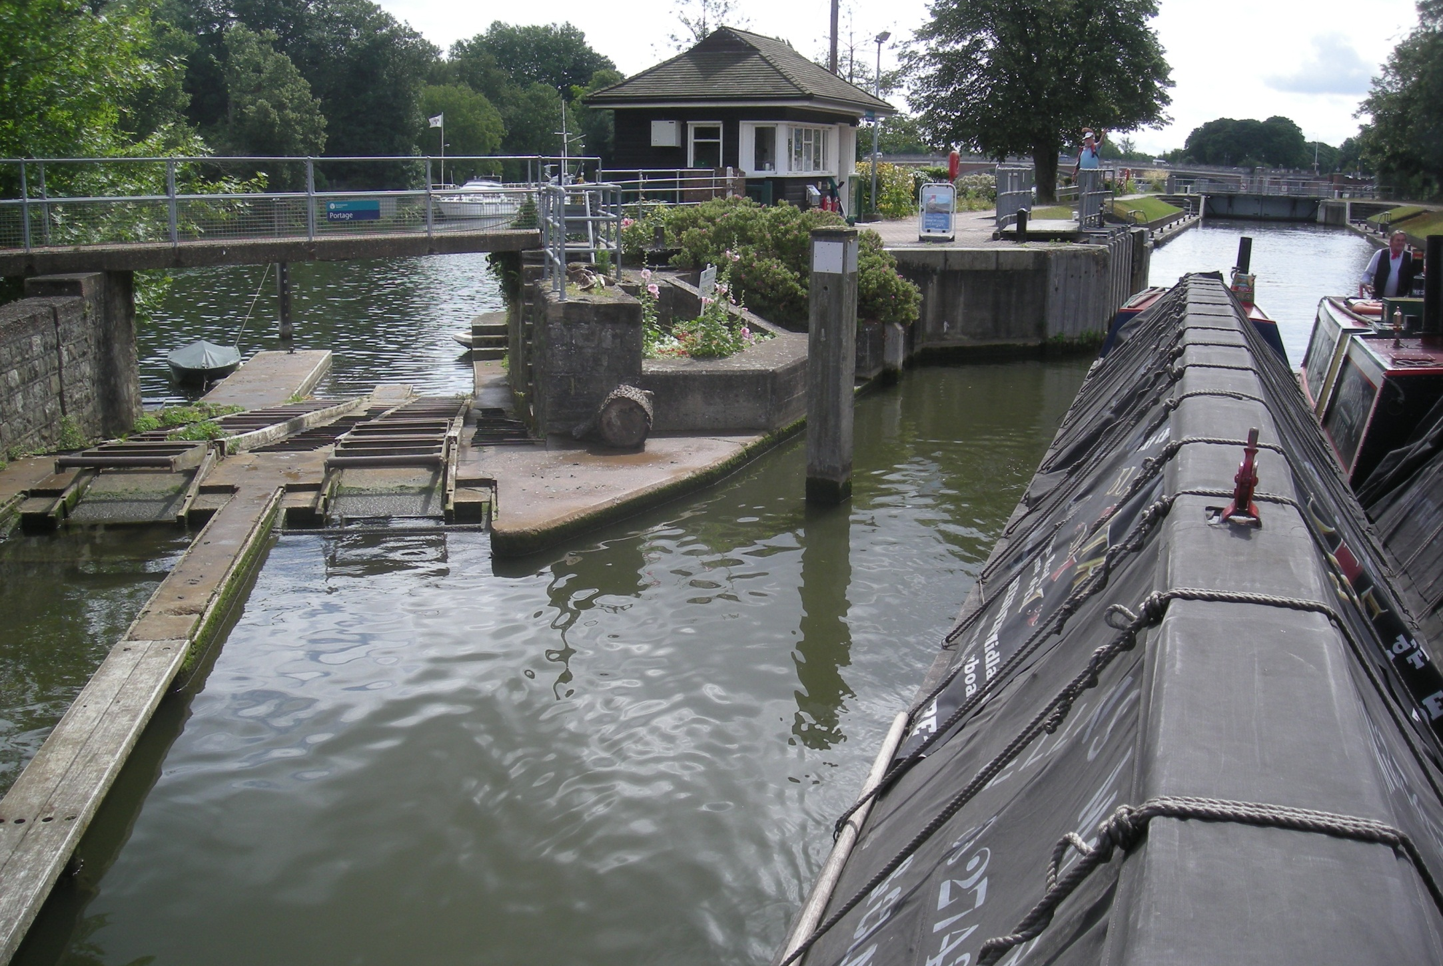
Nearby is Molsey Lock. Small craft and canoes can use the boat rollers, still a handy feature of some Thames locks.

Slide 18
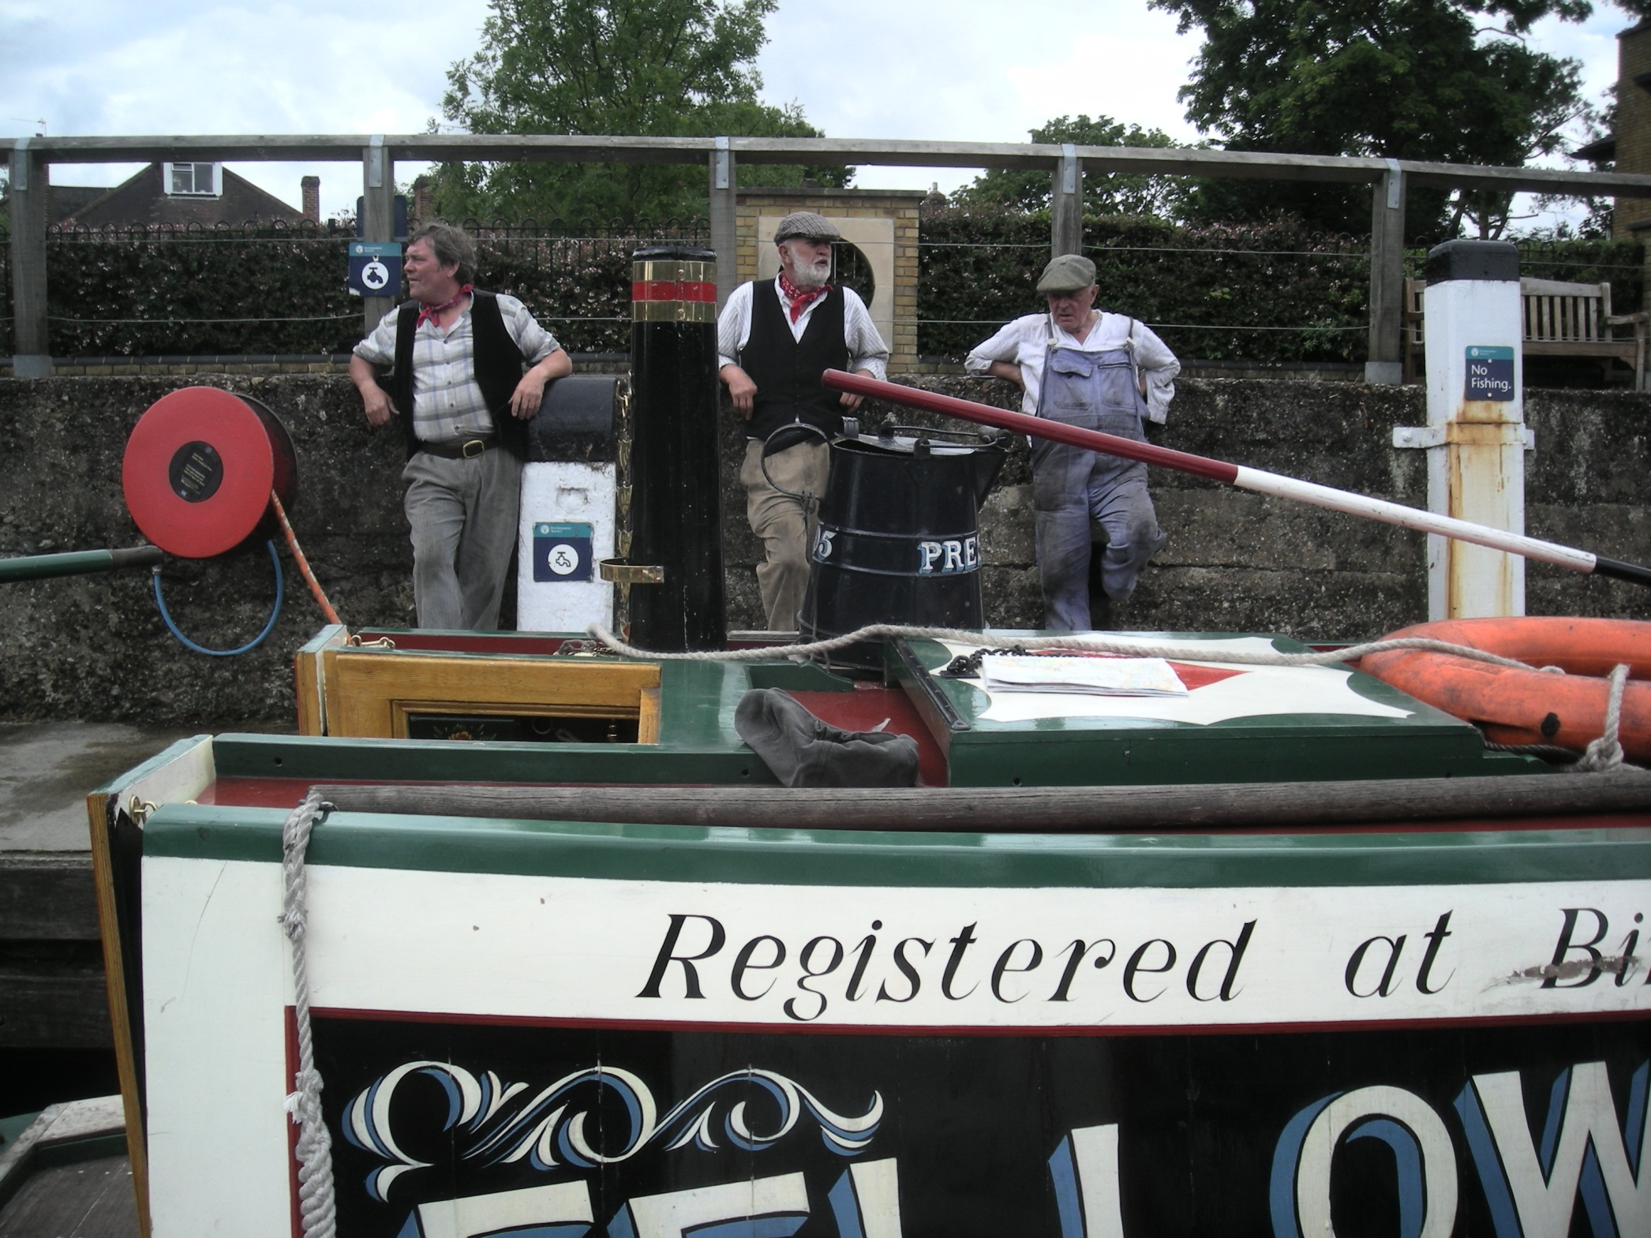
Three of President’s crew at Molsey Lock.

Slide 19
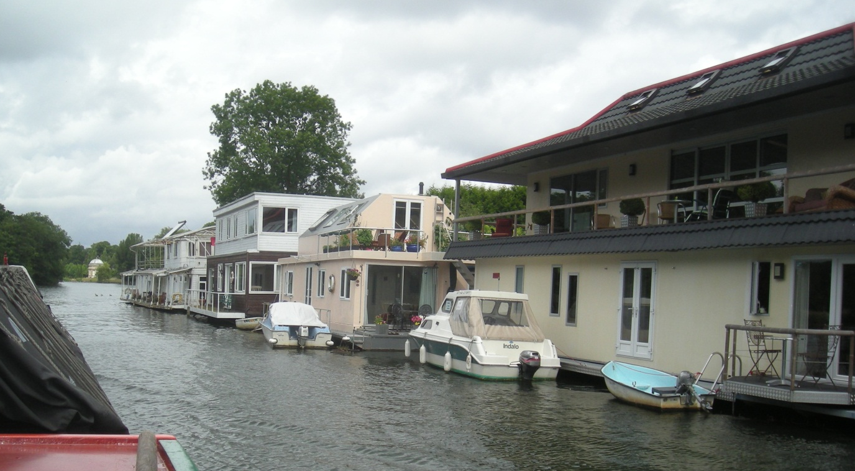
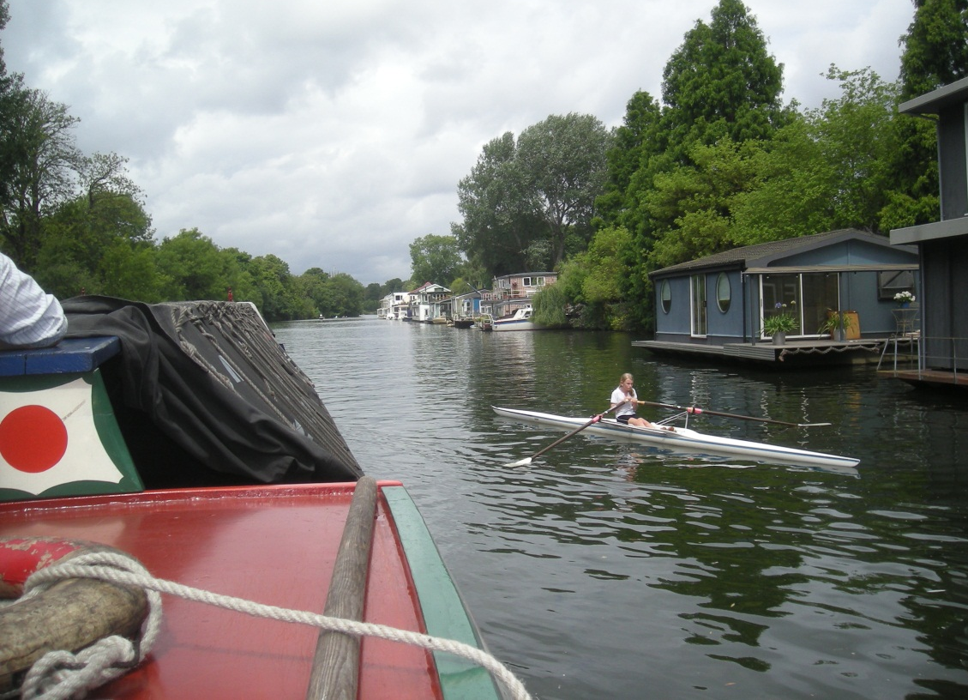
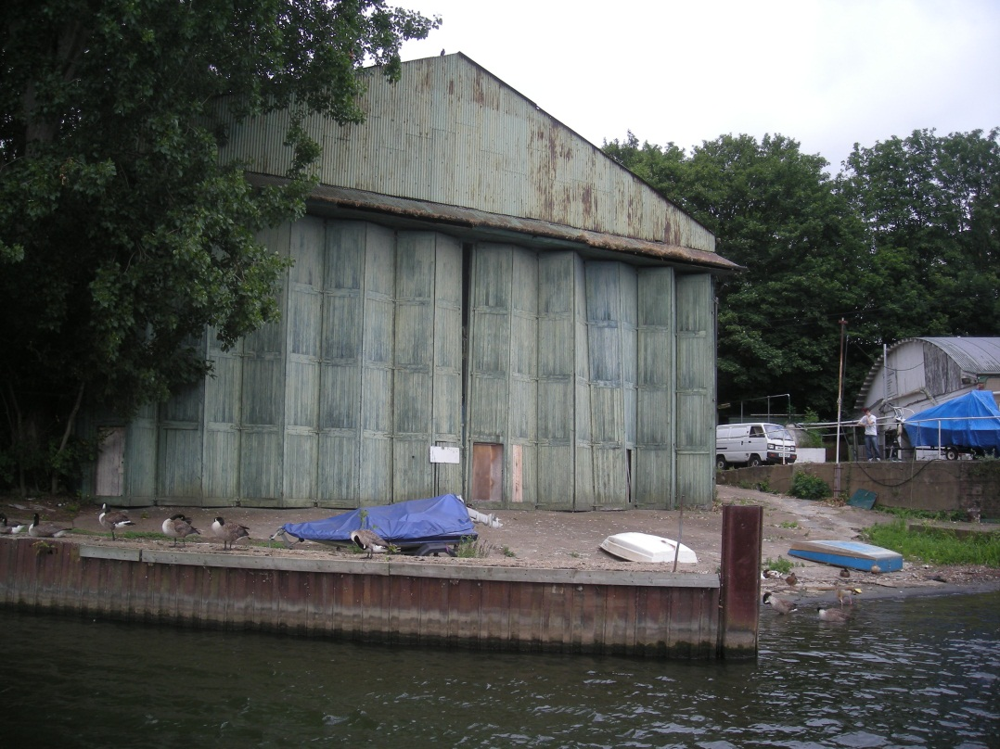
Designer houseboats, a nervous rower and the remains of the once extensive Thornycroft works leaving Molsey Lock.

Slide 20
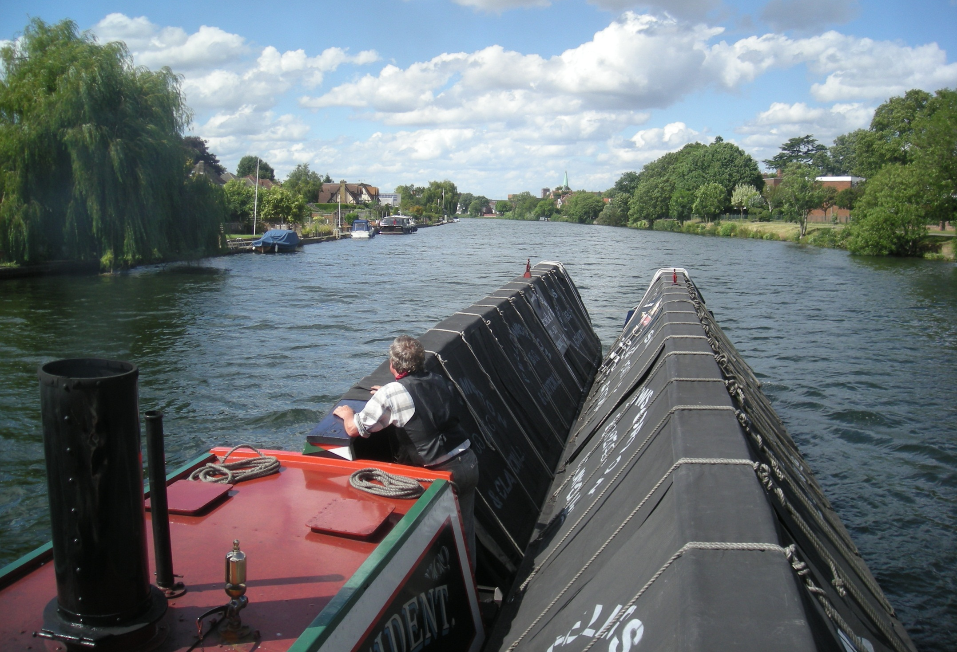
Staines Church is the landmark ahead here.

Slide 21
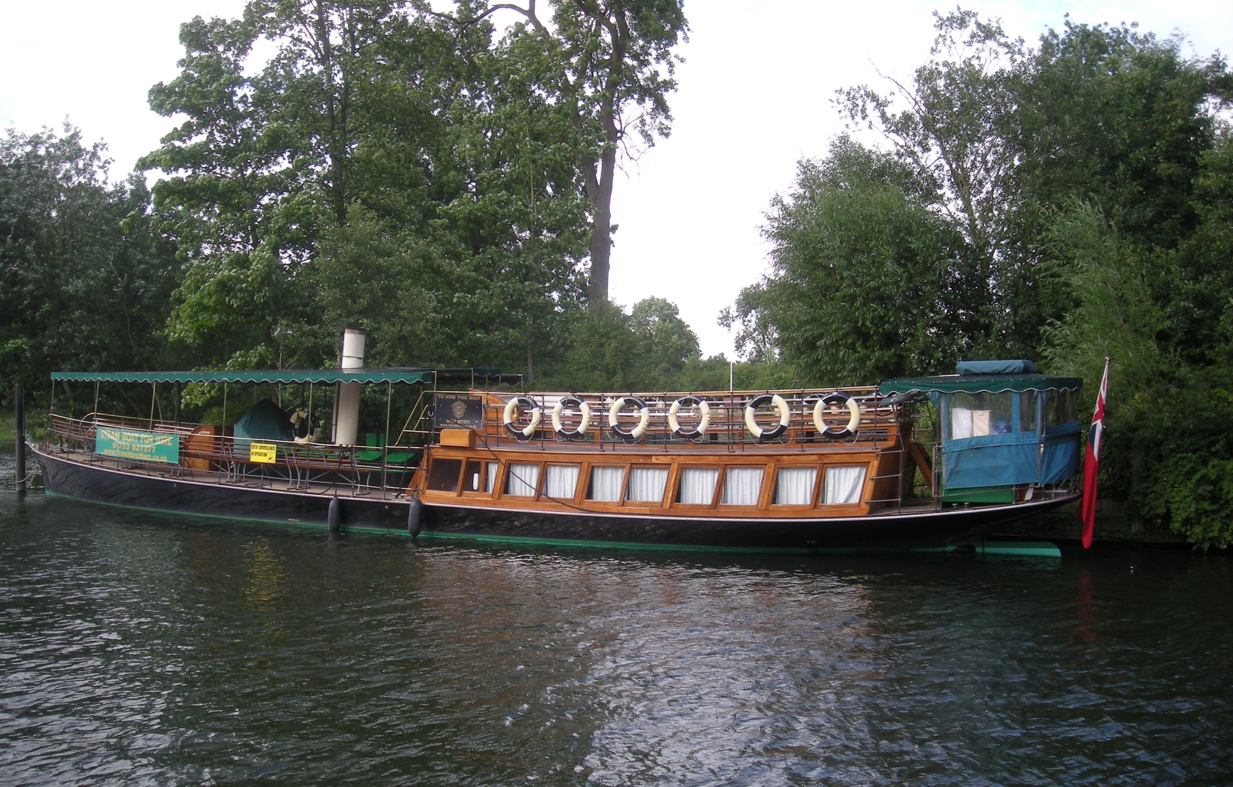
And moored at Runneymede is Nuneham, a restored
1898 steamer, once part of the Salter’s fleet.

Slide 22
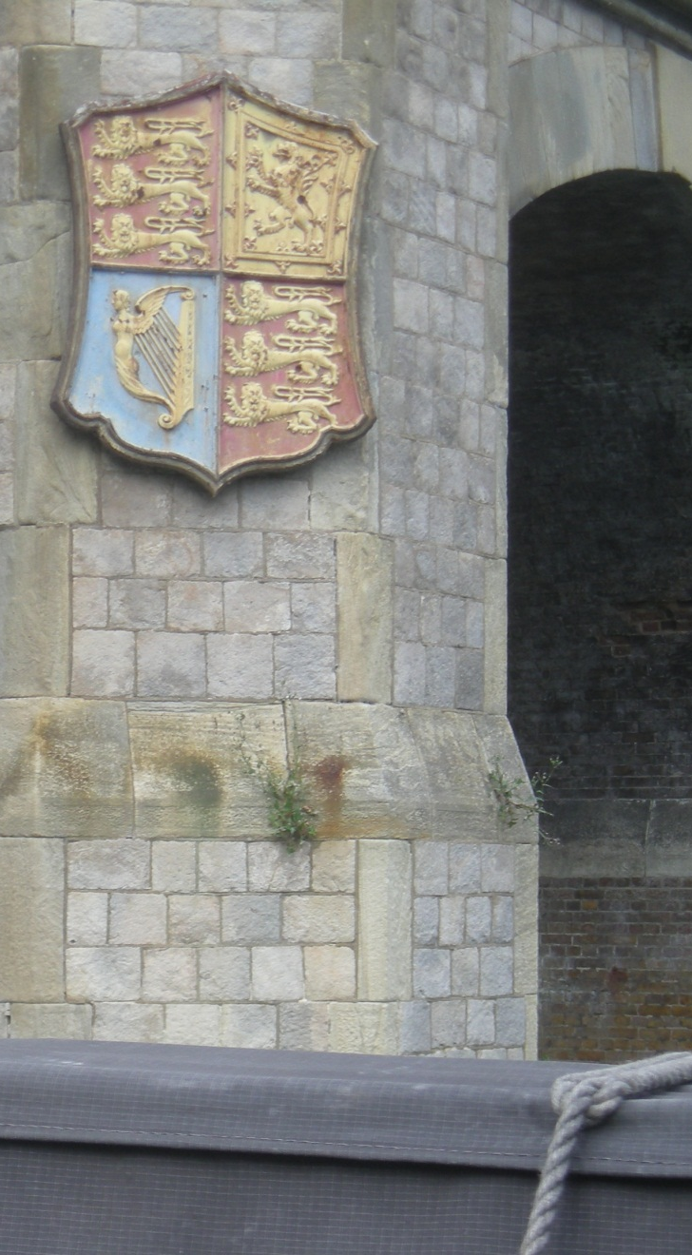
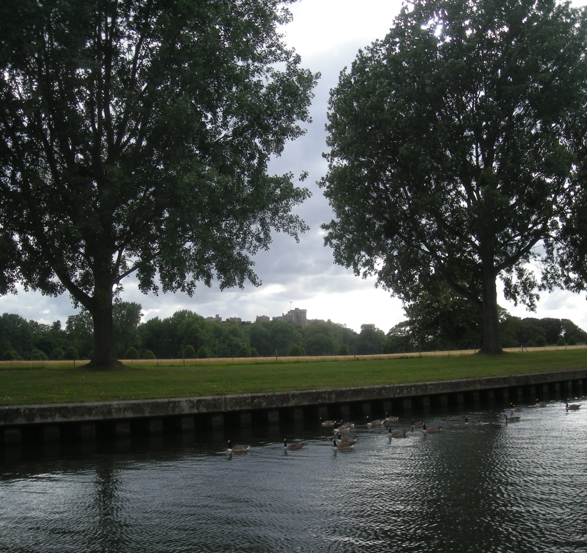
Royal crests mark the approach to Windsor Castle and the Crown Estate. Beautifully kept grounds but very strictly “No Mooring”!

Slide 23
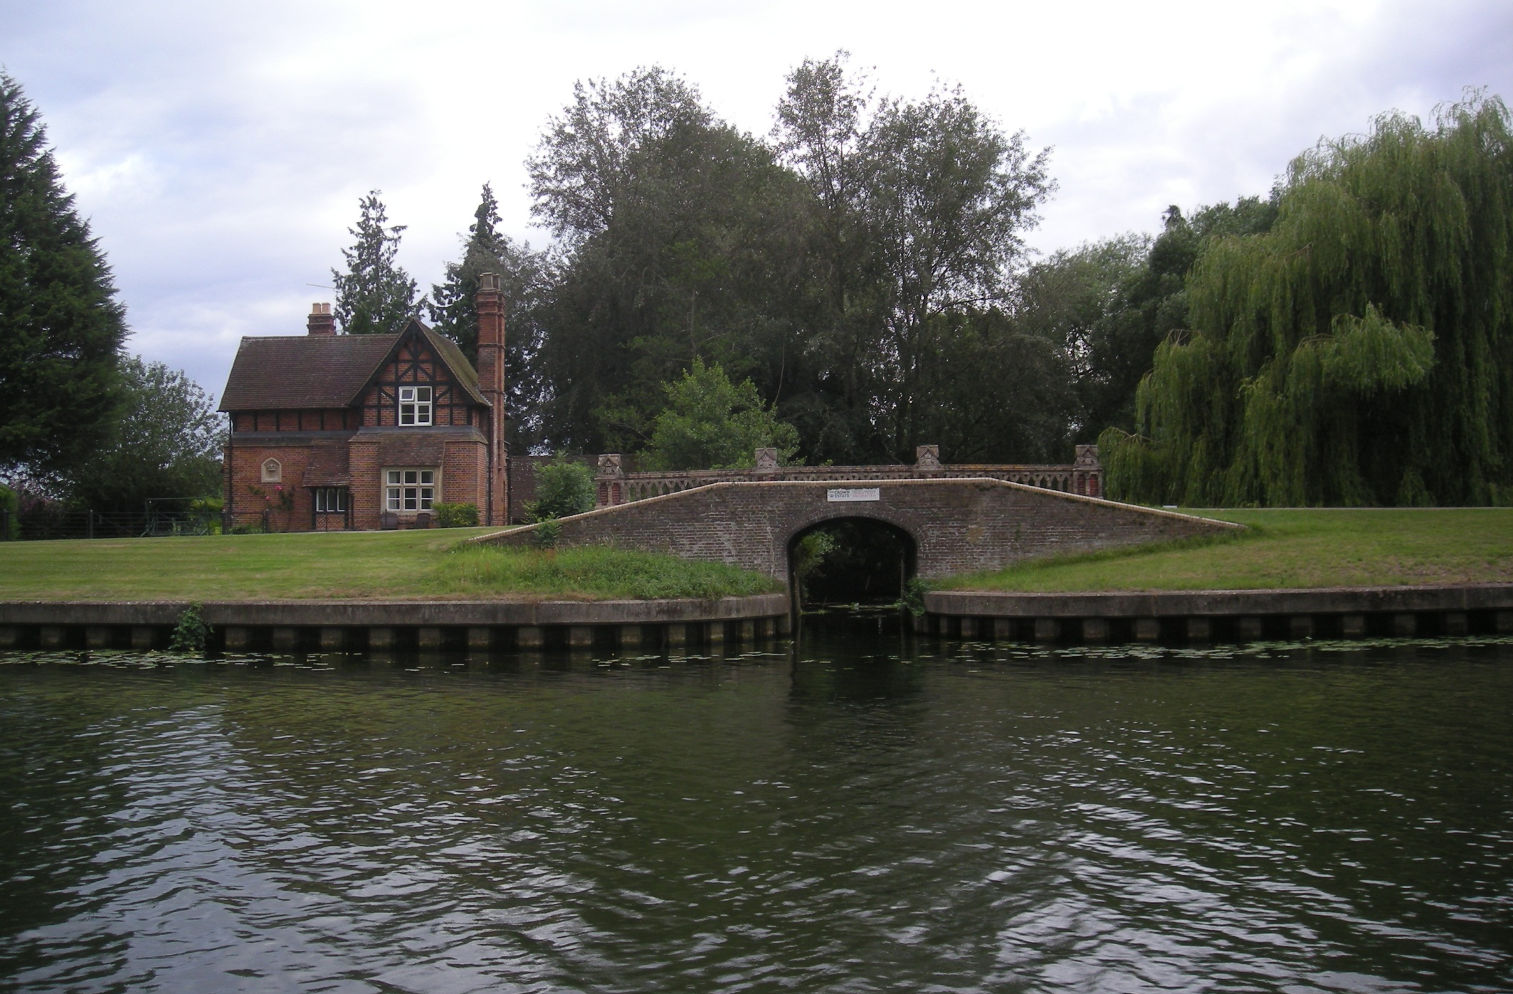
My amazing 1948 map of the Thames Navigation labels this Windsor arm “HM Boatyard”.

Slide 24
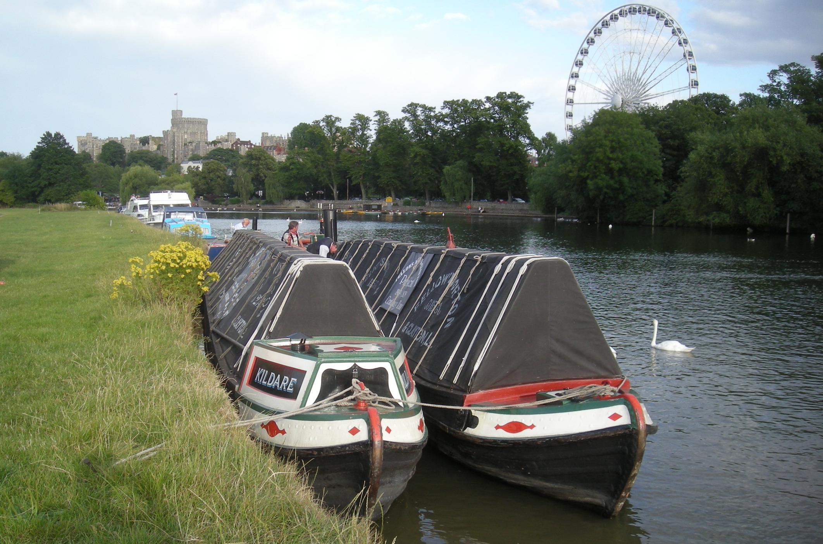
A fine mooring for President and Kildare on Eton Meadow, backed by Windsor Castle. Windsor, too, now has an observation wheel.

Slide 25
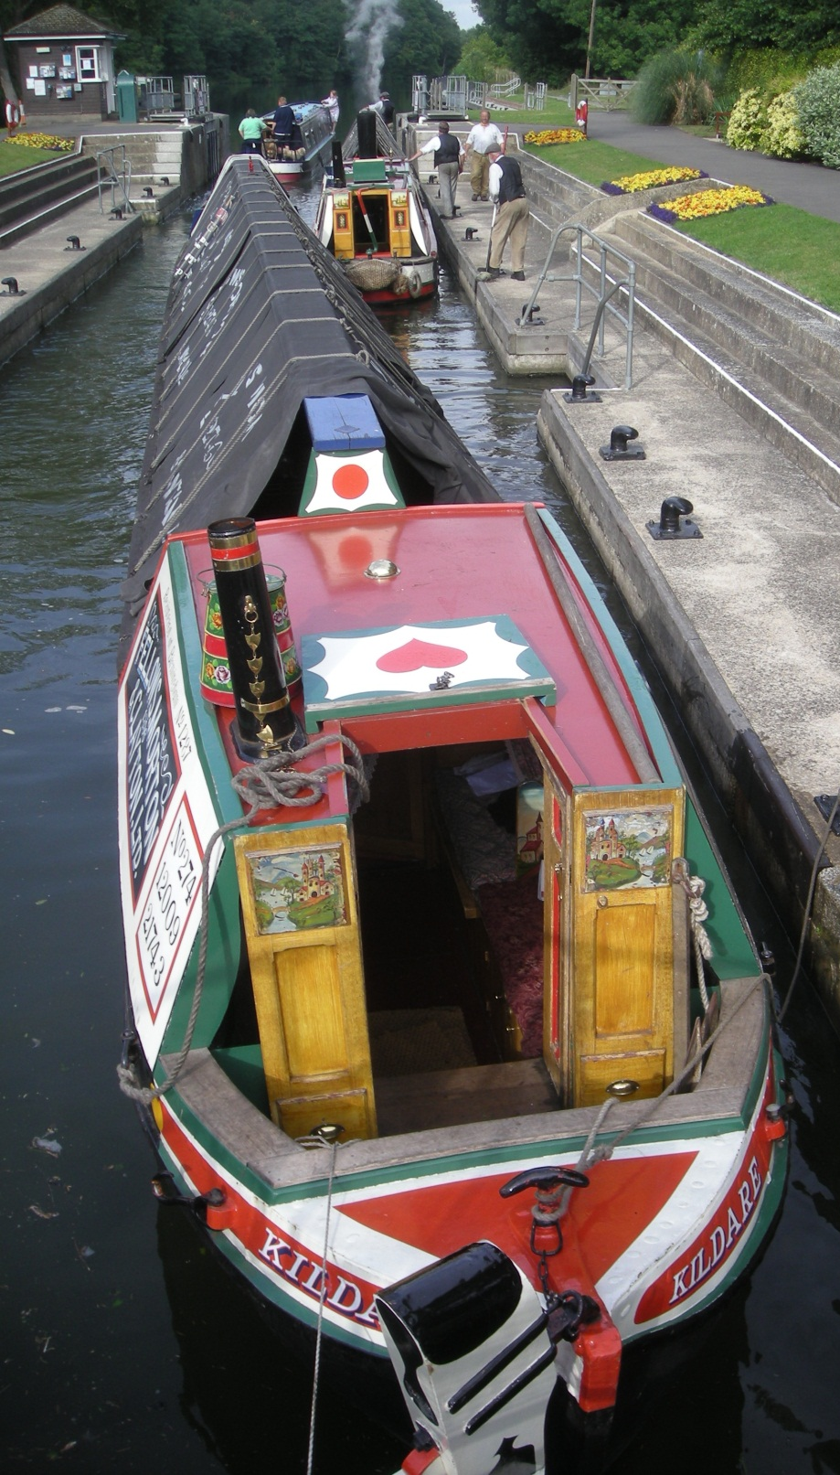
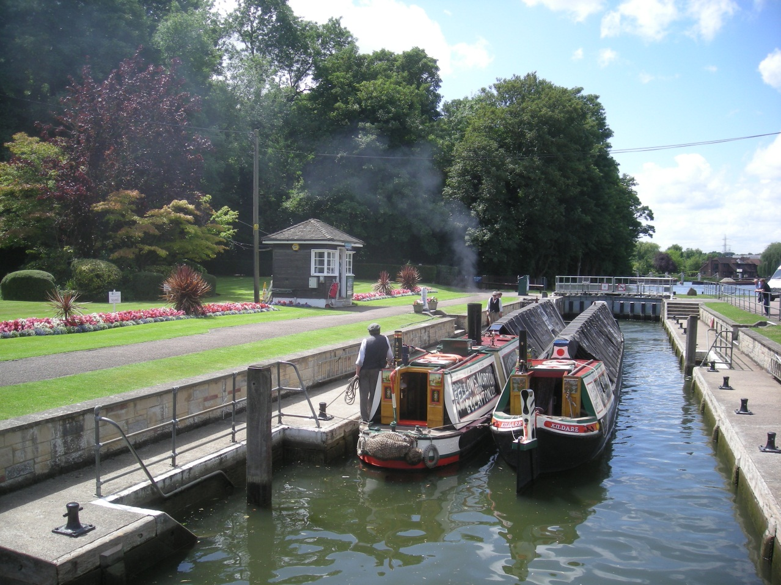
Onwards again along the Thames and its immaculately kept locks.
President is 100 years old this year and on a special centenary tour!

Slide 26
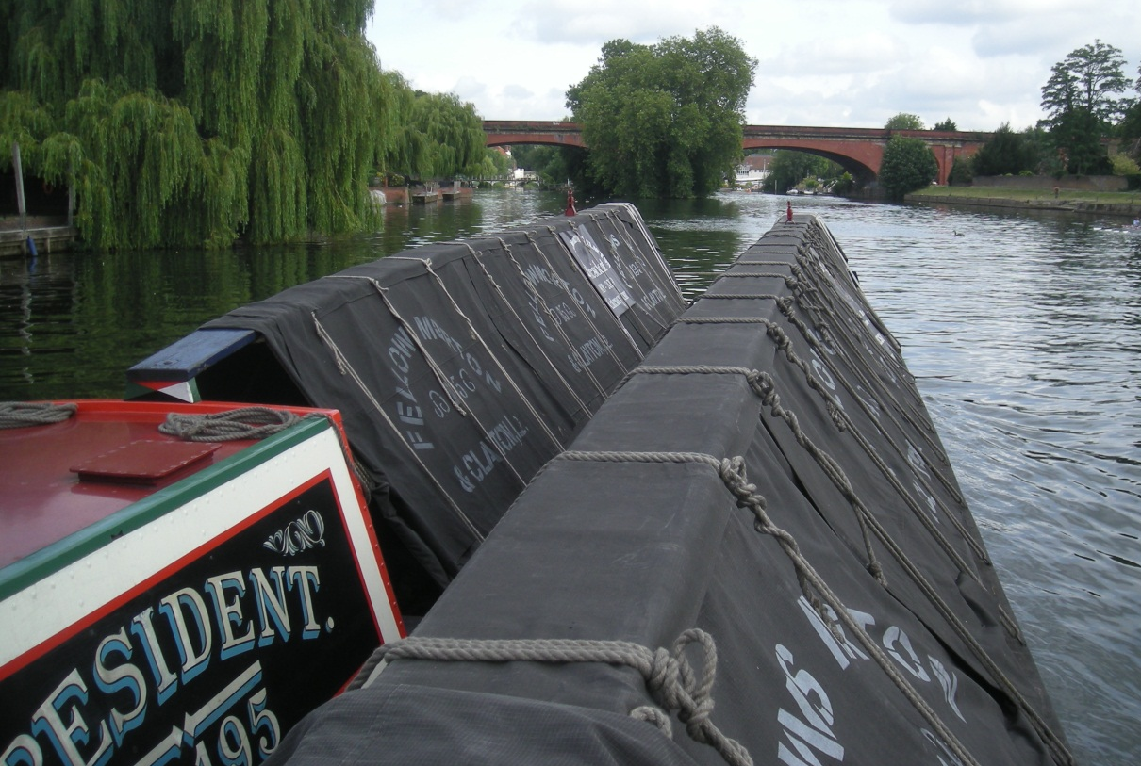
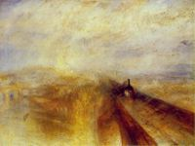
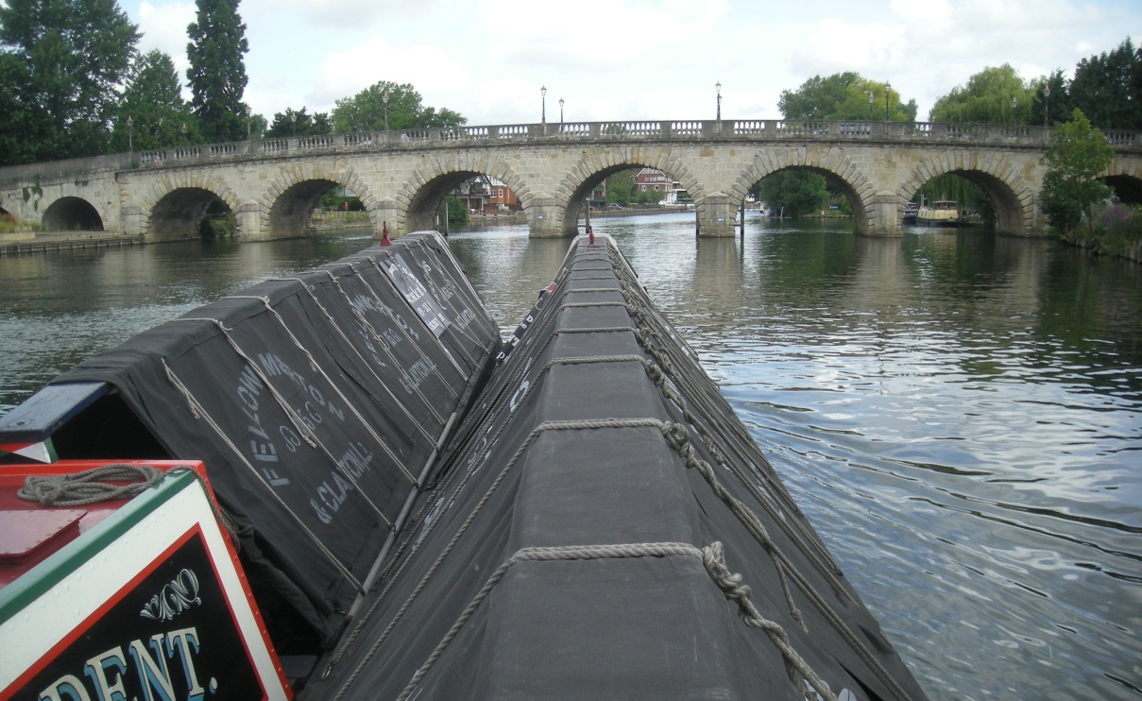
Two Maidenhead bridges now, the first is Brunel’s famous flat arch, the scene of Turner’s 1844 classic, “Rain, Steam and Speed”.
The second is older, narrower and trickier!

Slide 27
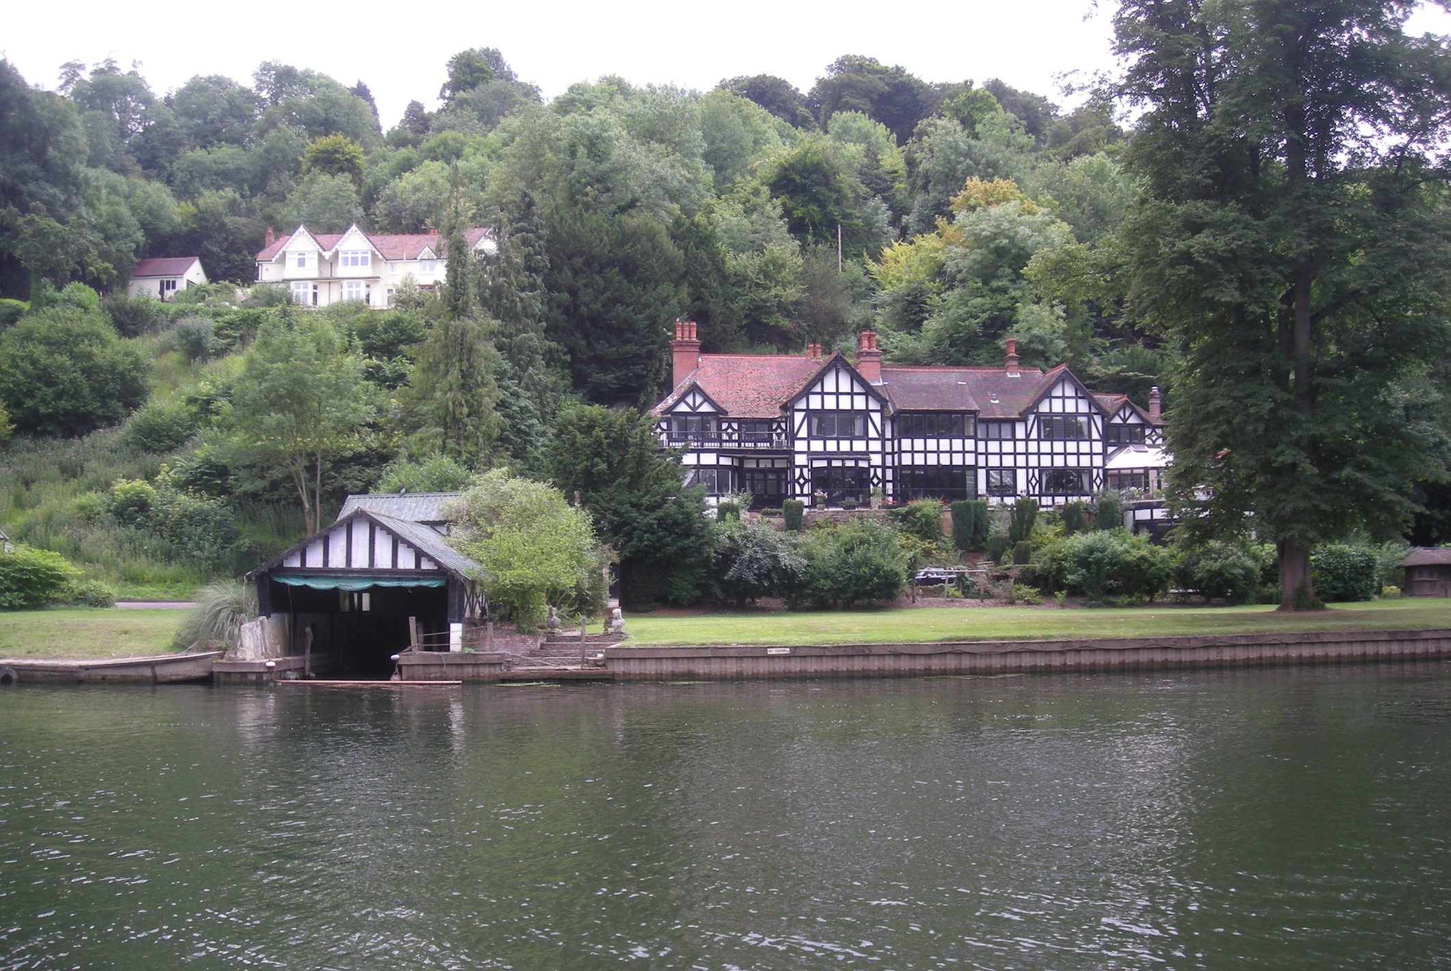
And how about this for a home, a spacious Thames side residence near Cookham Dean, complete with boathouse.

Slide 28
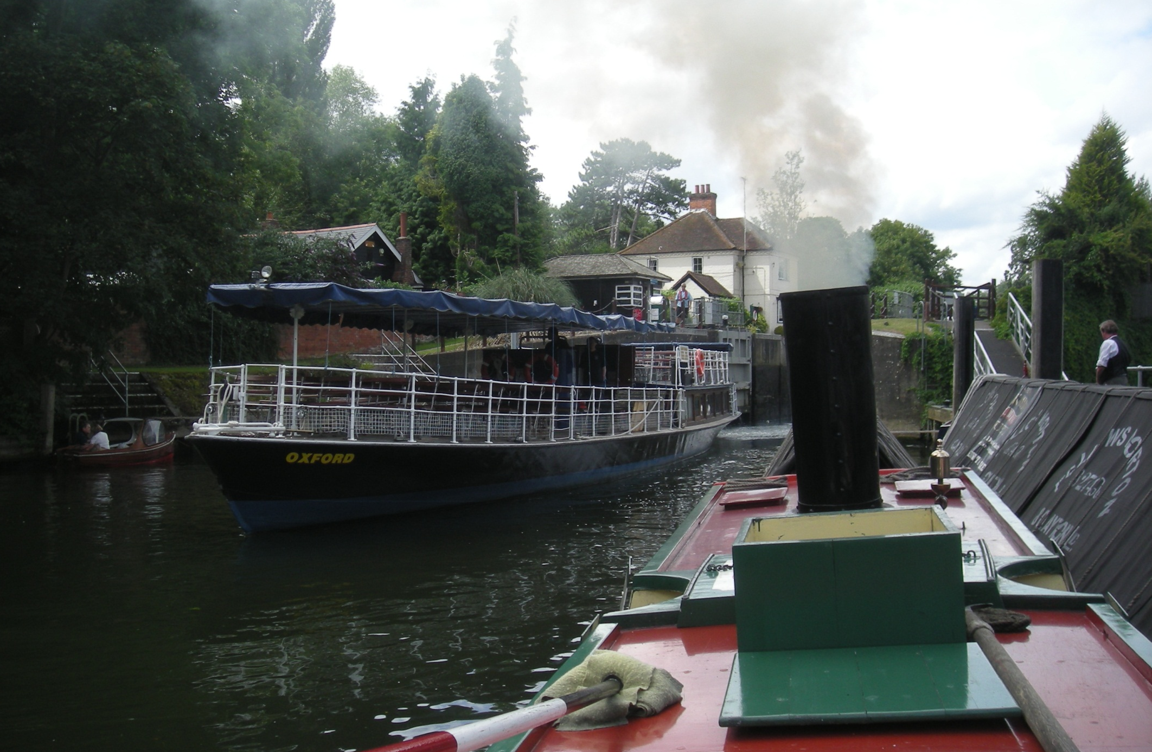
And this is what Salter’s Steamers look like today as Oxford, built in Oxford in 1922, emerges from Marlow Lock on a scheduled run.

Slide 29
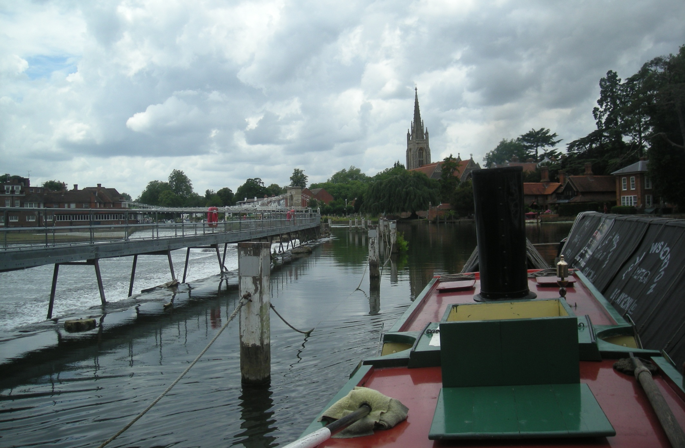
And more action as we emerge from Marlow Lock.
Care is obviously required here.

Slide 30
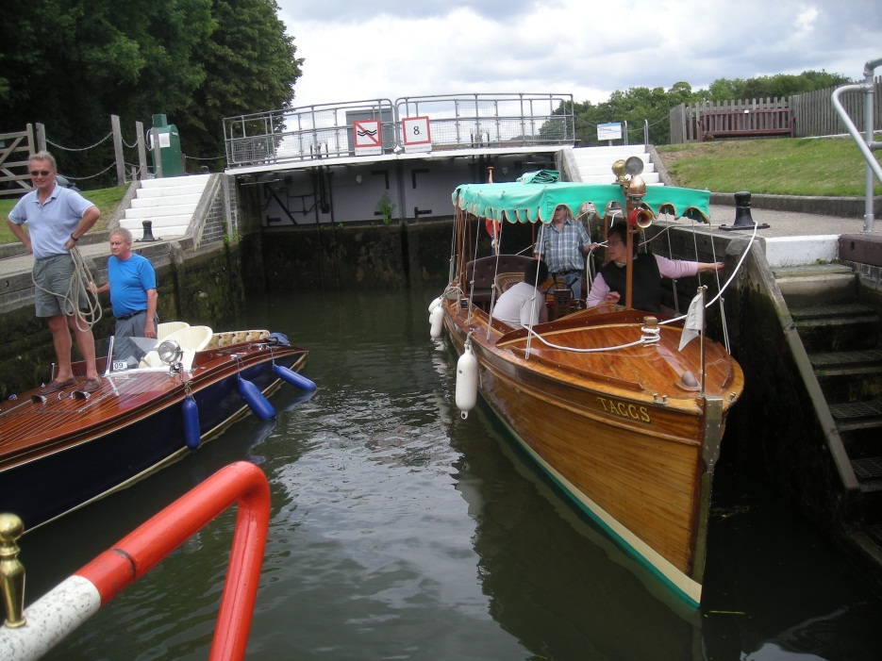
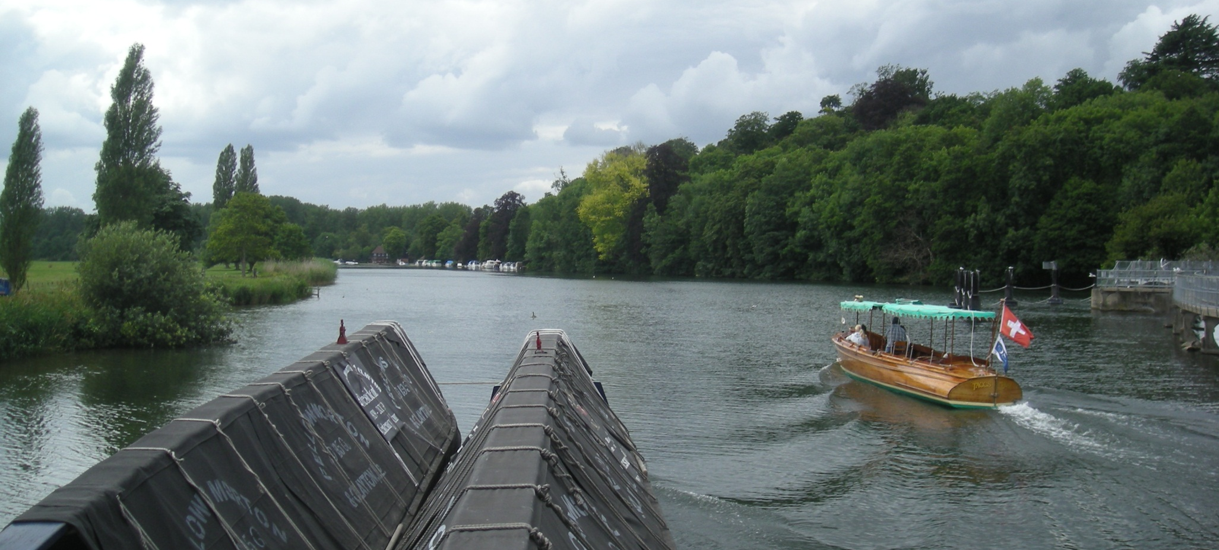
There were more rally bound boats in Temple Lock.
Taggs is Swiss built and designed for speed on Swiss lakes and here demonstrates its lines by zooming away from Hurley Lock.

Slide 31
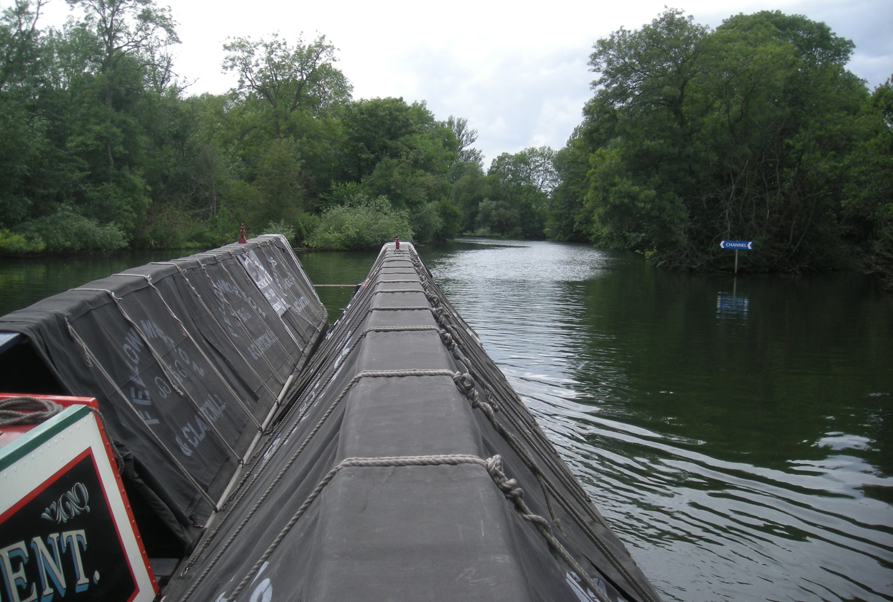
It is narrower and twistier around here, particularly by the islands.

Slide 32
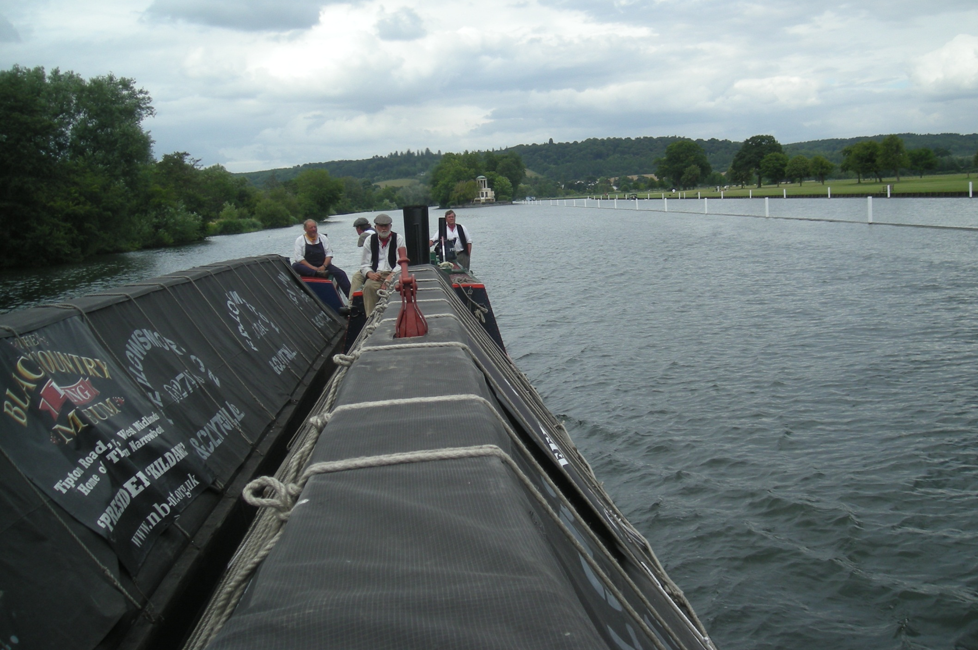
Until one reaches Henley that is and the famous regatta course, dead straight river from Temple Island.

Slide 33
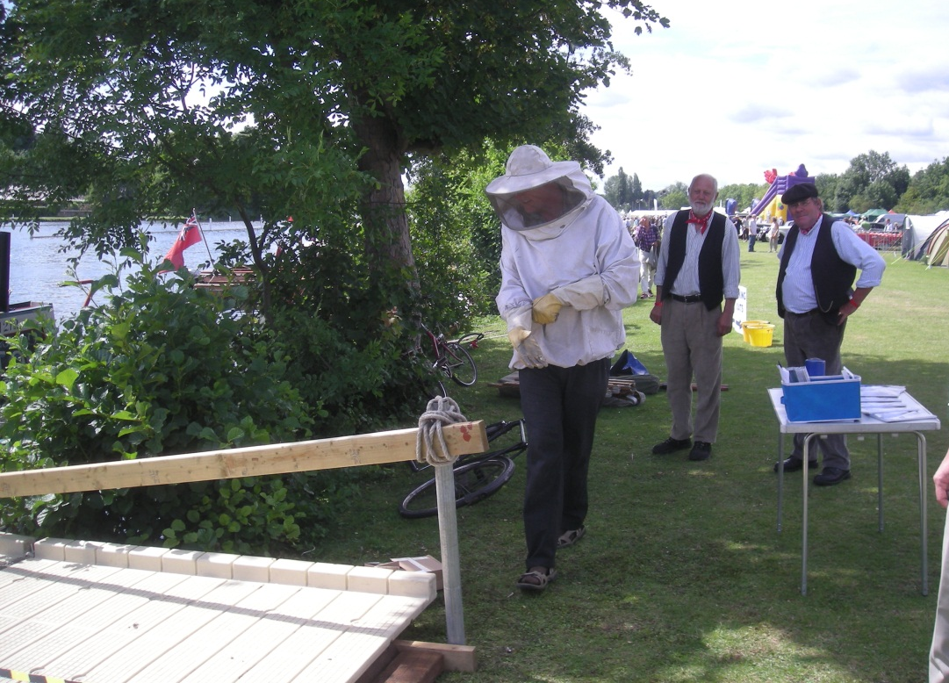
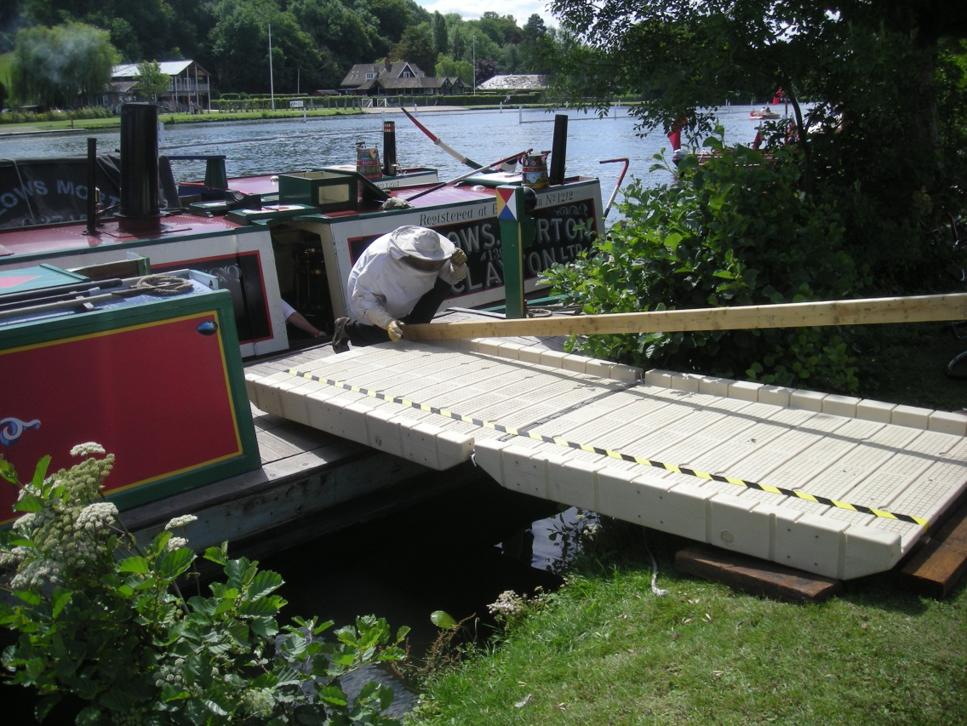
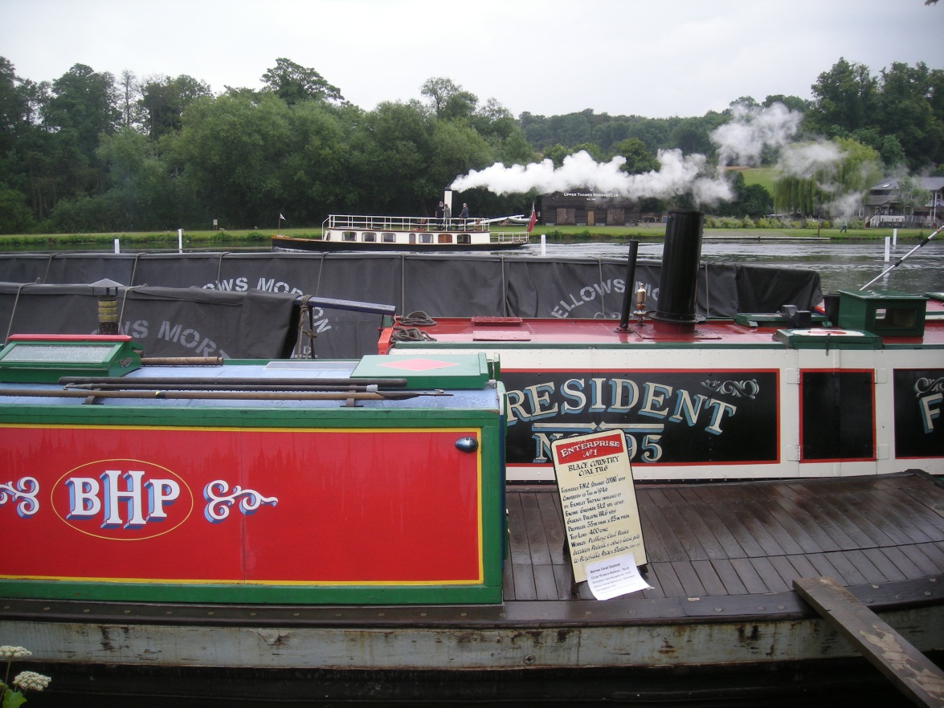
And three scenes from the Thames Traditional Boat Rally as the wasp man removes a nest from beside our mooring.

Slide 34
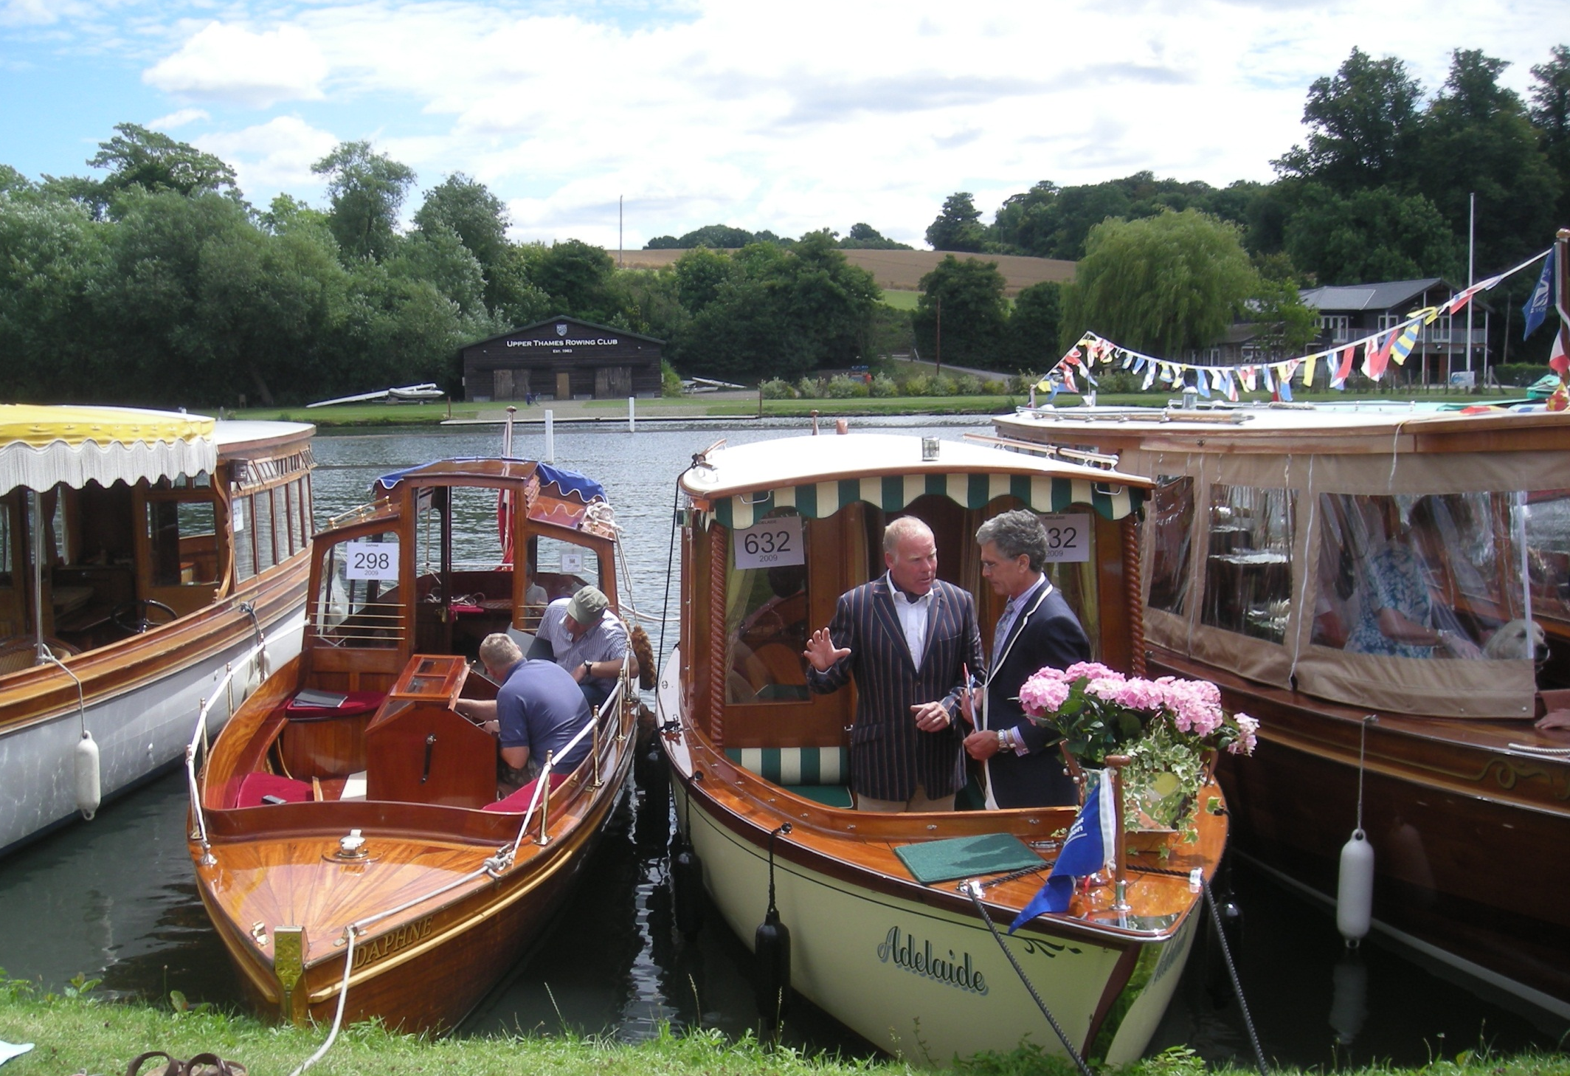
What a pleasure to be with such wonderful boats.

Slide 35
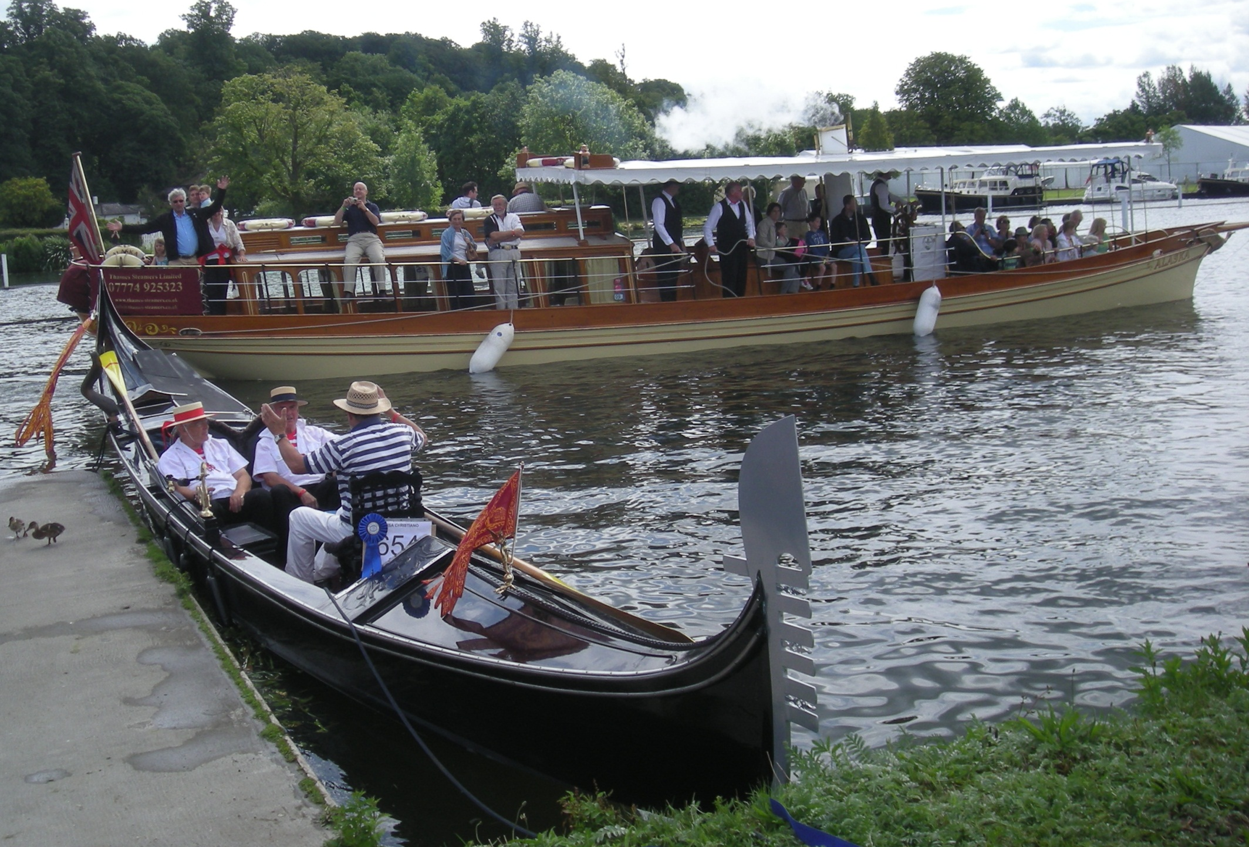
A star attraction was the steamer Alaska of 1883, the boat that started Salter’s Oxford Kingston scheduled services in 1887.

Slide 36
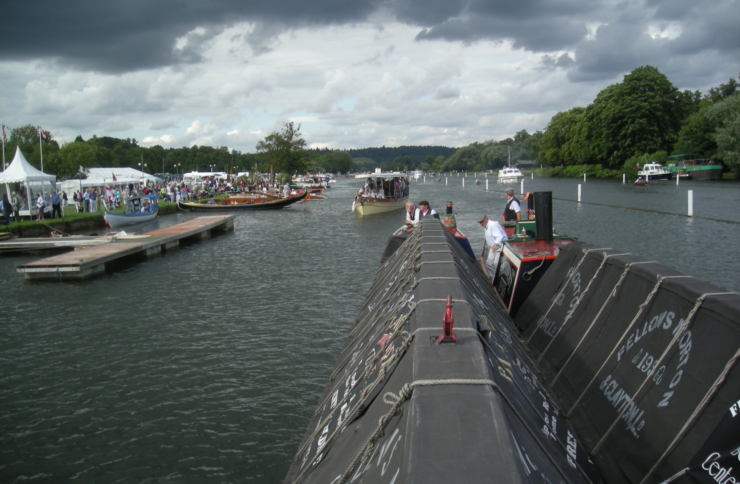
And here we are on a rally parade with Alaska behind us.
The white regatta posts are pulled from the mud after this rally.

Slide 37

And these are the Dunkirk little ships. On the outside is Fermain V from Guernsey, outside the row behind is Quisisana.

Slide 38

But, incredibly, pride of place is here! President with rosettes for “best restored steam plant” and “best boat in show”. Fantastic!

Slide 39

However not all rally weather was wonderful and a wet afternoon gave a chance to travel further upstream on the daily sailing of Salter’s Mary Stuart.

Slide 40


Paul was at the helm, a Salter’s man for over 25 years. We chatted the whole way as only a handful of hardy individuals were travelling today.

Slide 41

This is the approach to Marsh Lock. The wooden walkway ahead being familiar from both our walking and our cycling trips.

Slide 42



Dry weather for a while now as we pass attractive
Shiplake Lock.
Engines are always cut in Thames locks.

Slide 43

Sonning Bridge of 1775, a tricky obstacle and a tight fit for the Mary Stuart.

Slide 44

Much more room for us under Reading Bridge as we near the end of this blustery journey.

Slide 45


Salter’s Reading mooring is by Caversham Bridge and the Mary Stuart will return to Henley at 11.00 tomorrow. Our next trip will be another upstream service, the 2.30 to Wallingford.

Slide 46

Which we enjoy on the summer Saturday of 8th August 2009 aboard Salter’s oldest boat, the 1901 Reading, again Oxford built.

Slide 47

Reading also displays the graceful lines of Edwardian river craft. Fantastic to be aboard another boat over 100 years old!

Slide 48

Departing “Reading on the Reading” soon brings us to the helipad house, the riverside home of a skilful helicopter pilot!

Slide 49



Ashley is Reading’s skipper today, in his 9th year on the Thames.

Slide 50



A treat at Mapledurham where Streatley, Reading’s sister ship, (and still steam powered), is moored. The fine lines are identical.

Slide 51

As usual, all details are recorded in the log. This is the approach to Whitchurch toll bridge and attractive lock.

Slide 52

Under we go!

Slide 53

The elegant lines of the Reading mean we are fast in the water. This cruiser is not slow but it is about to be overtaken.

Slide 54

The famous landscape feature of the Goring Gap, where the historic Ridgeway routeway meets the Thames.

Slide 55

Goring bridge, lock and weir.
It all happens here!

Slide 56

And a nice Salters study approaching shallow Cleeve Lock.

Slide 57

As, in early evening sunshine, we glide under Wallingford Bridge to the Salter’s mooring the other side.

Slide 58

Reading at her Wallingford mooring just one month later, as we continue our journey up the Thames.

Slide 59



Benson is today’s first lock and, just upstream, our first stop at this hidden landing stage.

Slide 60

As we enjoy the tranquil Thames on a perfect September morning.

Slide 61

With, in the distance, landmark Didcot Power Station.

Slide 62


This is stylish, Clifton Hampden, a brick bridge of 1867.

Slide 63

What a cheery river! Four men in a boat greet us at Appleford and nice that the Salter’s crew return their wave.

Slide 64

Surprisingly, Appleford Railway Bridge of 1843, is older than the brick arches of Clifton Hampden!

Slide 65

And older still is this 1809 arched bridge at Culham lock cut, where a mile of canal cuts off a series of bends.

Slide 66

And Reading arriving in Abingdon, one of England’s oldest towns.

Slide 67

For a brief pre-railway hey-day, Abingdon was a junction with the ambitious Wilts and Berks Canal.

Slide 68

Salter’s Steamers moor by Abingdon Bridge beside the Nags Head. An onward service to Oxford departs here at 4.45.

Slide 69

Operated today by Wargrave, one of the largest boats in the fleet, maximum capacity 199. Passengers numbers today are 11!

Slide 70

Once again Wargrave is Oxford built but modern renovation has removed the wooden decking.

Slide 71

But there is plenty of space for special events.

Slide 72

This is Sandford Lock, approaching Oxford, at 8 feet 10 inches the deepest lock on the Thames, as Joe, our captain, holds us steady.

Slide 73

And that is pretty much it for the wonderful River Thames.

Slide 74

Low Folly Bridge is ahead, too low for these old steamers to get under so Salter’s base by the bridge must be journeys end.

Slide 75

As Wargrave reverses in to moor beside Iffley and Goring.

Slide 76


We have reached Oxford, a city of spires and exceptional learning.
It is also the start of the Oxford Canal and the next Chapter of this tale.

