Slide 1
Exploring Britain Boating North Chapter 8
Spurn Head to Edinburgh
14th May to
6th June 2012

Slide 2
We pick up our tale in the North Sea, just off Spurn Head, with darkness beginning to fall.

Slide 3
We are aboard rolling yacht Tonic and Humber bound shipping lanes are busy with traffic.

Slide 4
Yacht Tonic is used for Yachtmaster training and, as such, circumnavigates the British Isles twice a year.

Slide 5
Some night cruising is involved, as here, off Flanborough Head. This is Paul, an experienced sailor yet still training.

Slide 6
There are six of us on board, the captain, three trainees and two novices, of which I am one!

Slide 7
This is Brian, the Captain, a Queenslander, checking distances up the east coast of Britain, a lightly travelled route in the modern world.

Slide 8
This challenging experience had actually begun in the Medway, Tonic’s home base.

Slide 9
A 05.00 start had then taken us into the Thames for a fast (10 knot) run up the east coast, assisted by favourable wind and tide.

Slide 10
To spend the night in fascinating Southwold Harbour.

Slide 11
Tonic can travel fast in the right conditions and is a past competitor of the Fastnet Race.

Slide 12
And conditions did become challenging crossing The Wash.

Slide 13
To reach the gas rigs of the North Sea and our overnight passage across the mouth of the Humber, the real start of this trip.

Slide 14
And so to daybreak, near Scarborough, on 14th May 2012.

Slide 15
As we look towards Ravenscar and Robin Hood’s Bay.

Slide 16
As Tonic passes Ravenscar with Whitby our next port of call.

Slide 17
The approach to Whitby is spectacular.

Slide 18
Whitby harbour entrance, with double breakwaters, can be tricky.

Slide 19
We enter under engine power.

Slide 20
Then, when conditions permit, drop the sail.

Slide 21
We had to moor at the waiting pier to await Town Bridge, only swung around high tide. It is then free time for the crew.

Slide 22
And a treat awaits the discerning. Whitby kippers. Delicious!

Slide 23
Whitby is a fascinating little town. Both down by the harbour.

Slide 24
And up by the abbey. From where we look northwards, along the route of tomorrow’s trip. But the forecast is poor.

Slide 25
No fishing trips are heading out to sea at the moment!

Slide 26
But we are going and young Paul, also a diving instructor, is at the helm for our Whitby departure at 05.06.

Slide 27
And we are soon battling with an angry sea as the Cleveland coastline stretches ahead.

Slide 28
Paul, as acting skipper, has plenty to think about.

Slide 29
As the waves pound the boat. This is a Force 7, Near Gale.

Slide 30
We tack along the coast and by 7.30 are passing Boulby Potash, Europe’s second deepest mine, nearly a mile deep.

Slide 31
Only the experts helm today. The main sail is reefed to 2nd reef to reduce sail area and any smoother water is nearer the coast.

Slide 32
Tacking out to sea the rolling intensifies. Paul is now very wet.

Slide 33
This is Seaham with industry where there used to be coal mines. It is 13.30 and, with the tide against us, the sea is at its worst.

Slide 34
Rough seas by Seaham Harbour as Tonic sails on by.

Slide 35
But, amazingly, it changed. It is now 17.00 and we have blue sea by Tynmouth Castle, built to defend the mouth of the River Tyne.

Slide 36
And we steer into nearby Blyth Harbour to recover!

Slide 37
And where, safely in, our wet clothing is laid out to dry.

Slide 38
The following day was a quality day in every way.

Slide 39
And Ann and I can helm again on this lovely morning.

Slide 40
We pass Coquet Island, Amble, on the flat Northumbrian coast.

Slide 41
Then Dustanburgh Castle, impressive from the sea.

Slide 42
Ahead now is Banburgh Castle, whilst on the right, the Farne Islands near.

Slide 43
The Farne Islands, a bird paradise, is today’s destination and it is the nesting season. Puffins ahoy!

Slide 44
We anchor on arrival, inflate the dingy and set off for shore.

Slide 45
Our timing was perfect as all the other visitors had returned to Seahouses and the island was deserted………except for the birds!

Slide 46
It was amazing to be so close to all these wonderful birds, for example, left to right, a Guillemot, a Razorbill and a Shag.

Slide 47
An interesting Farne Island bird is the Arctic Tern. These birds stay with long daylight and migrate to the Antarctic for winter, a 20,000 mile round trip!

Slide 48
Arctic Terns defend their territory too and are known to peck the heads of intruders!

Slide 49
There are 37,000 puffins on the Farne Islands and this group here have nesting burrows opposite Banburgh Castle.

Slide 50
The Farne Islands are truly amazing.

Slide 51
As Tonic moves on!

Slide 52
Passing Bamburgh Castle and then Lindisfarne, Holy Island, with the Cheviot Hills behind.

Slide 53
We are now, as the displays indicate, heading for Scotland and doing 7.5 knots in 24.9 metres of water.

Slide 54
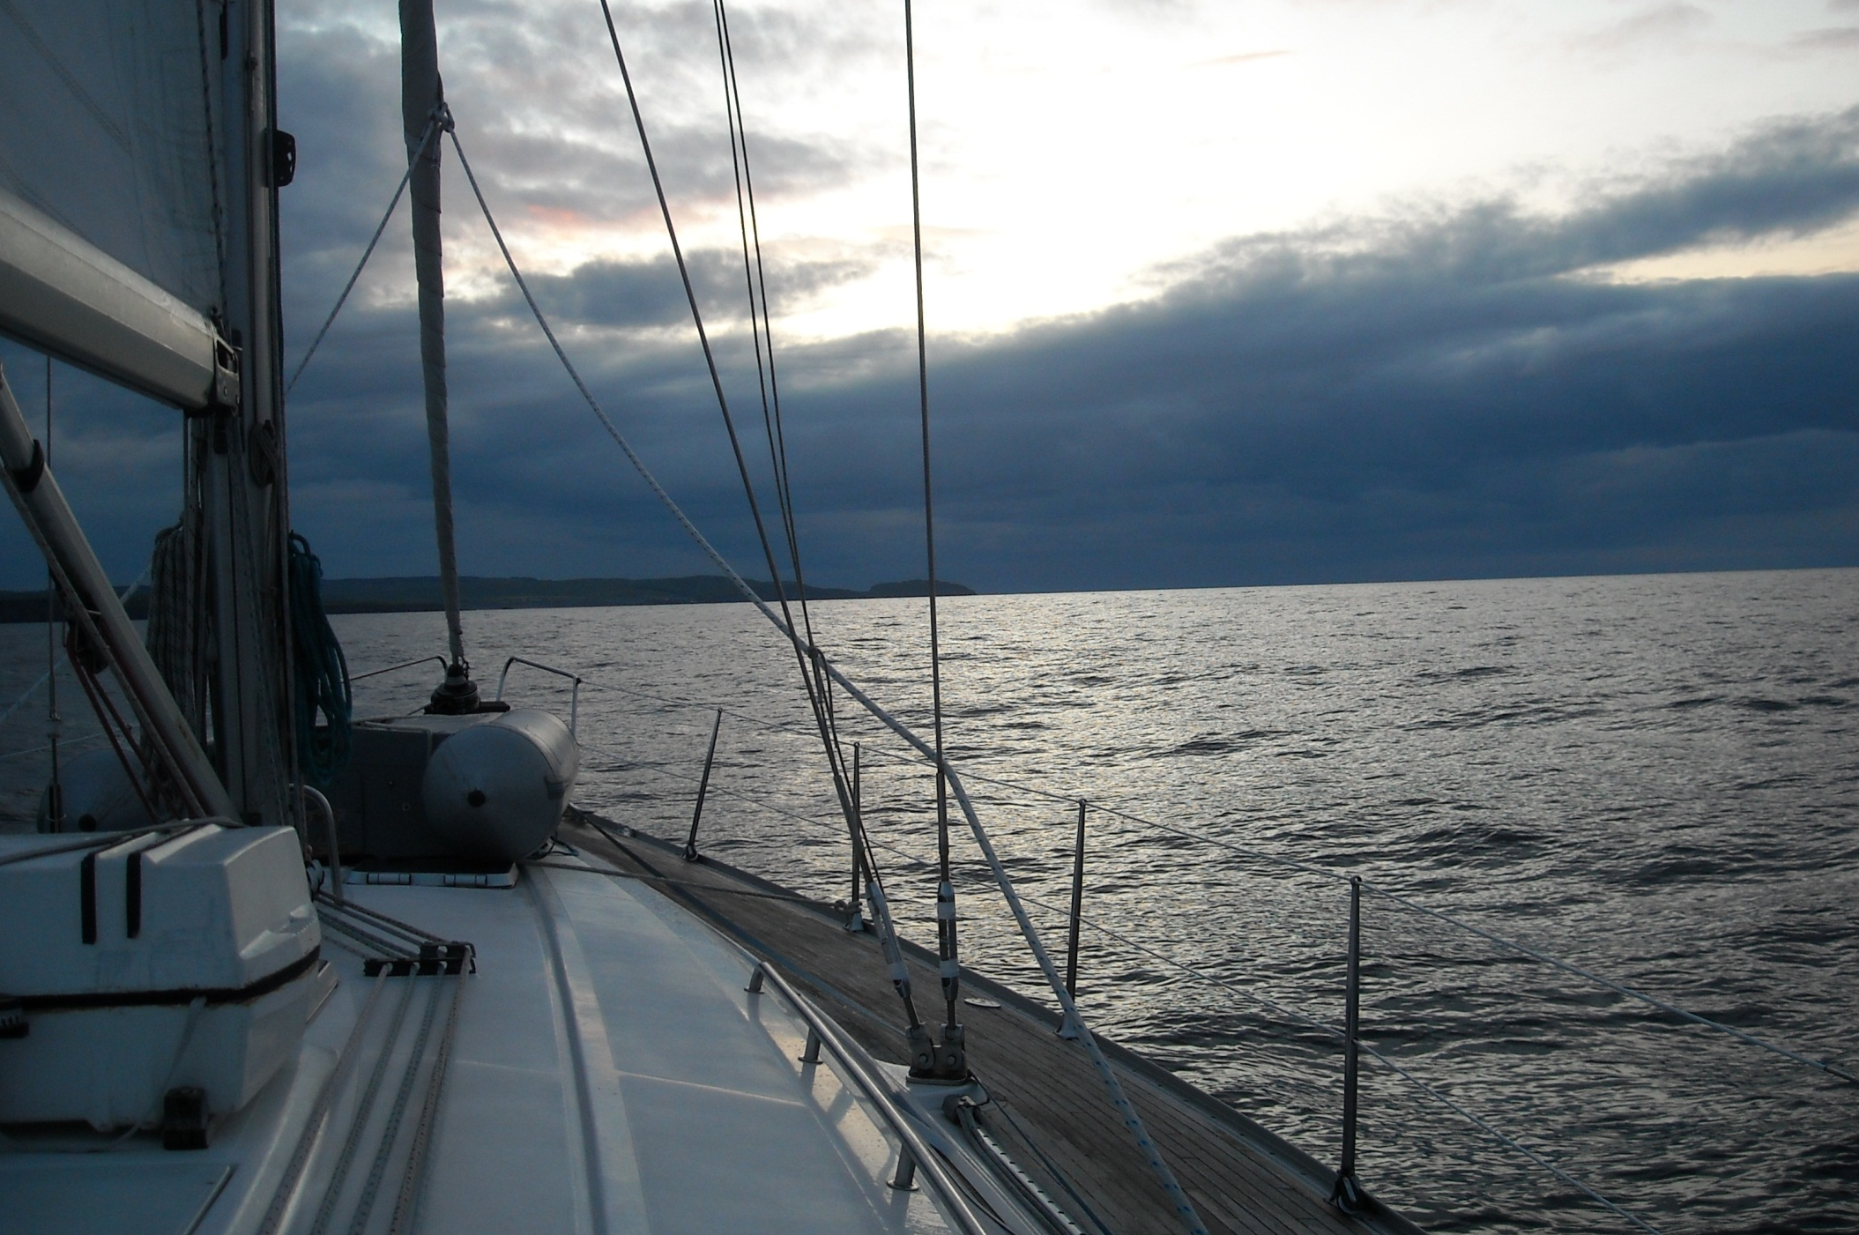
It is late evening as we pass Berwick-upon-Tweed with Eyemouth now ahead.

Slide 55
The rocky approach to Eyemouth is not for the faint hearted!

Slide 56
But once through the rocks Eyemouth offers excellent moorings and a choice of pubs!

Slide 57
Next morning dawns wet, as skipper Brian takes the helm.

Slide 58
Although heading for Lossiemouth and the Shetland Islands, Brian is taking a course around Bass Rock to assist my journey.

Slide 59
St Abb’s Head, with its spectacular lighthouse, is our first coastal feature of the day.

Slide 60
As the funnel of the Firth of Forth begins to take shape. Bass Rock, my destination this trip, can just be glimpsed far right.

Slide 61
We pass Dunbar.

Slide 62
As a gannet, with a beakful of seaweed, passes by. The 150,000 gannets on Bass Rock are a wildlife wonder of the world.

Slide 63
Here it is, amazing Bass Rock, white with gannets.

Slide 64
There are gannets everywhere! The chicks are heavier than the adults on leaving the nest and were once taken as food.

Slide 65
And here, at Bass Rock, my Tonic adventure ends.

Slide 66
As from here I follow the southern shore of the Firth of Forth.

Slide 67
And this begins aboard Seabird on 4th June 2012, a Diamond Jubilee weekend.

Slide 68
The Seabird gets very close in as we pass the lighthouse and the old prison.

Slide 69
And, of course, we get very close to the gannets too.

Slide 70
Bass Rock is considered “full up” with every nesting site taken!

Slide 71
The Seabird returns to its home port, attractive North Berwick. North Berwick Harbour is in water only at high tide.

Slide 72
And Mike and Hilary are up here too and Mike and I are going kayaking!

Slide 73
Next morning sees us on North Berwick beach at low tide.

Slide 74
And we wish each other well before heading into the waves. We will get very wet in the harbour entrance. Mike is a an experienced kayaker.

Slide 75
We paddle away from North Berwick and settle in. This lighthouse is on Fidra, three miles into our journey.

Slide 76
It is amazing how conditions vary today. Around 11.30, at Gullane, the Firth of Forth is absolutely idyllic.

Slide 77
We then cross Aberlady Bay, well out to sea. The chimney ahead, some six miles away, is Cockenzie power station.

Slide 78
The wind then strengthened and it took a good while to get here.

Slide 79
But we then saved a yard or two by paddling beneath the pier. Cockenzie is being converted to burn gas instead of coal/biomass.

Slide 80
We beach around the corner for a late lunch in Prestonpans. Salt panning and coal mining were once local trades.

Slide 81
Beyond Prestonpans things become rougher.

Slide 82
Reclaimed land by Musselburgh racecourse is protected by a severe sea wall which leads to difficult and complex turbulence.

Slide 83
Arthur’s Seat and Edinburgh approach as we pause for a while in the welcome shelter of Musselburgh Harbour.

Slide 84
We then battle the waves to reach the Edinburgh suburbs and touristy Portobello Strand on this Bank Holiday weekend.

Slide 85
The weather is really changing and we just made it in time.

Slide 86
As we power up the sandy beach. Distant Cockenzie power station is now 7 miles away and we have paddled 21 miles today.

Slide 87
We made it John!

Slide 88
Just over the railings, beyond the bus garage, are Leith Docks.

Slide 89
And we visit Leith Docks the following morning.

Slide 90
But access was tricky. These steps were the key. One then had to squeeze under several low bridges.

Slide 91
These are the last two. Only a canoe can make this trip.

Slide 92
We were timid in our travels around Leith Docks.

Slide 93
And made do with a foray of the older basins before returning back under the bridges to paddle the Water of Leith towards Edinburgh.

Slide 94
Whaling was once a mainstay of Leith and the man that ended up controlling the industry, Christian Salvesen, is buried nearby.

Slide 95
Few people travel the Water of Leith today.

Slide 96
As it mainly offers back views of unexciting Edinburgh suburbs and bankside vegetation that becomes ever thicker!

Slide 97
Nobody travels this way, it is time to call it a day. Not very far from here is Edinburgh canal basin and the start of our next leg.

Slide 98
It is time to return to the steps.

Slide 99
And to give a big “Thank you” to Mike and Hilary for this quite amazing experience.

