Slide 1
Exploring Britain
Boating South Part 1
Chapter 11
London, Tower Bridge
to Portsmouth Harbour
2nd October 2009 to
23rd September 2010

Slide 2
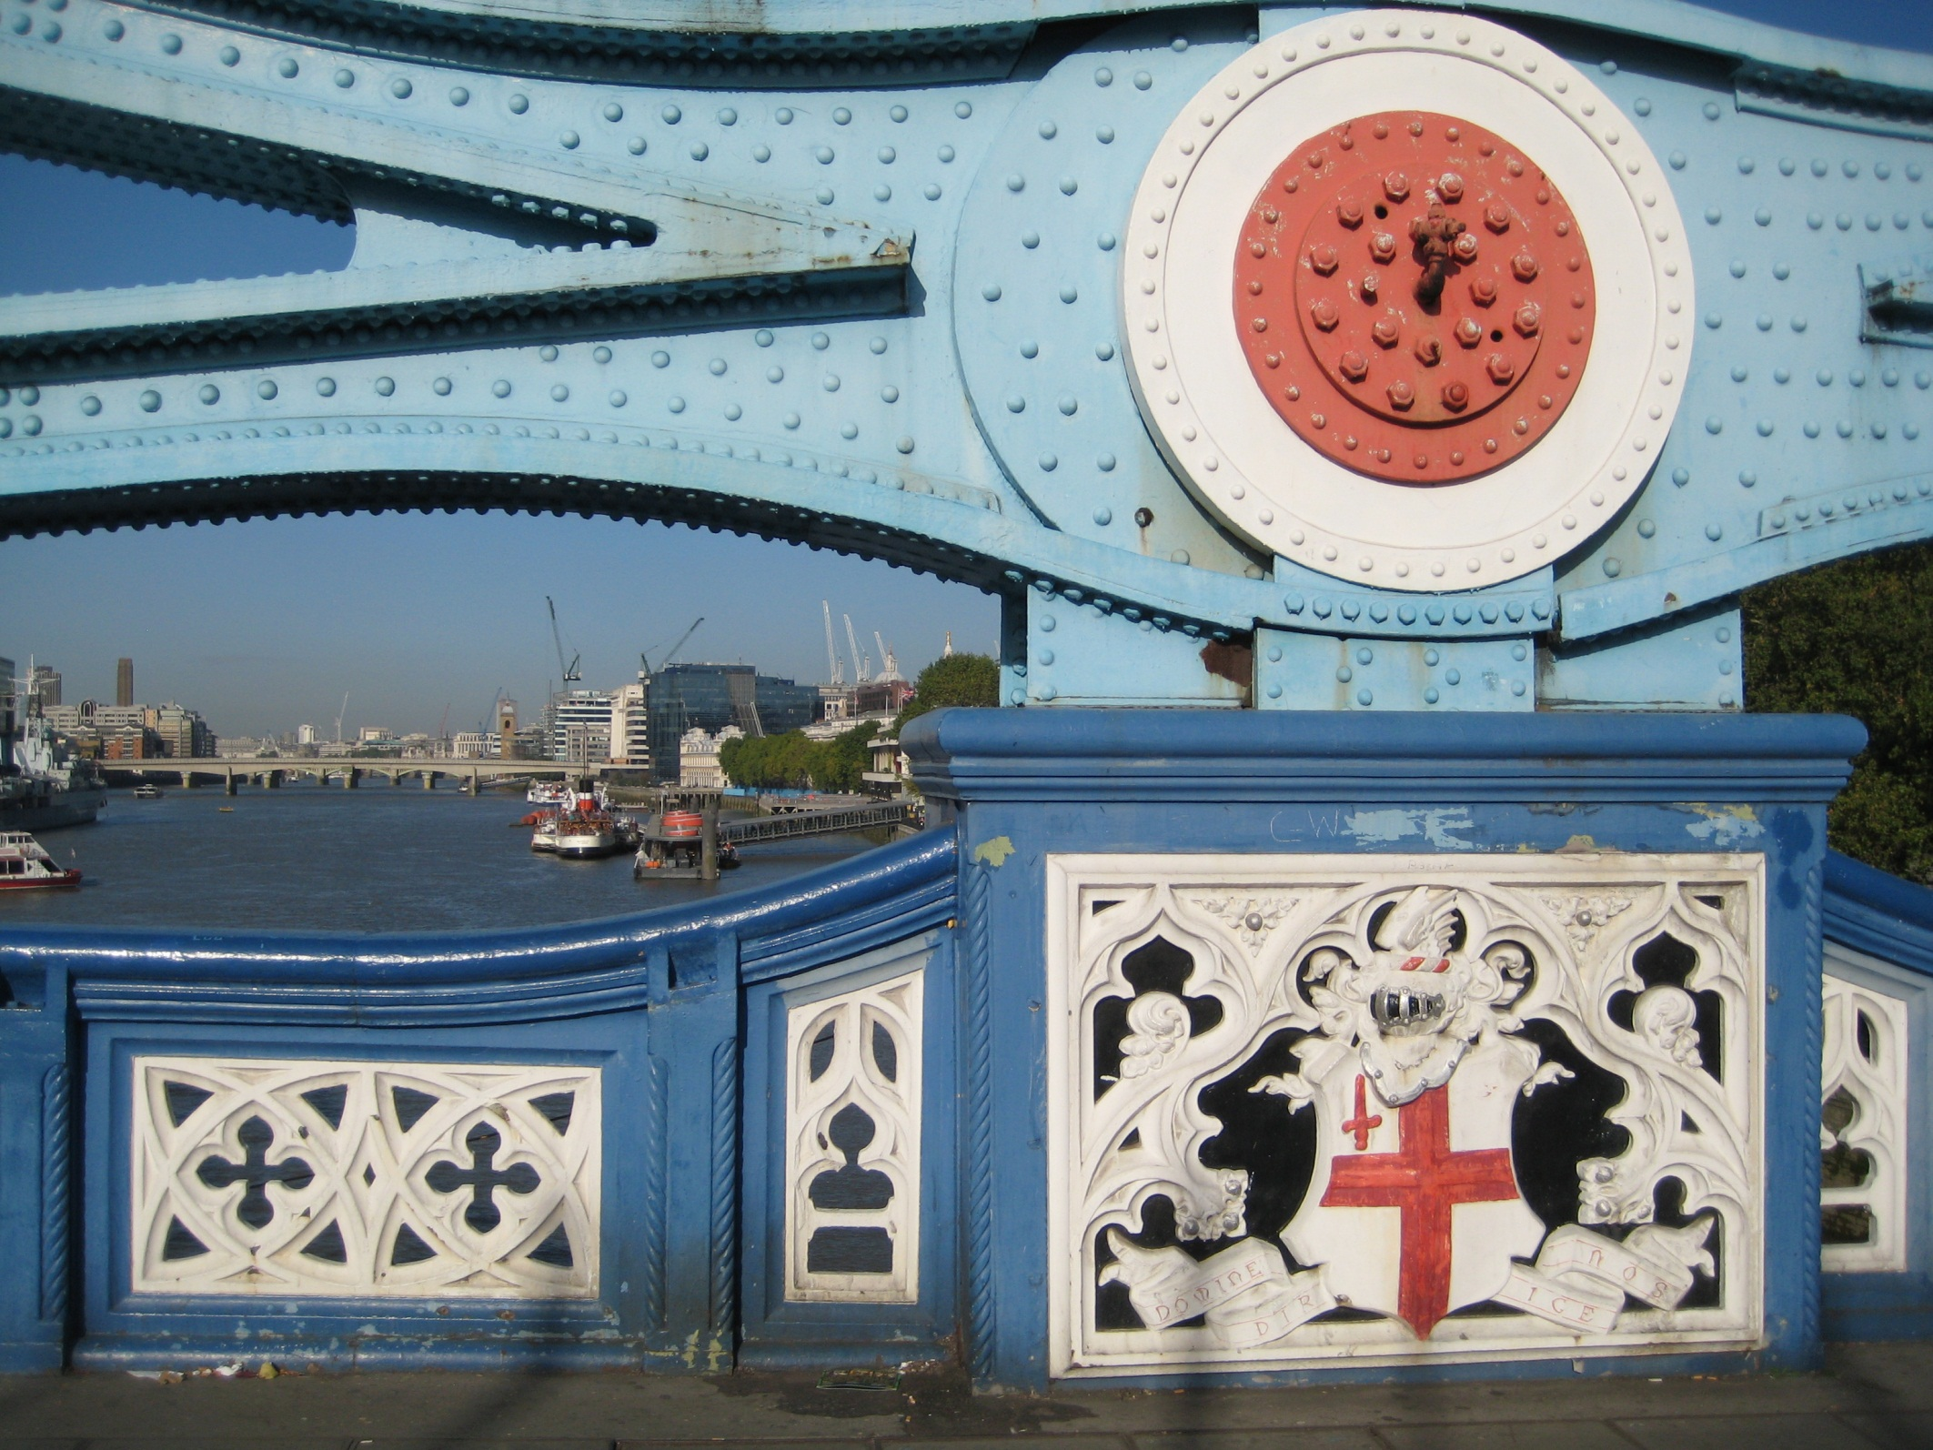
Moored on the River Thames by the Tower of London is Waverley, the last sea going paddle steamer in the world.

Slide 3
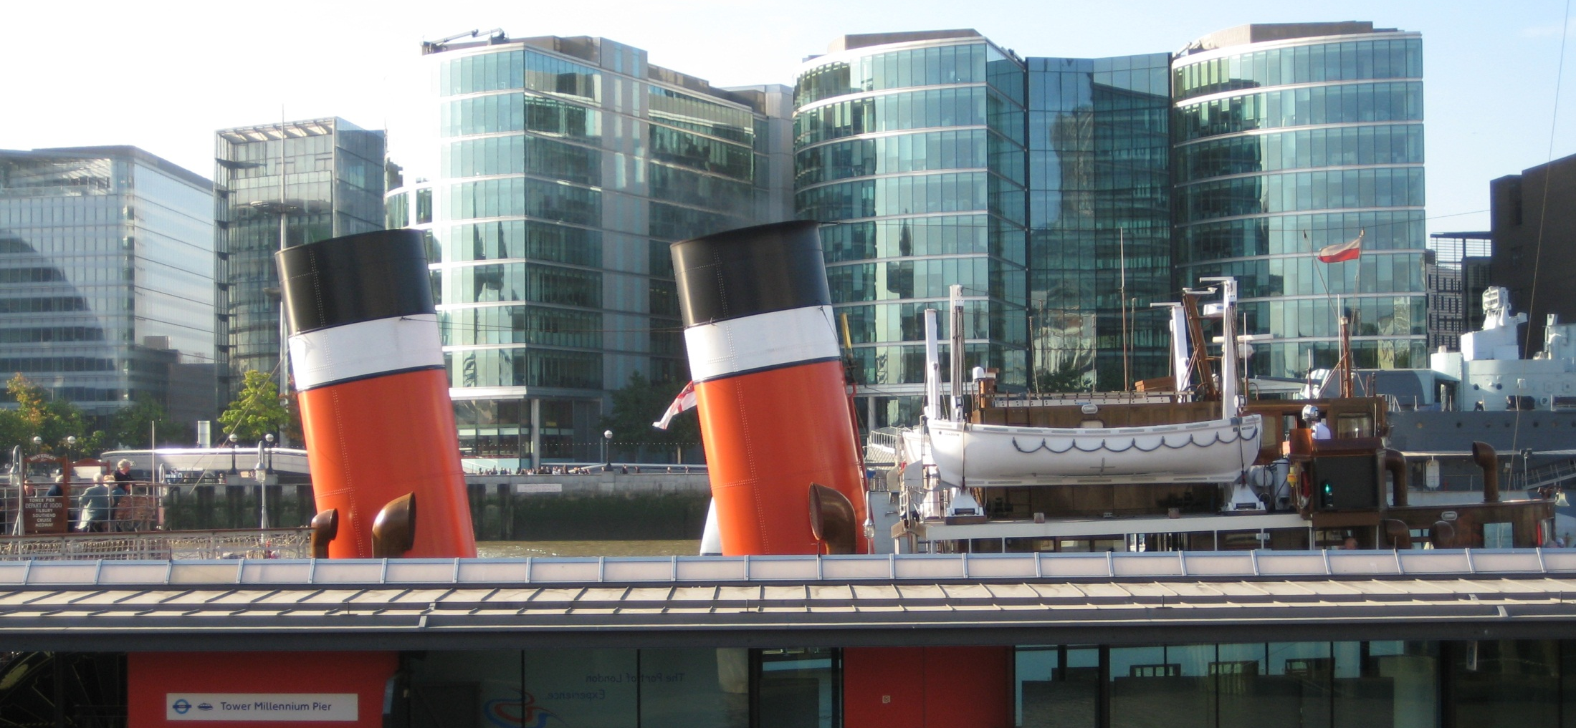
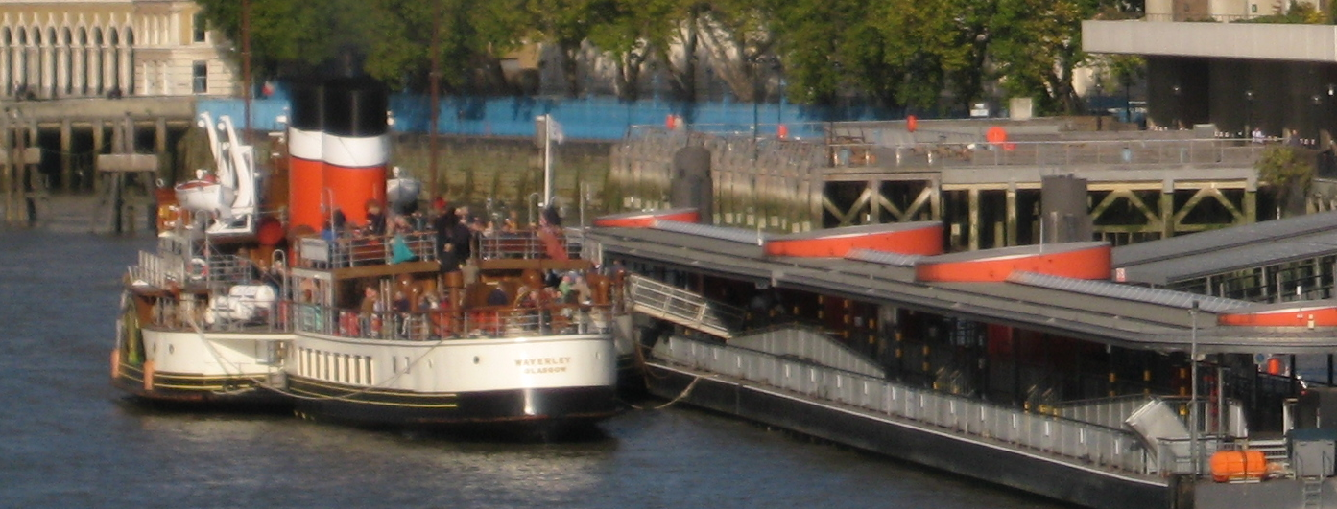
As passengers board at
Tower Pier.

Slide 4
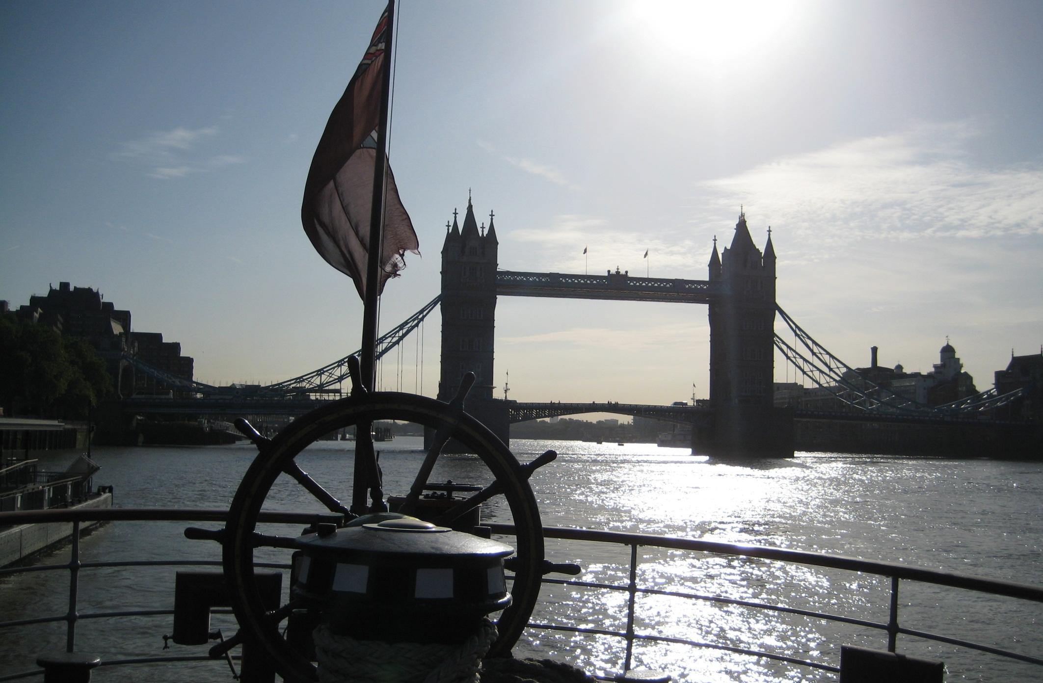
We are to head downstream to the estuary and departure is all action.

Slide 5
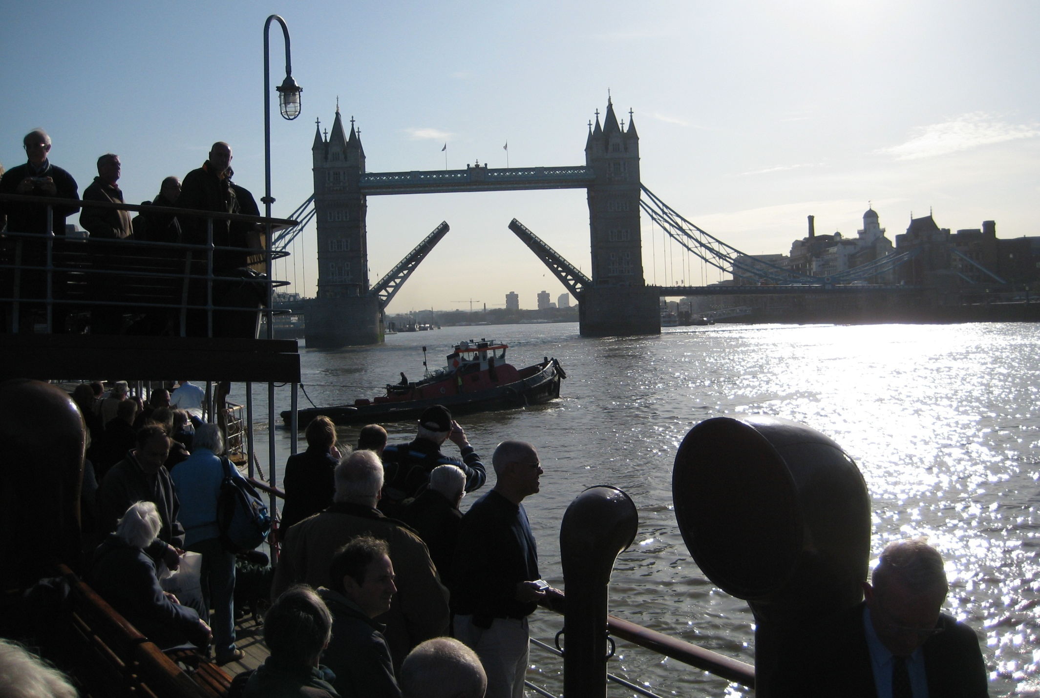
Road traffic is stopped, Tower Bridge is raised, a tug swings the bow and our stern approaches HMS Belfast…………

Slide 6
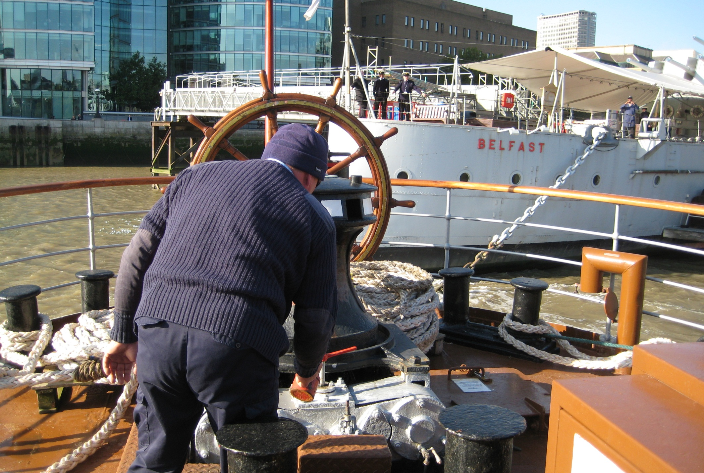
As a Waverley crewman casually oils the steam capstan.

Slide 7
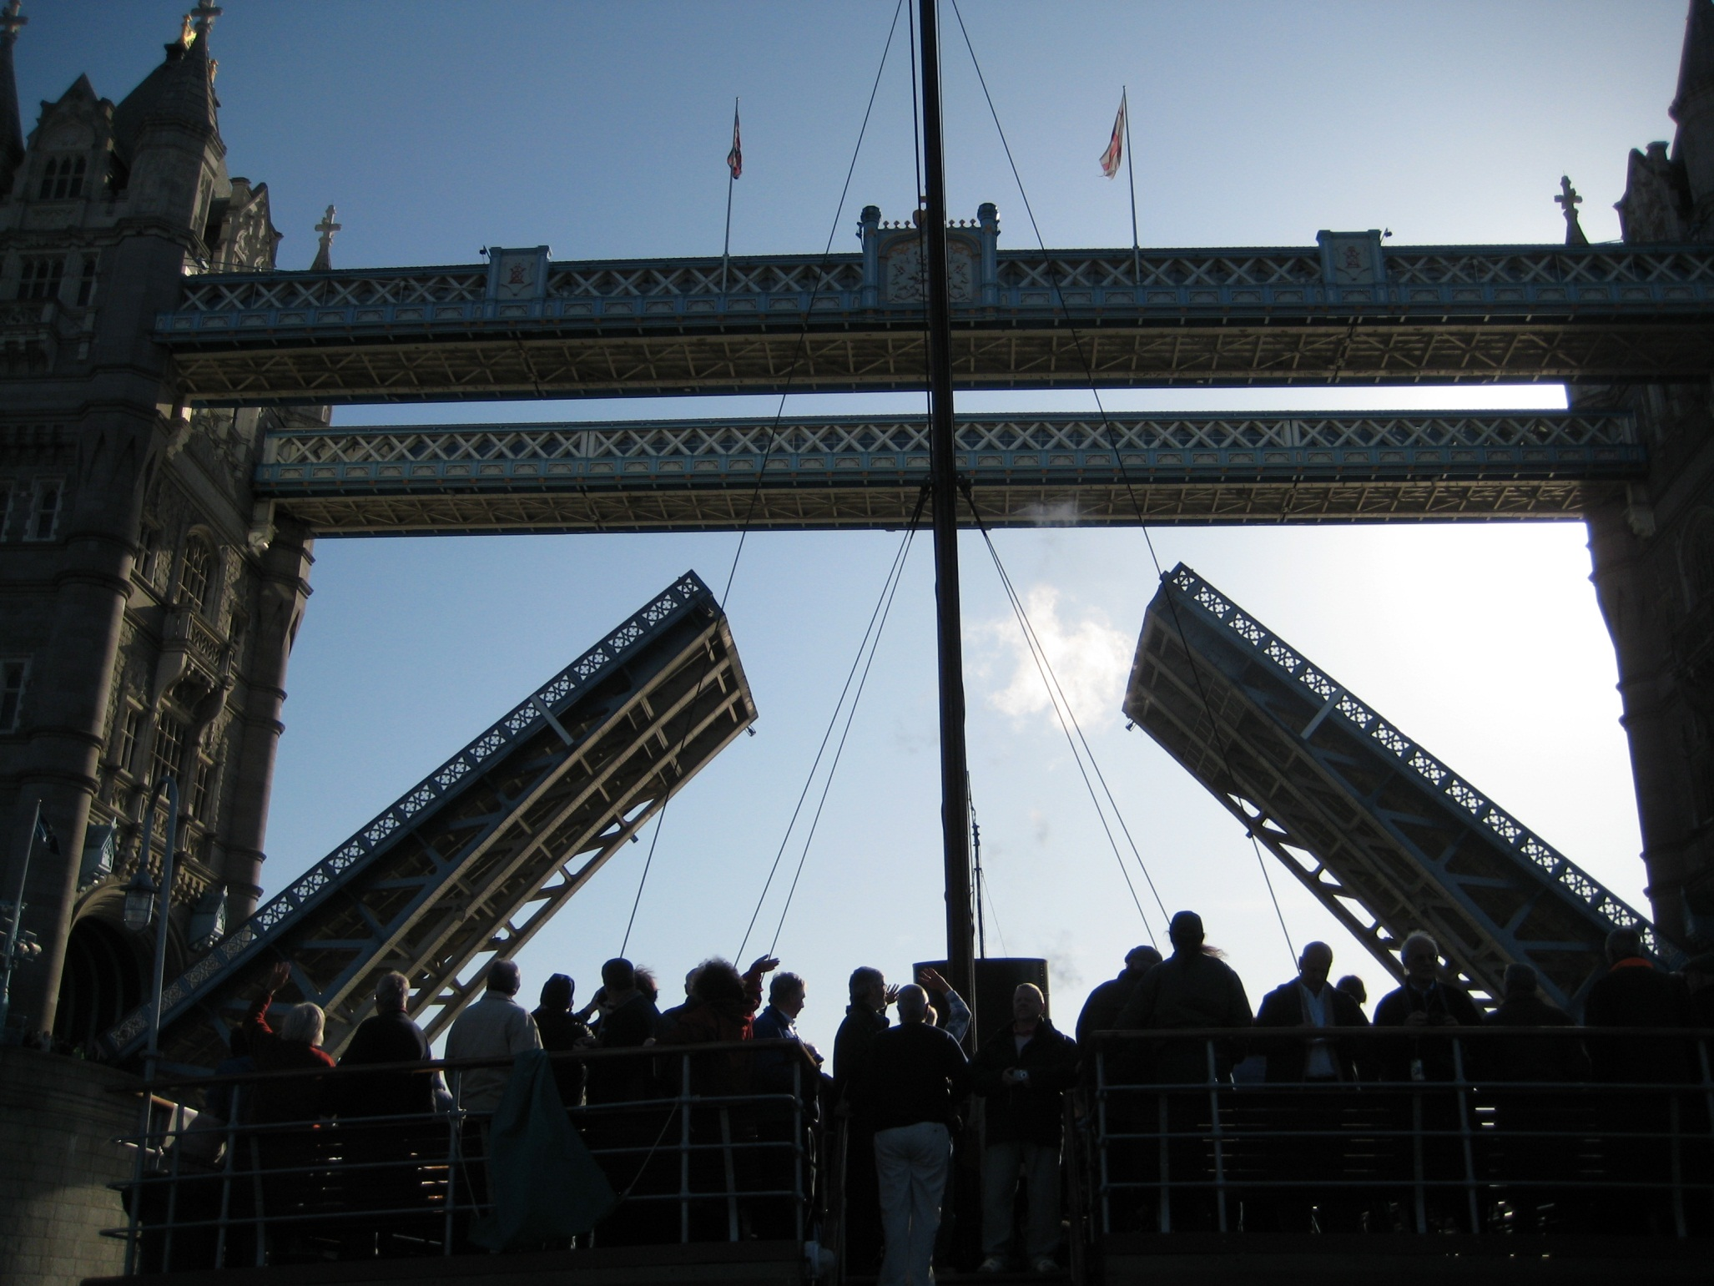
Passing beneath Tower Bridge was a great moment.

Slide 8
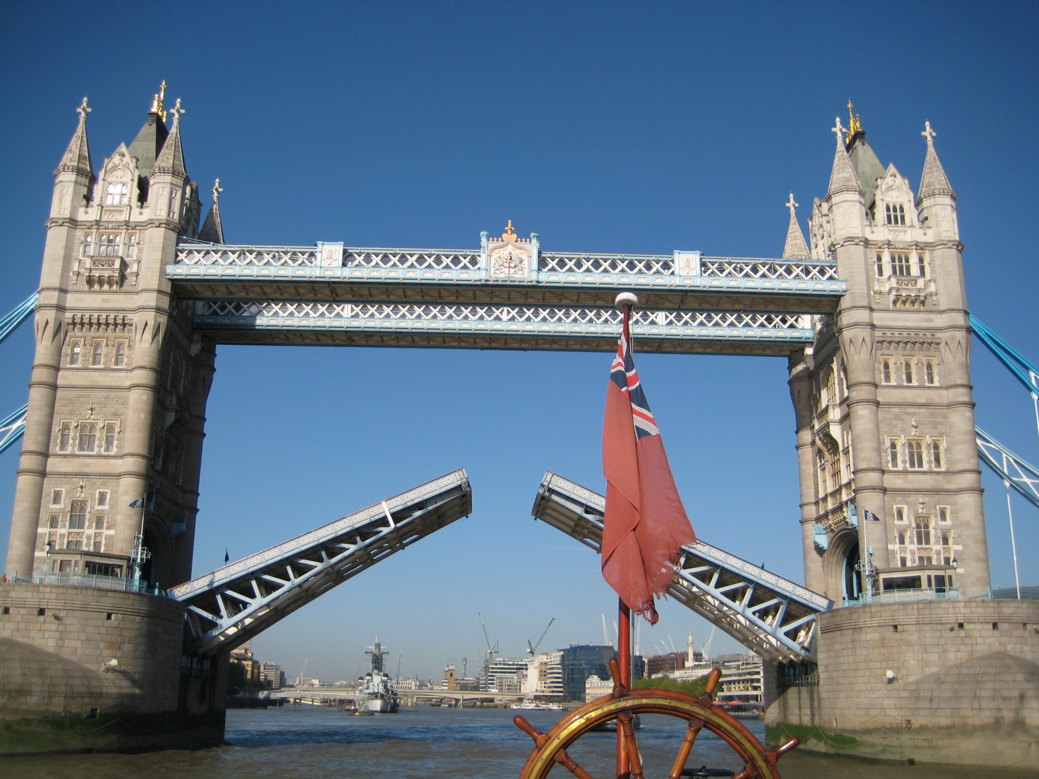
As the bridge closes behind us and we power downstream.

Slide 9
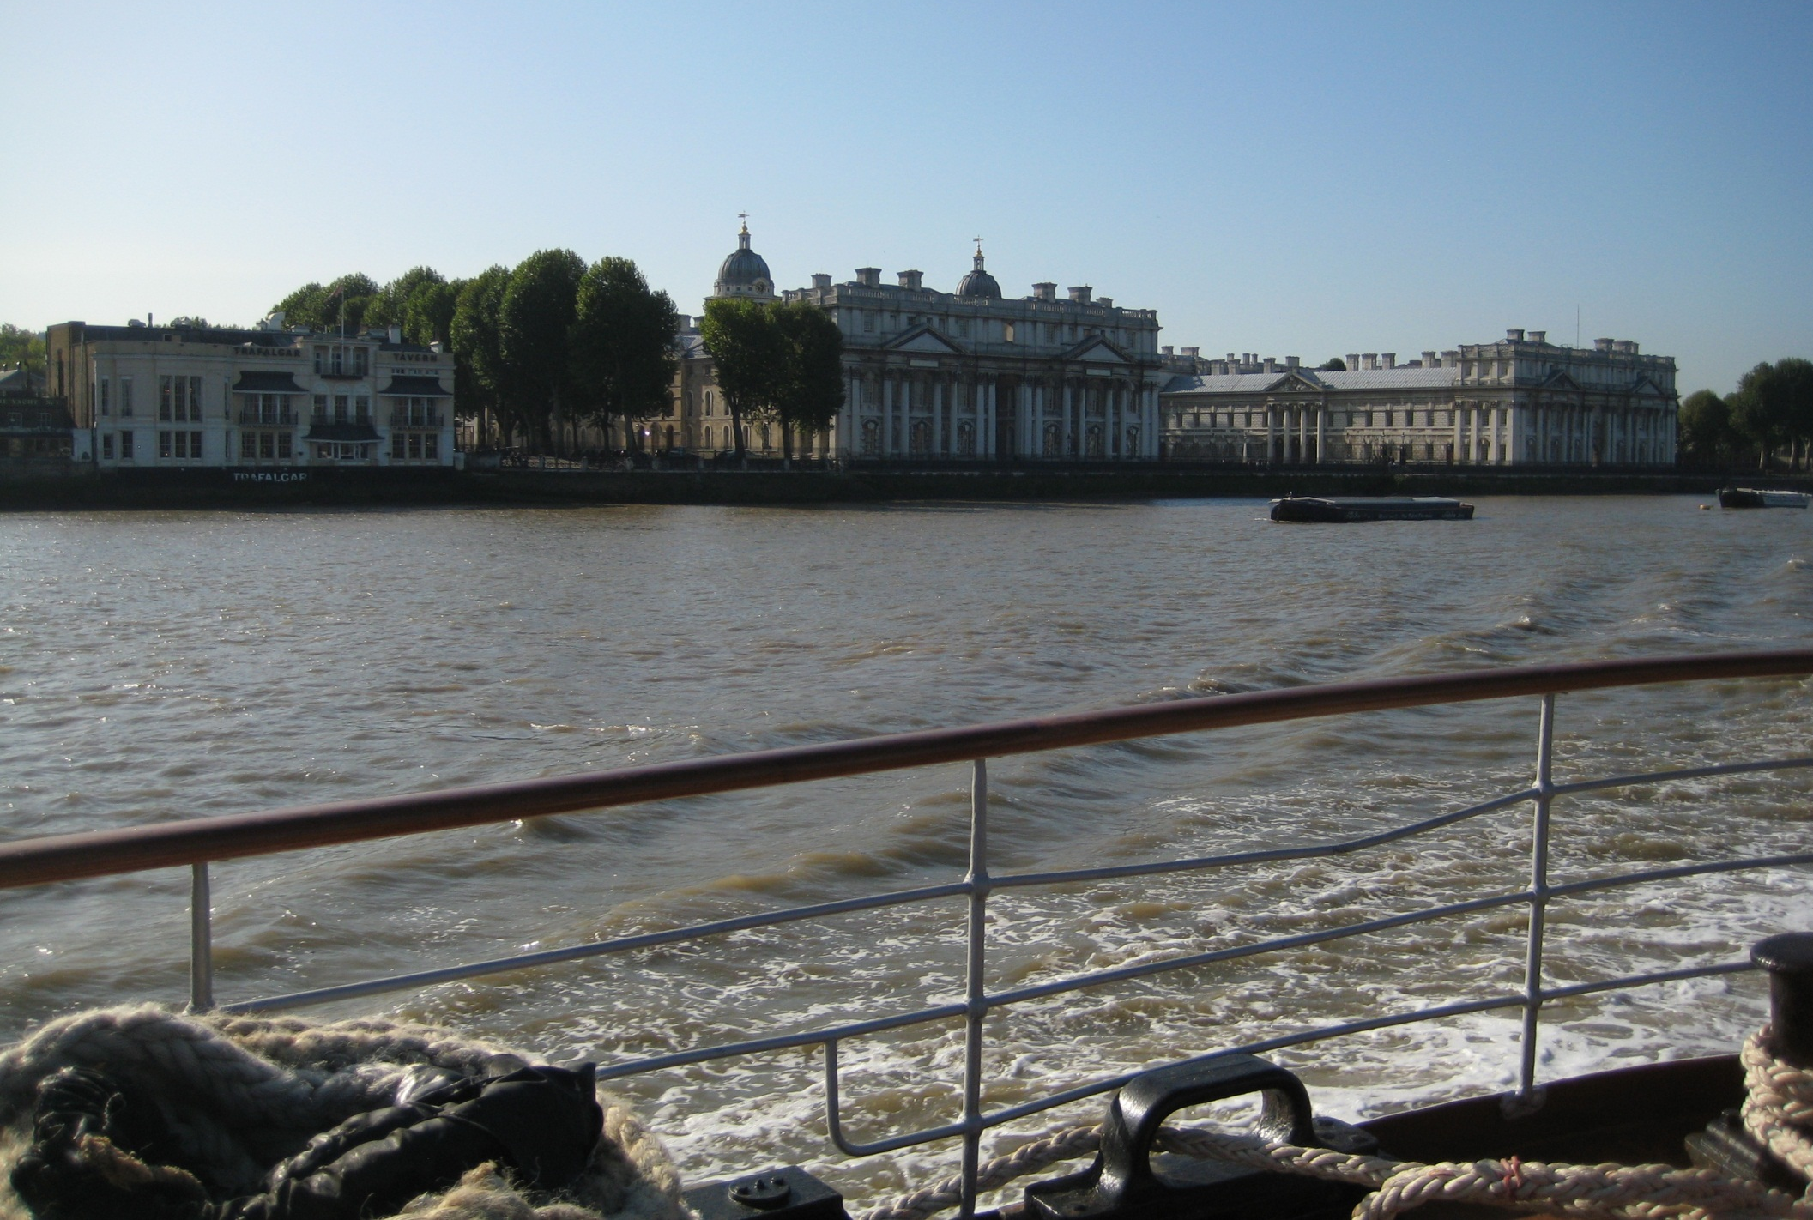
And in no time at all are passing the naval buildings at Greenwich.

Slide 10
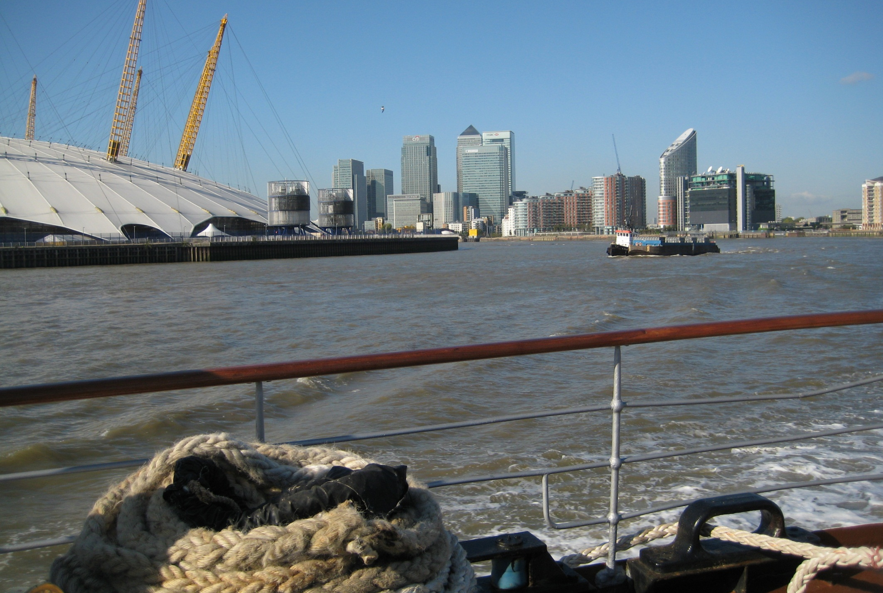
Then modern Canary Wharf and the Millennium Dome.

Slide 11
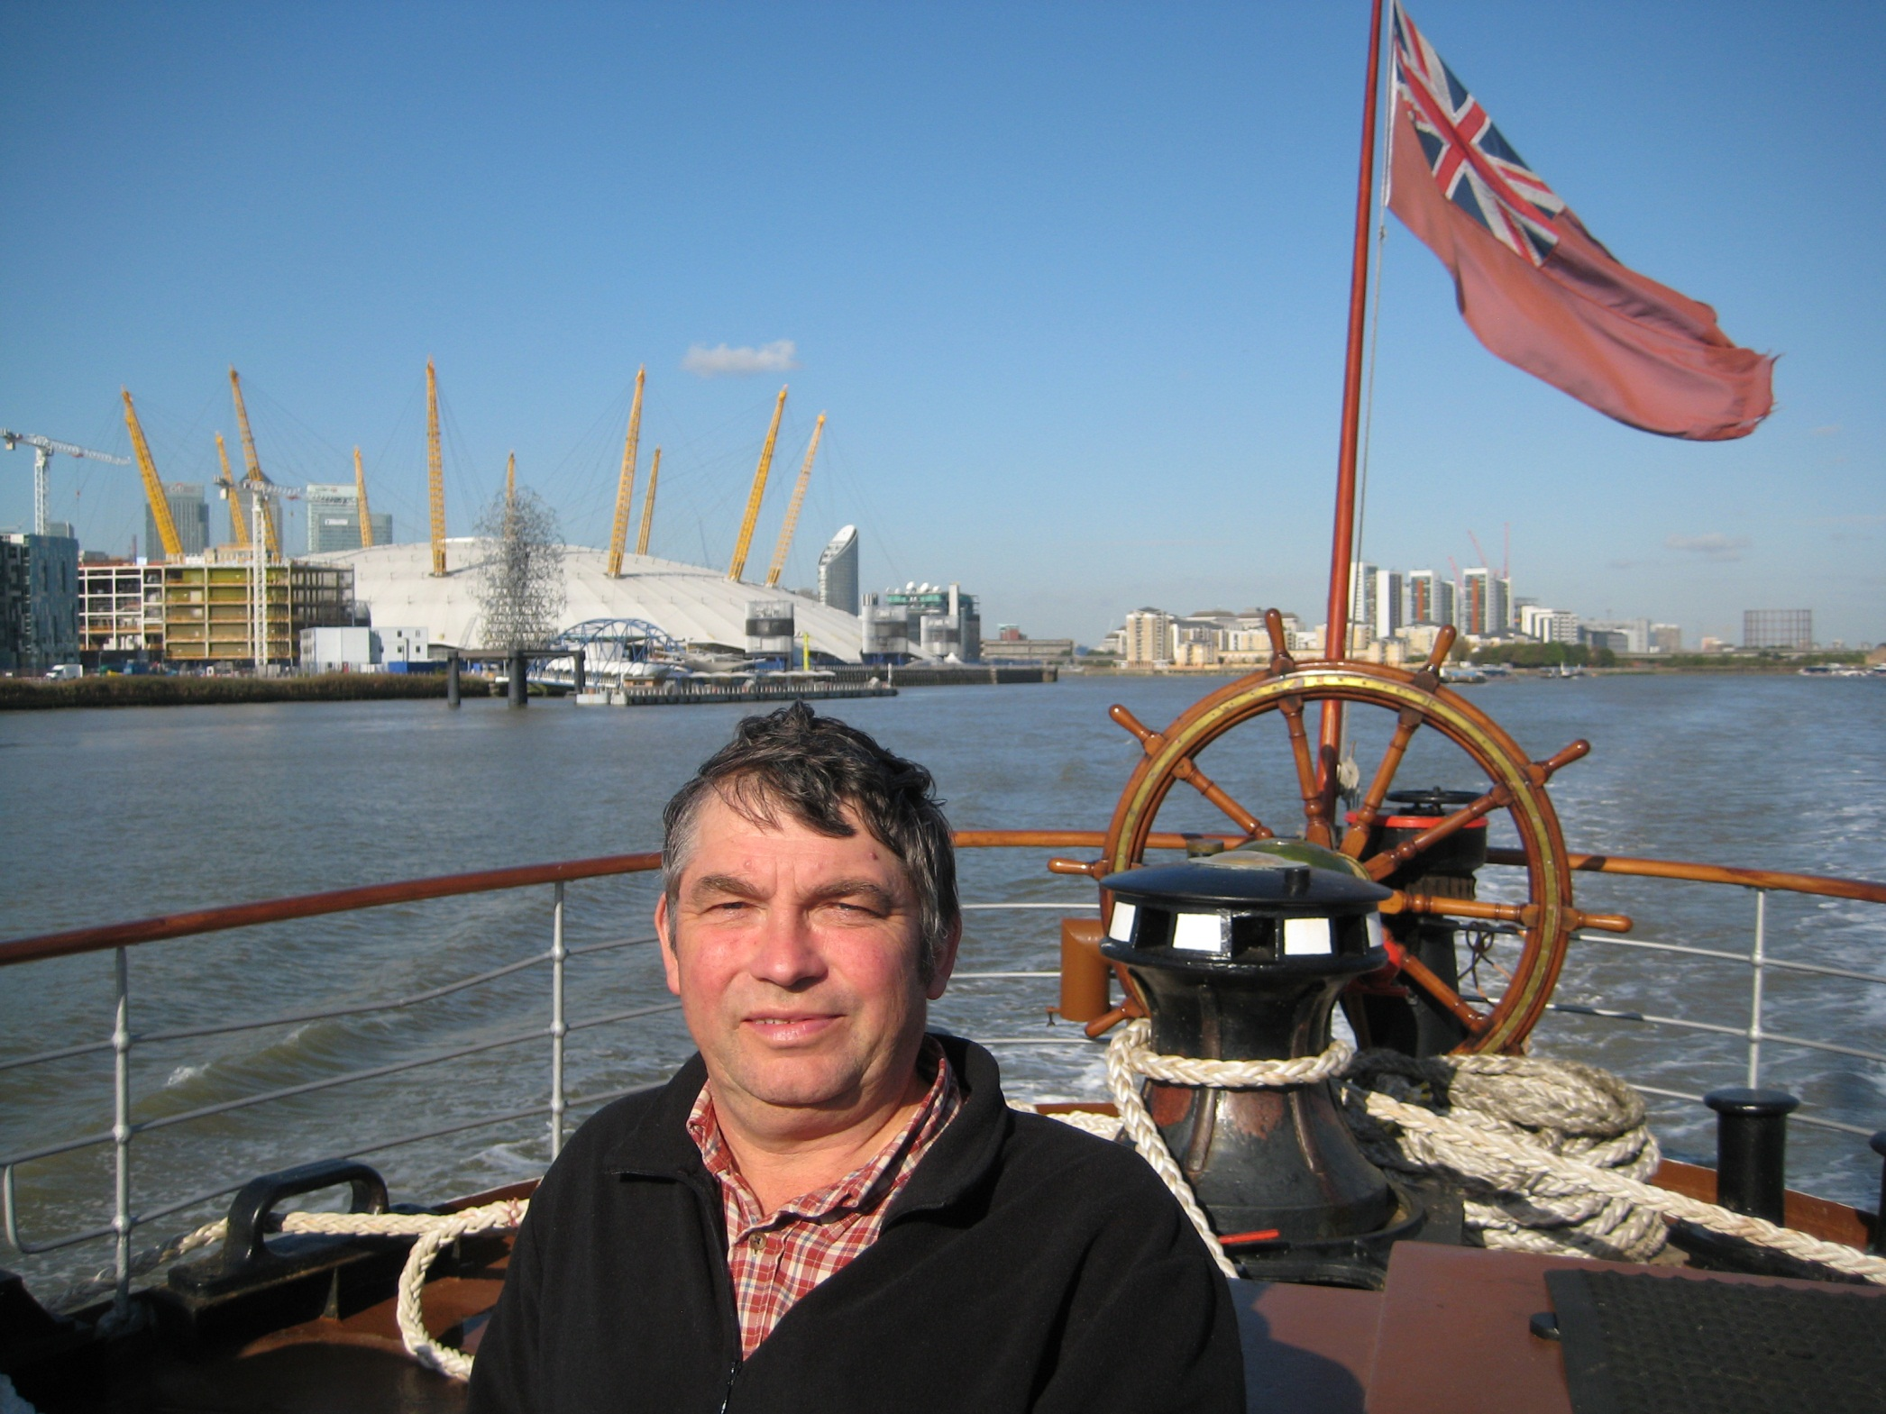
It is Friday 2nd October 2009, a perfect day to be on the Thames.

Slide 12
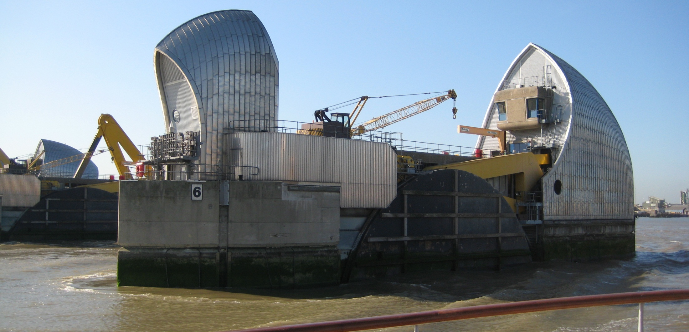
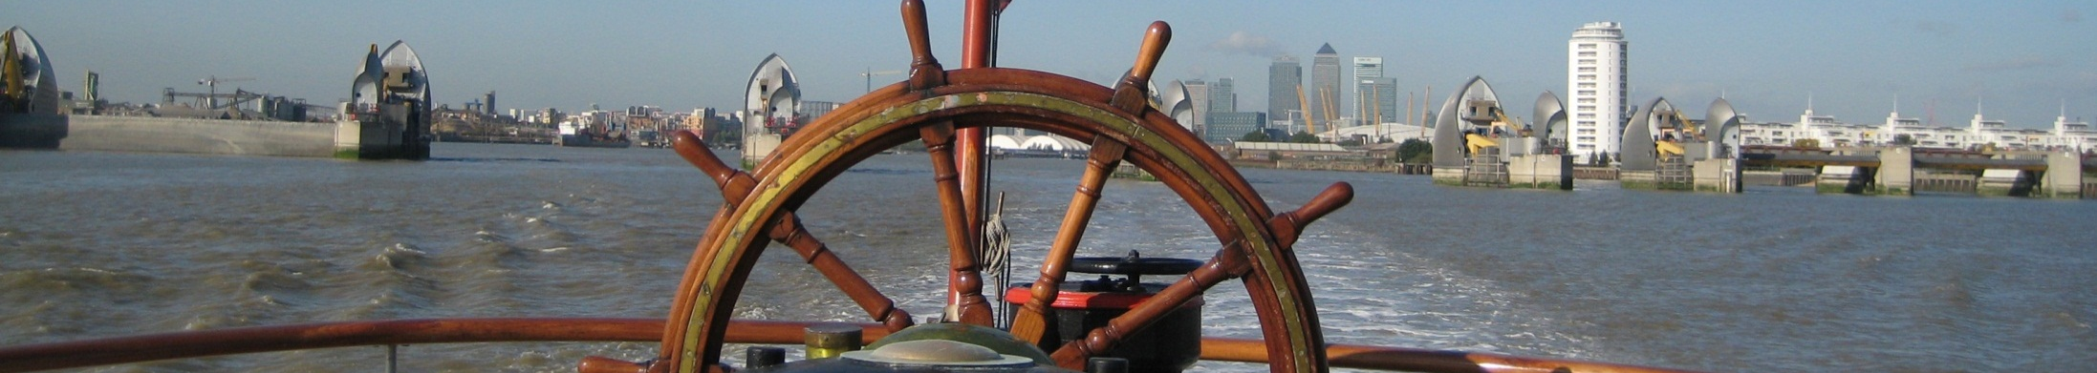
We pass through the Thames Flood Barrier at Woolwich where one of the rotary gates is shut for inspection.

Slide 13
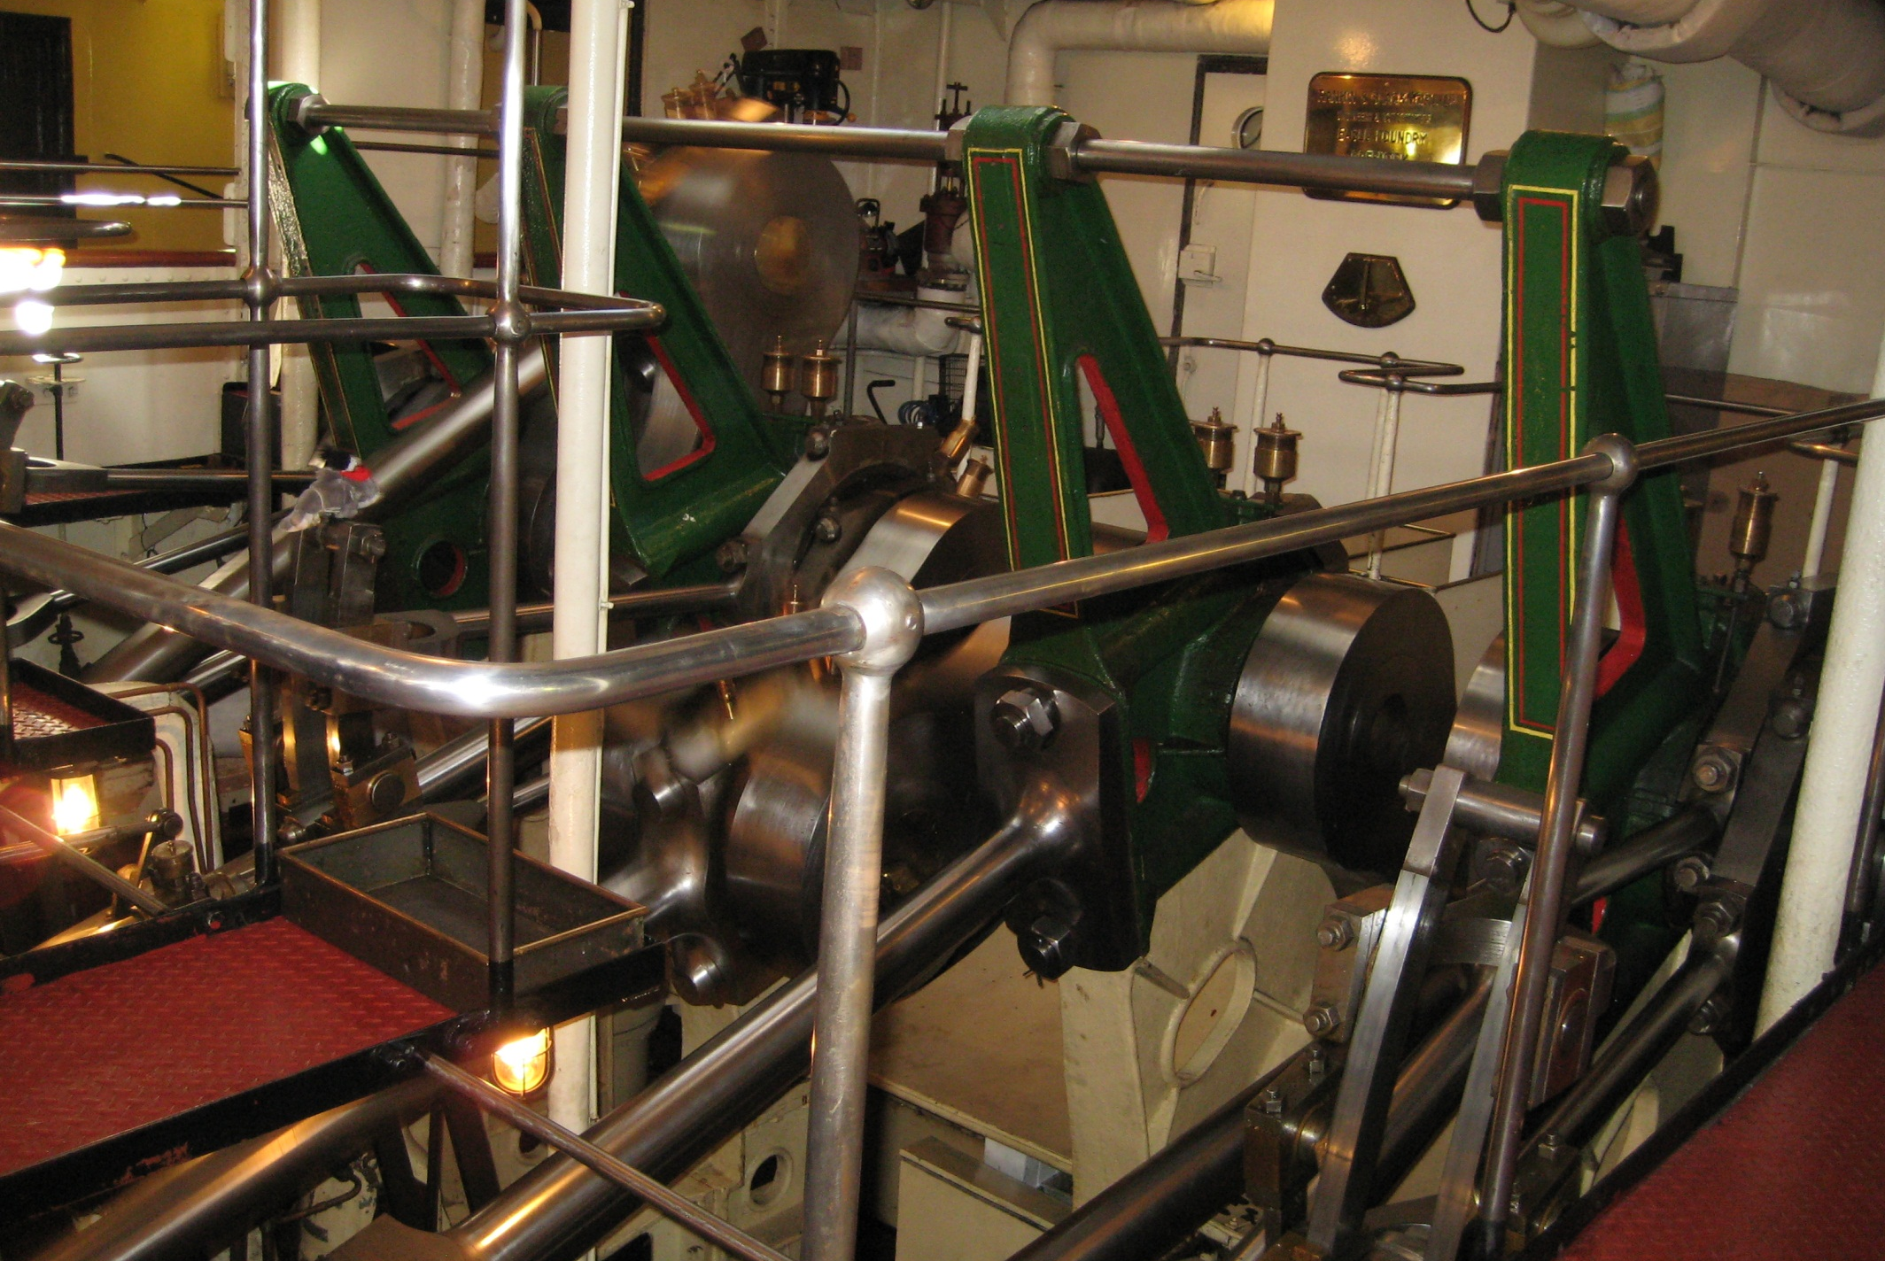
Below decks Waverley’s oil fired triple expansion steam engine is a fantastic sight.

Slide 14
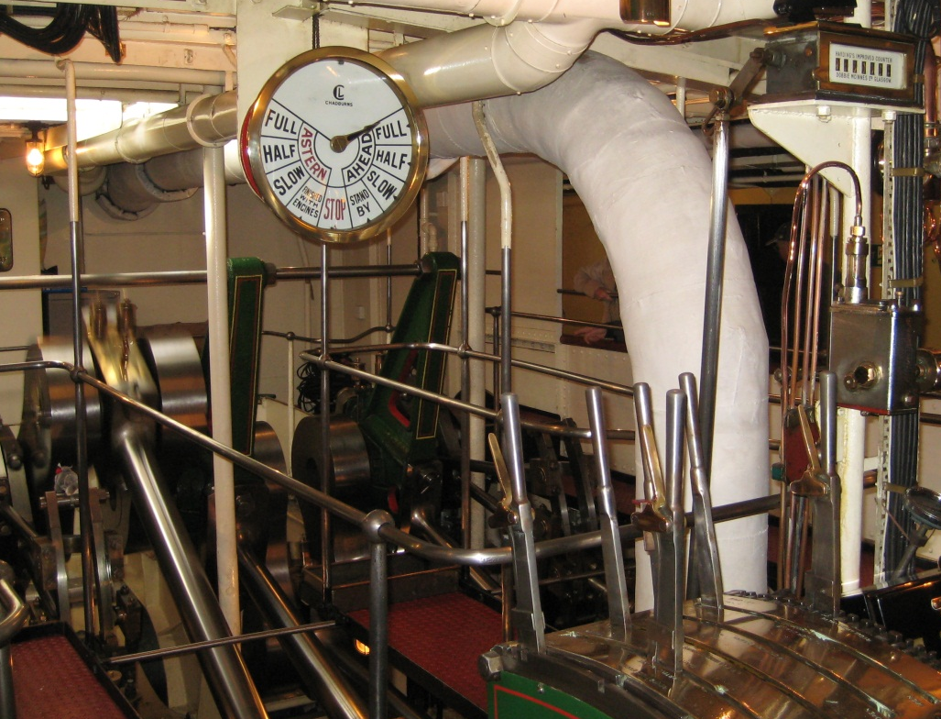
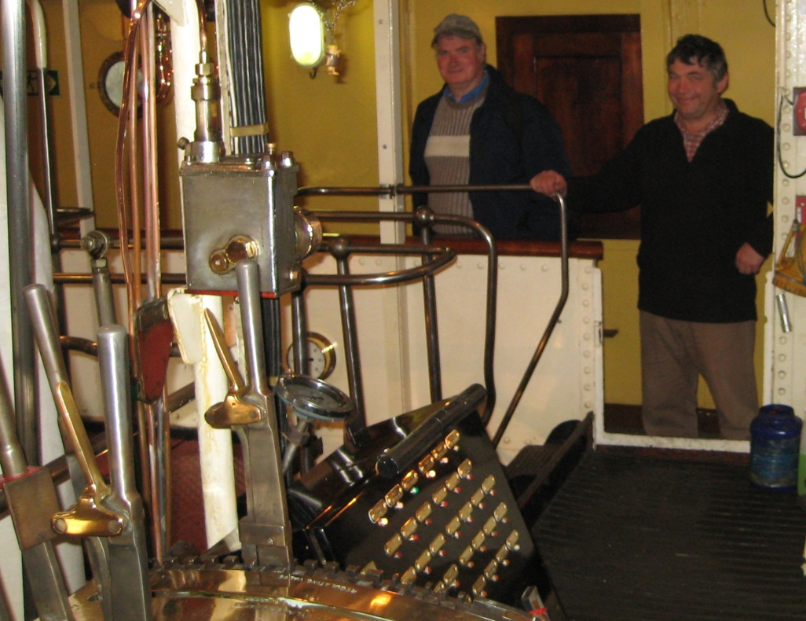
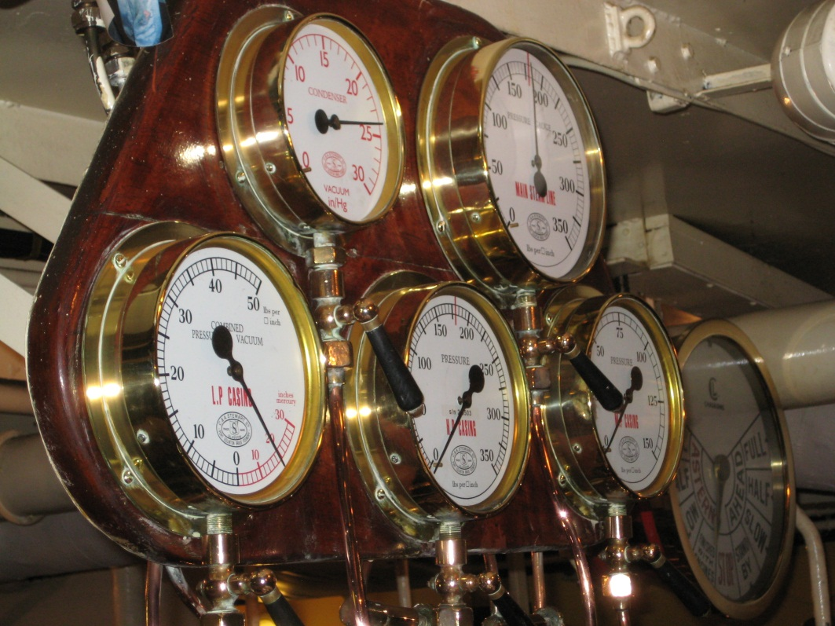
Walkways either side permit excellent views.
The main crankshaft directly powers the paddle wheels either side of the vessel.

Slide 15
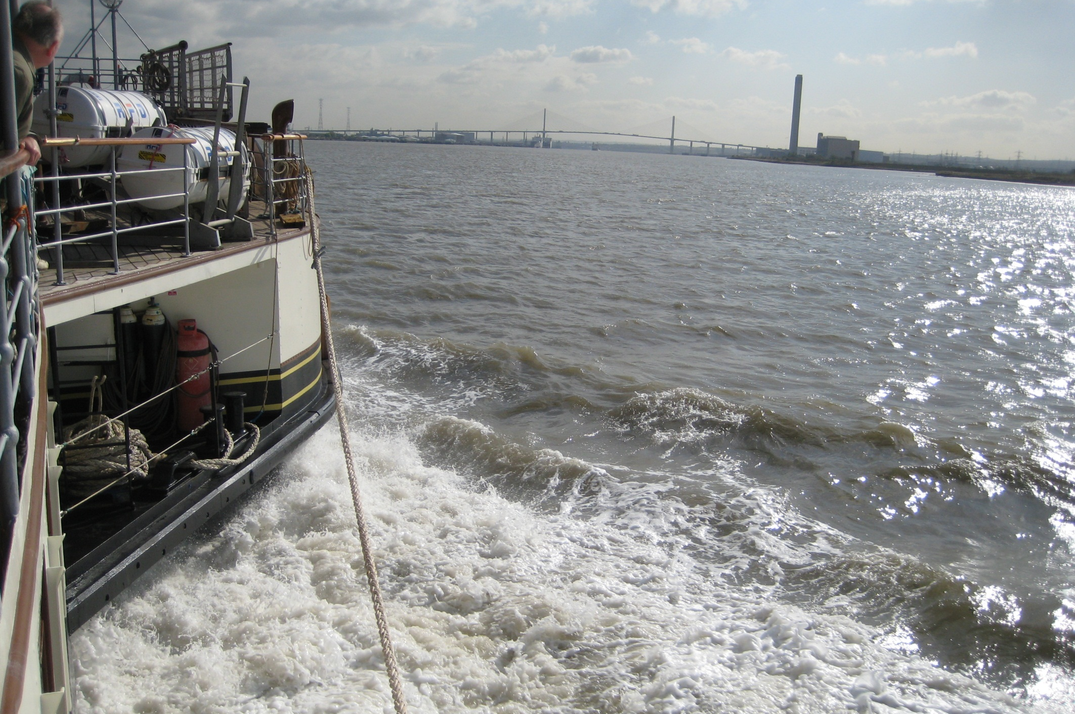
A view over the starboard paddle box as we approach the Dartford Tunnel.

Slide 16
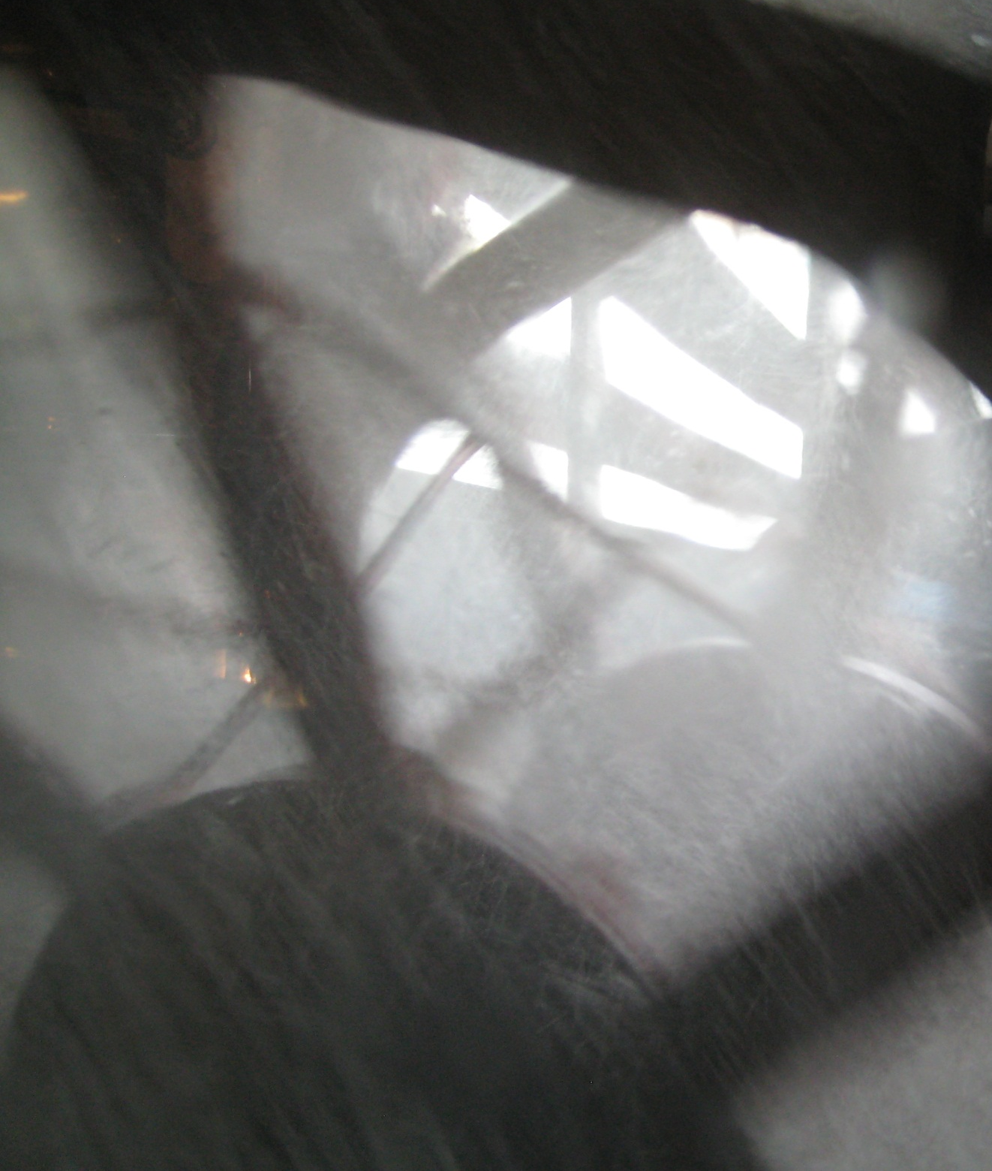
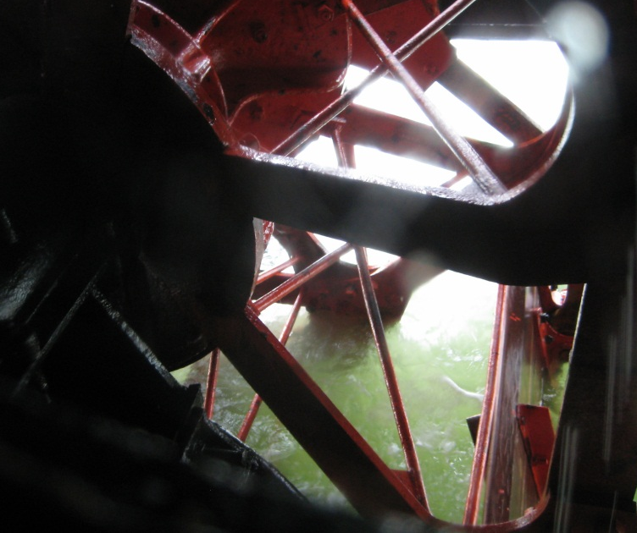
And the paddle wheels themselves.
One view in full cry and one view at rest.

Slide 17
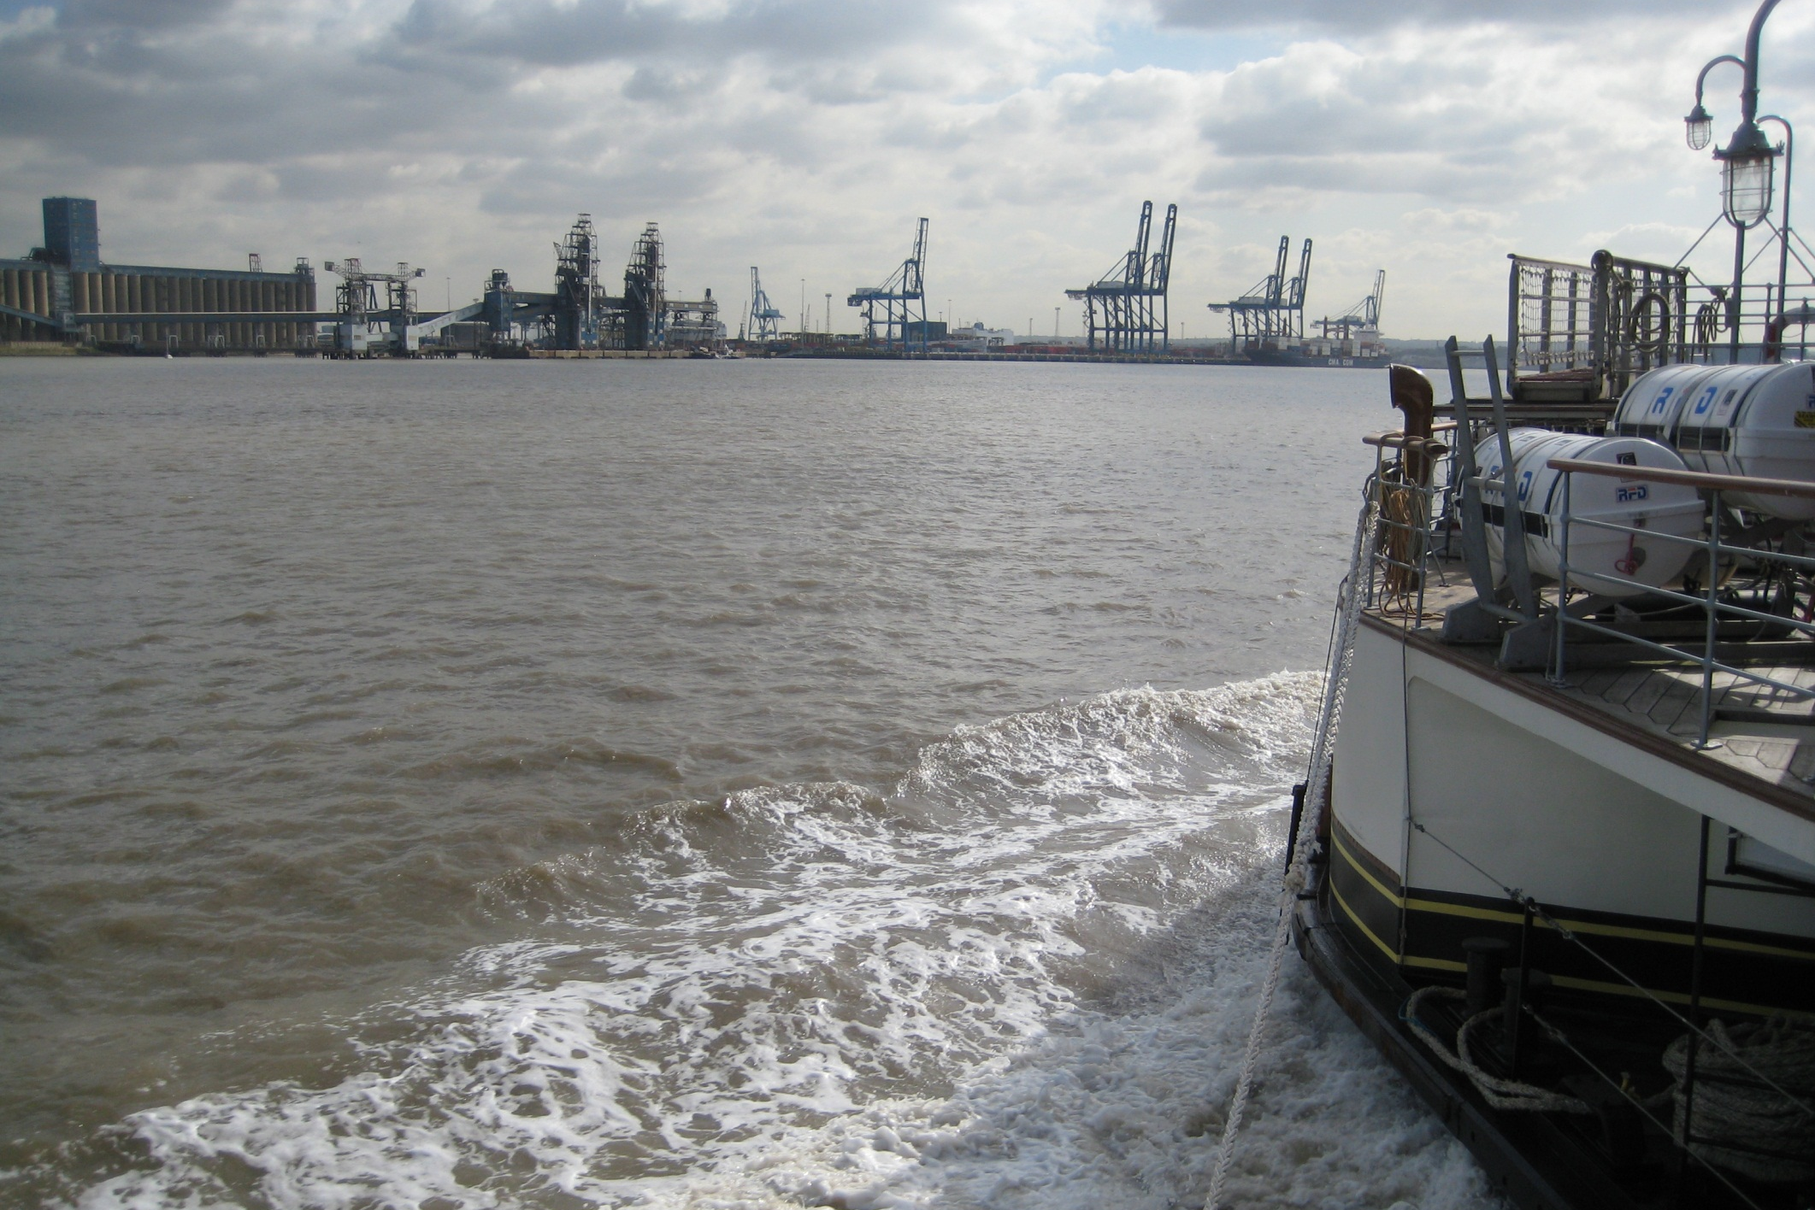
We pass the grain and container terminals at Tilbury.

Slide 18
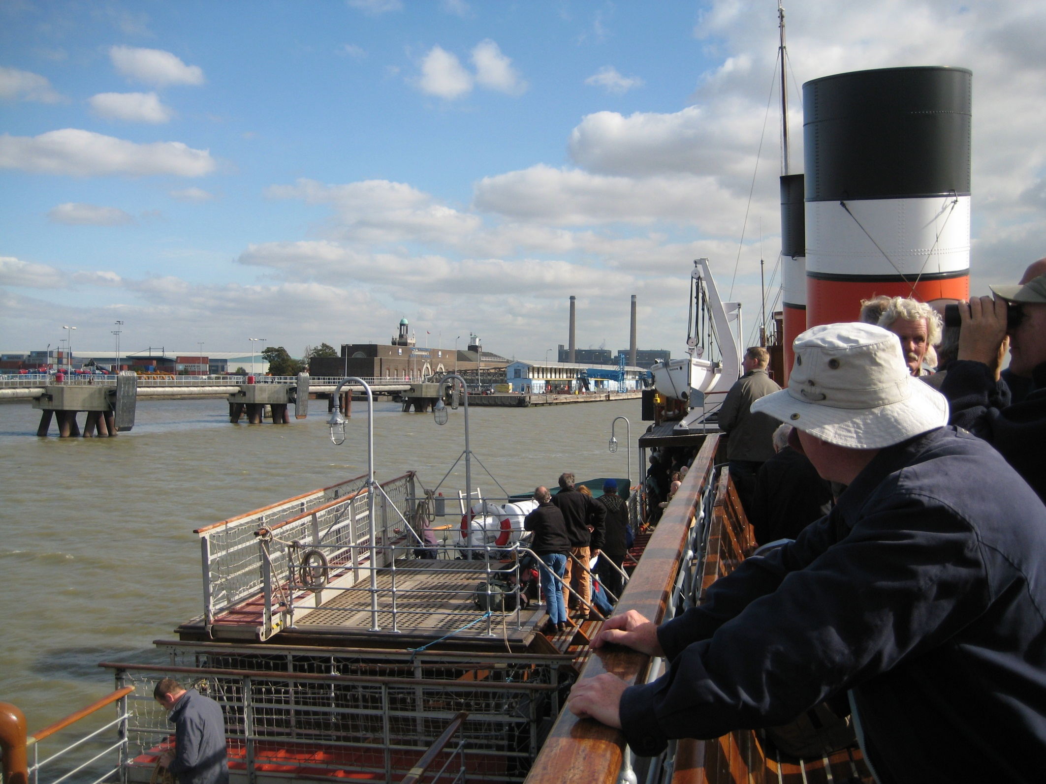
Then call at Tilbury’s former railway pier to pick up passengers.

Slide 19
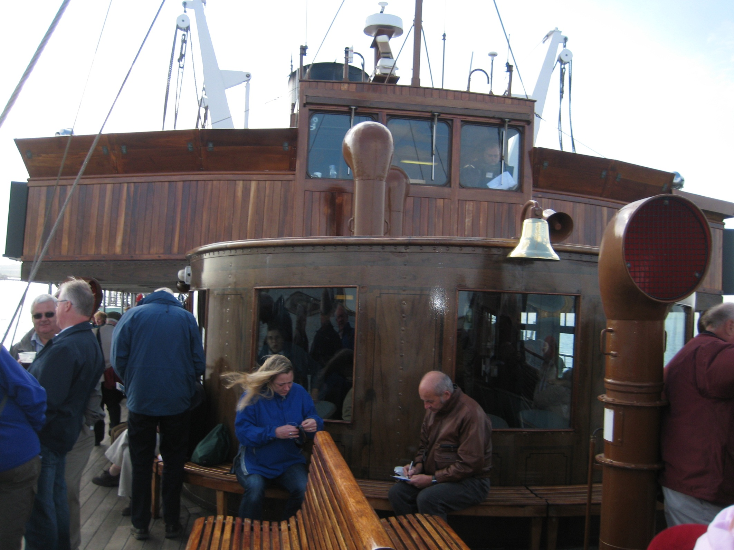
The Waverley is filling up!

Slide 20
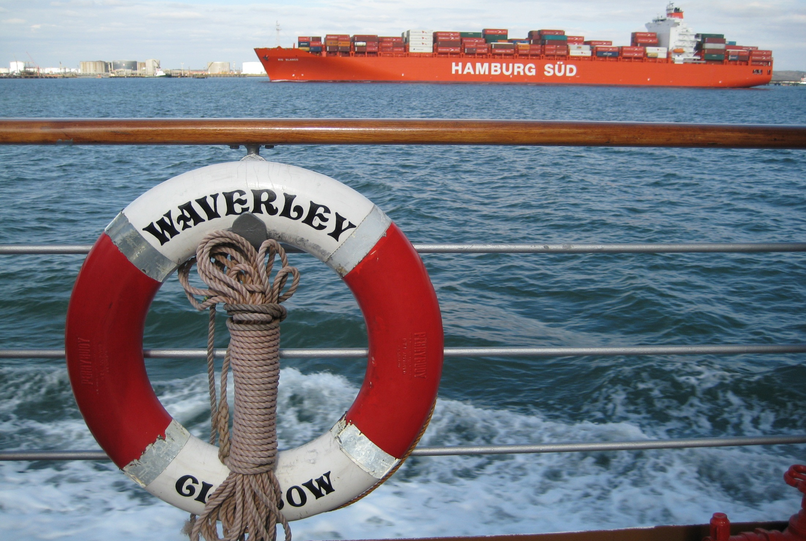
Moving on again, a well loaded container ship passes by.

Slide 21
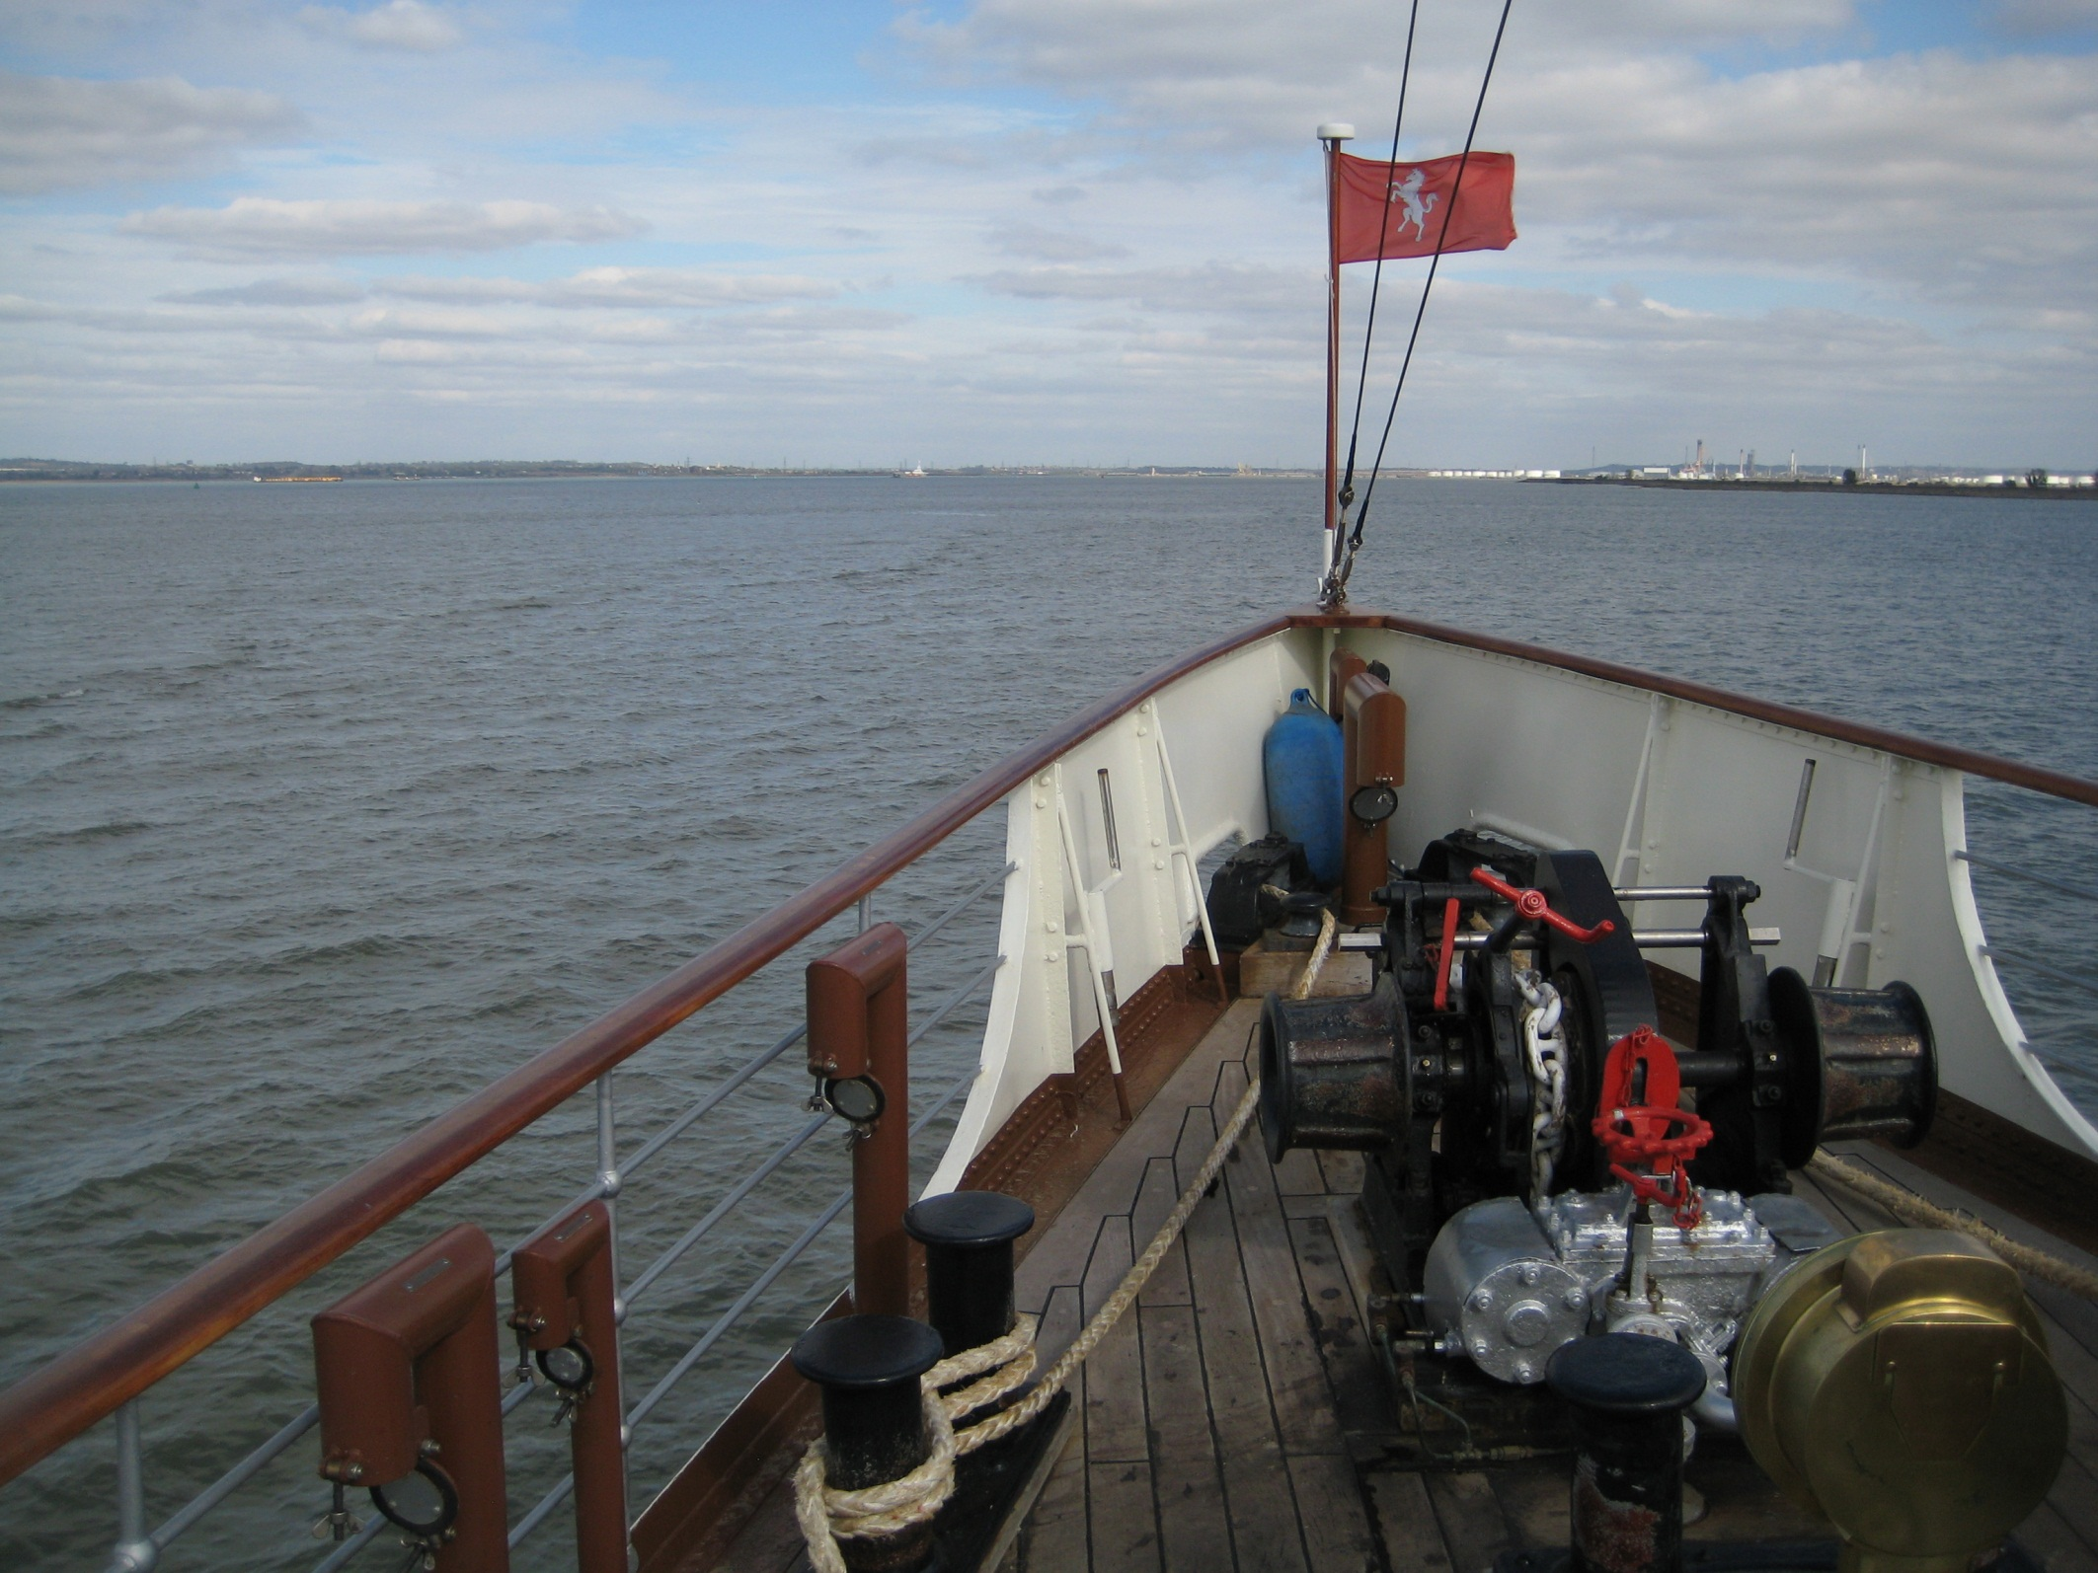
And a much wider Thames now passing Canvey Island.

Slide 22
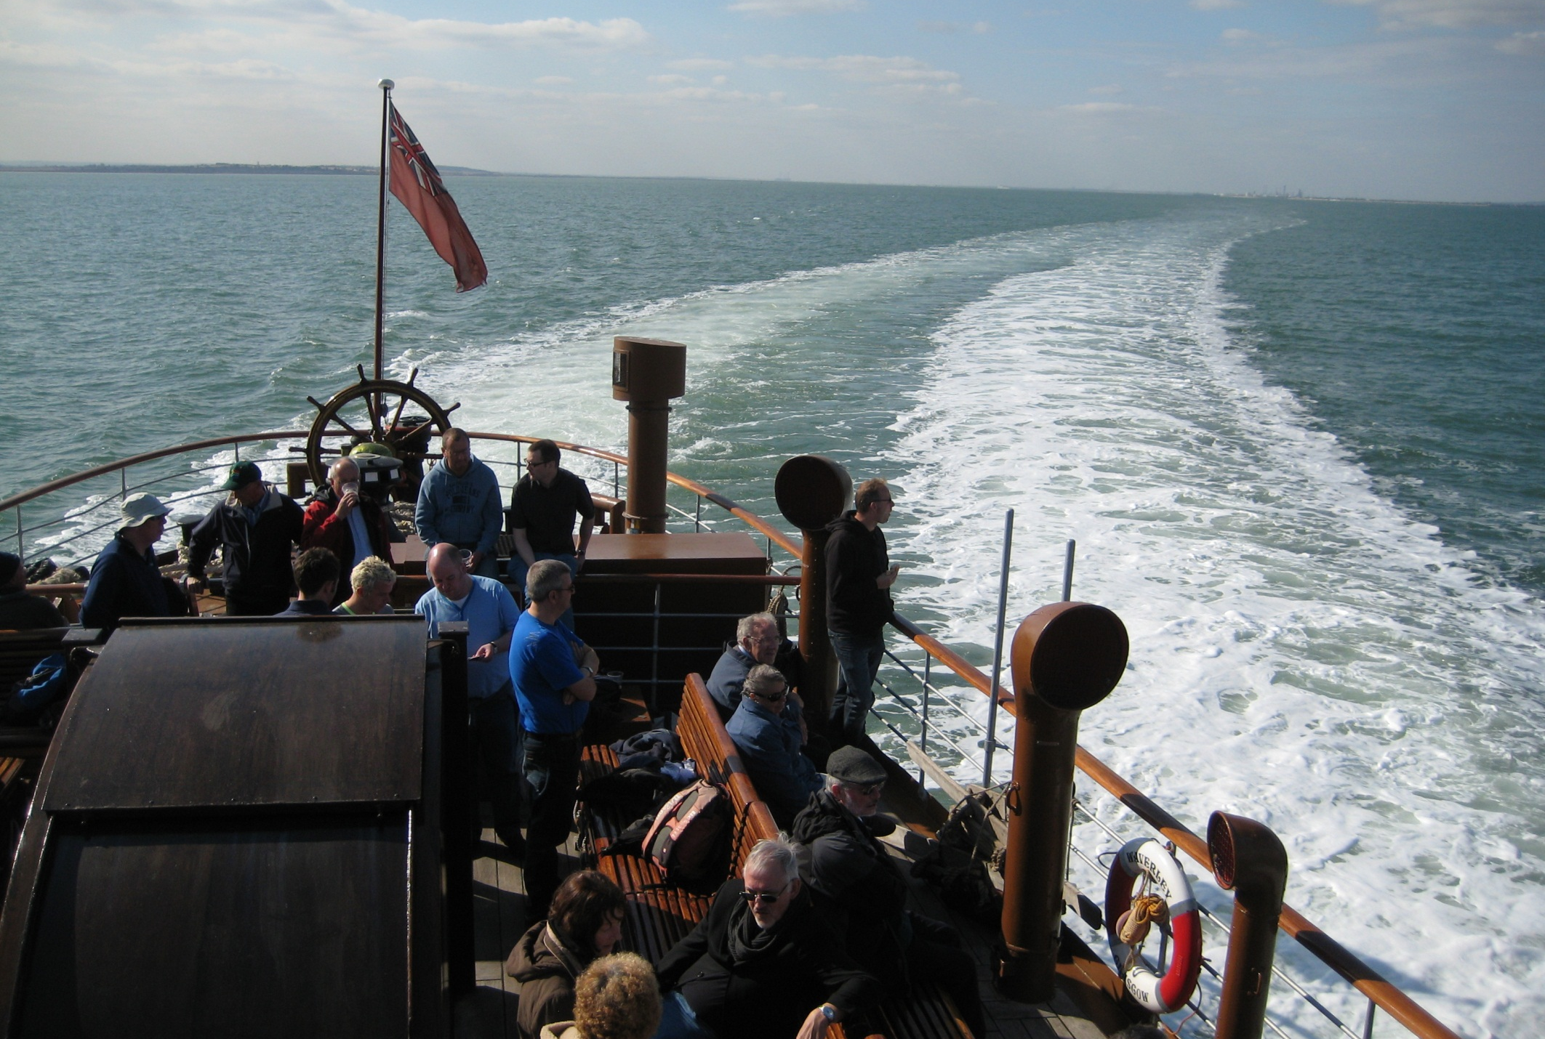
Then, with the Estuary widening ever more, we curve for our approach to Southend Pier.

Slide 23
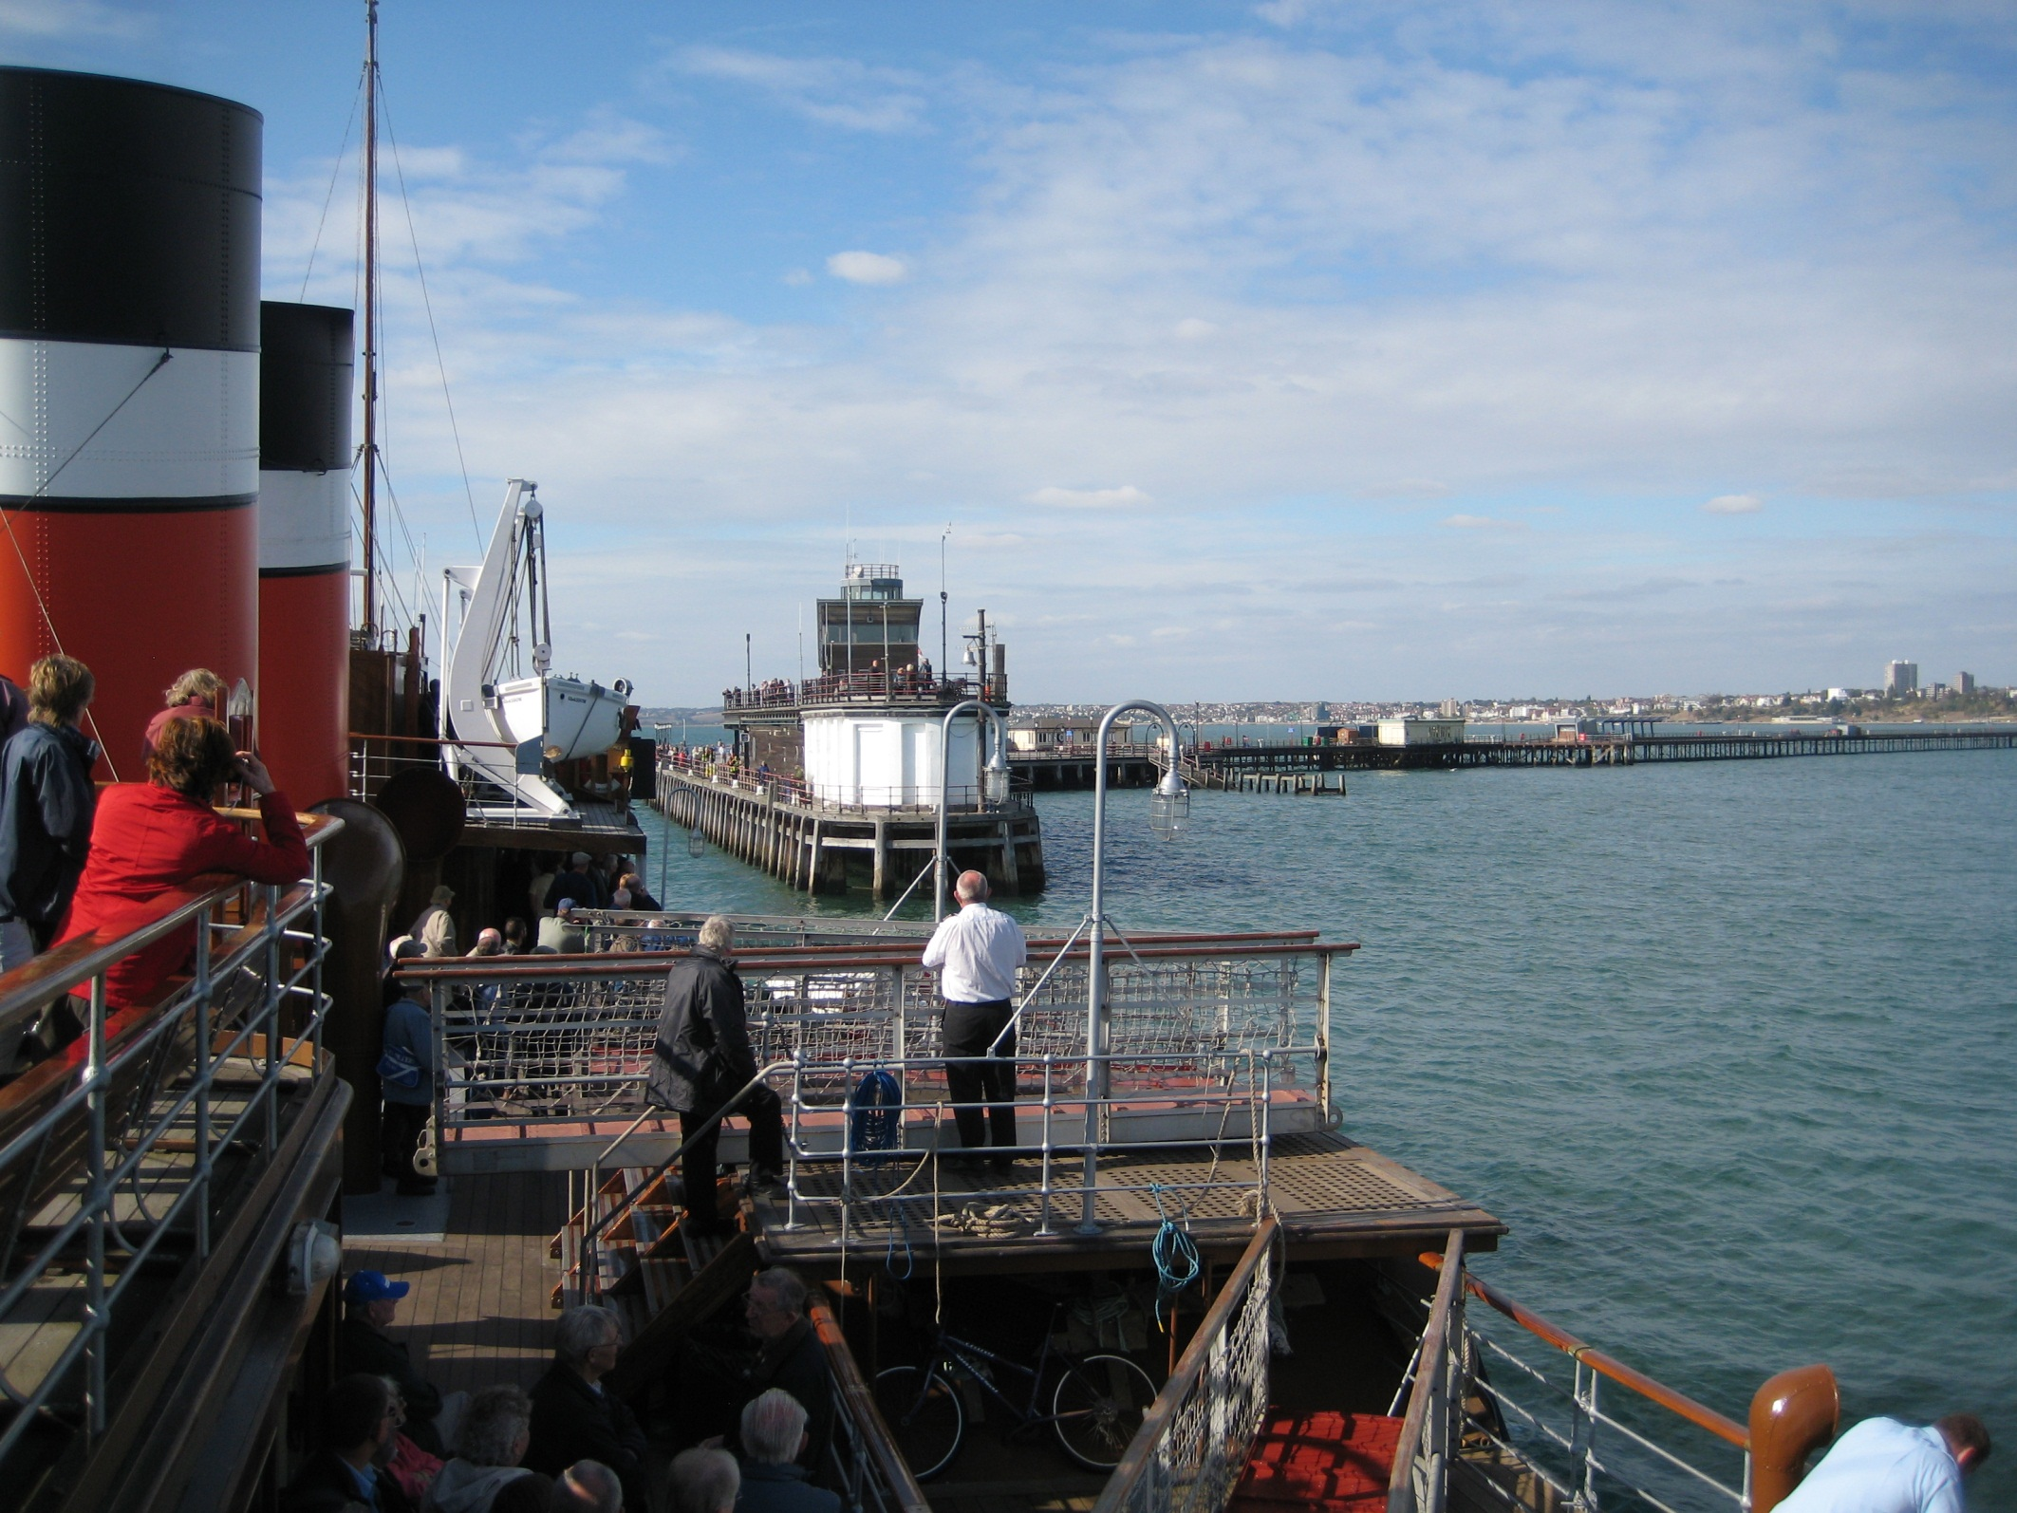
Famous Southend Pier stretches over a mile into the sea.

Slide 24
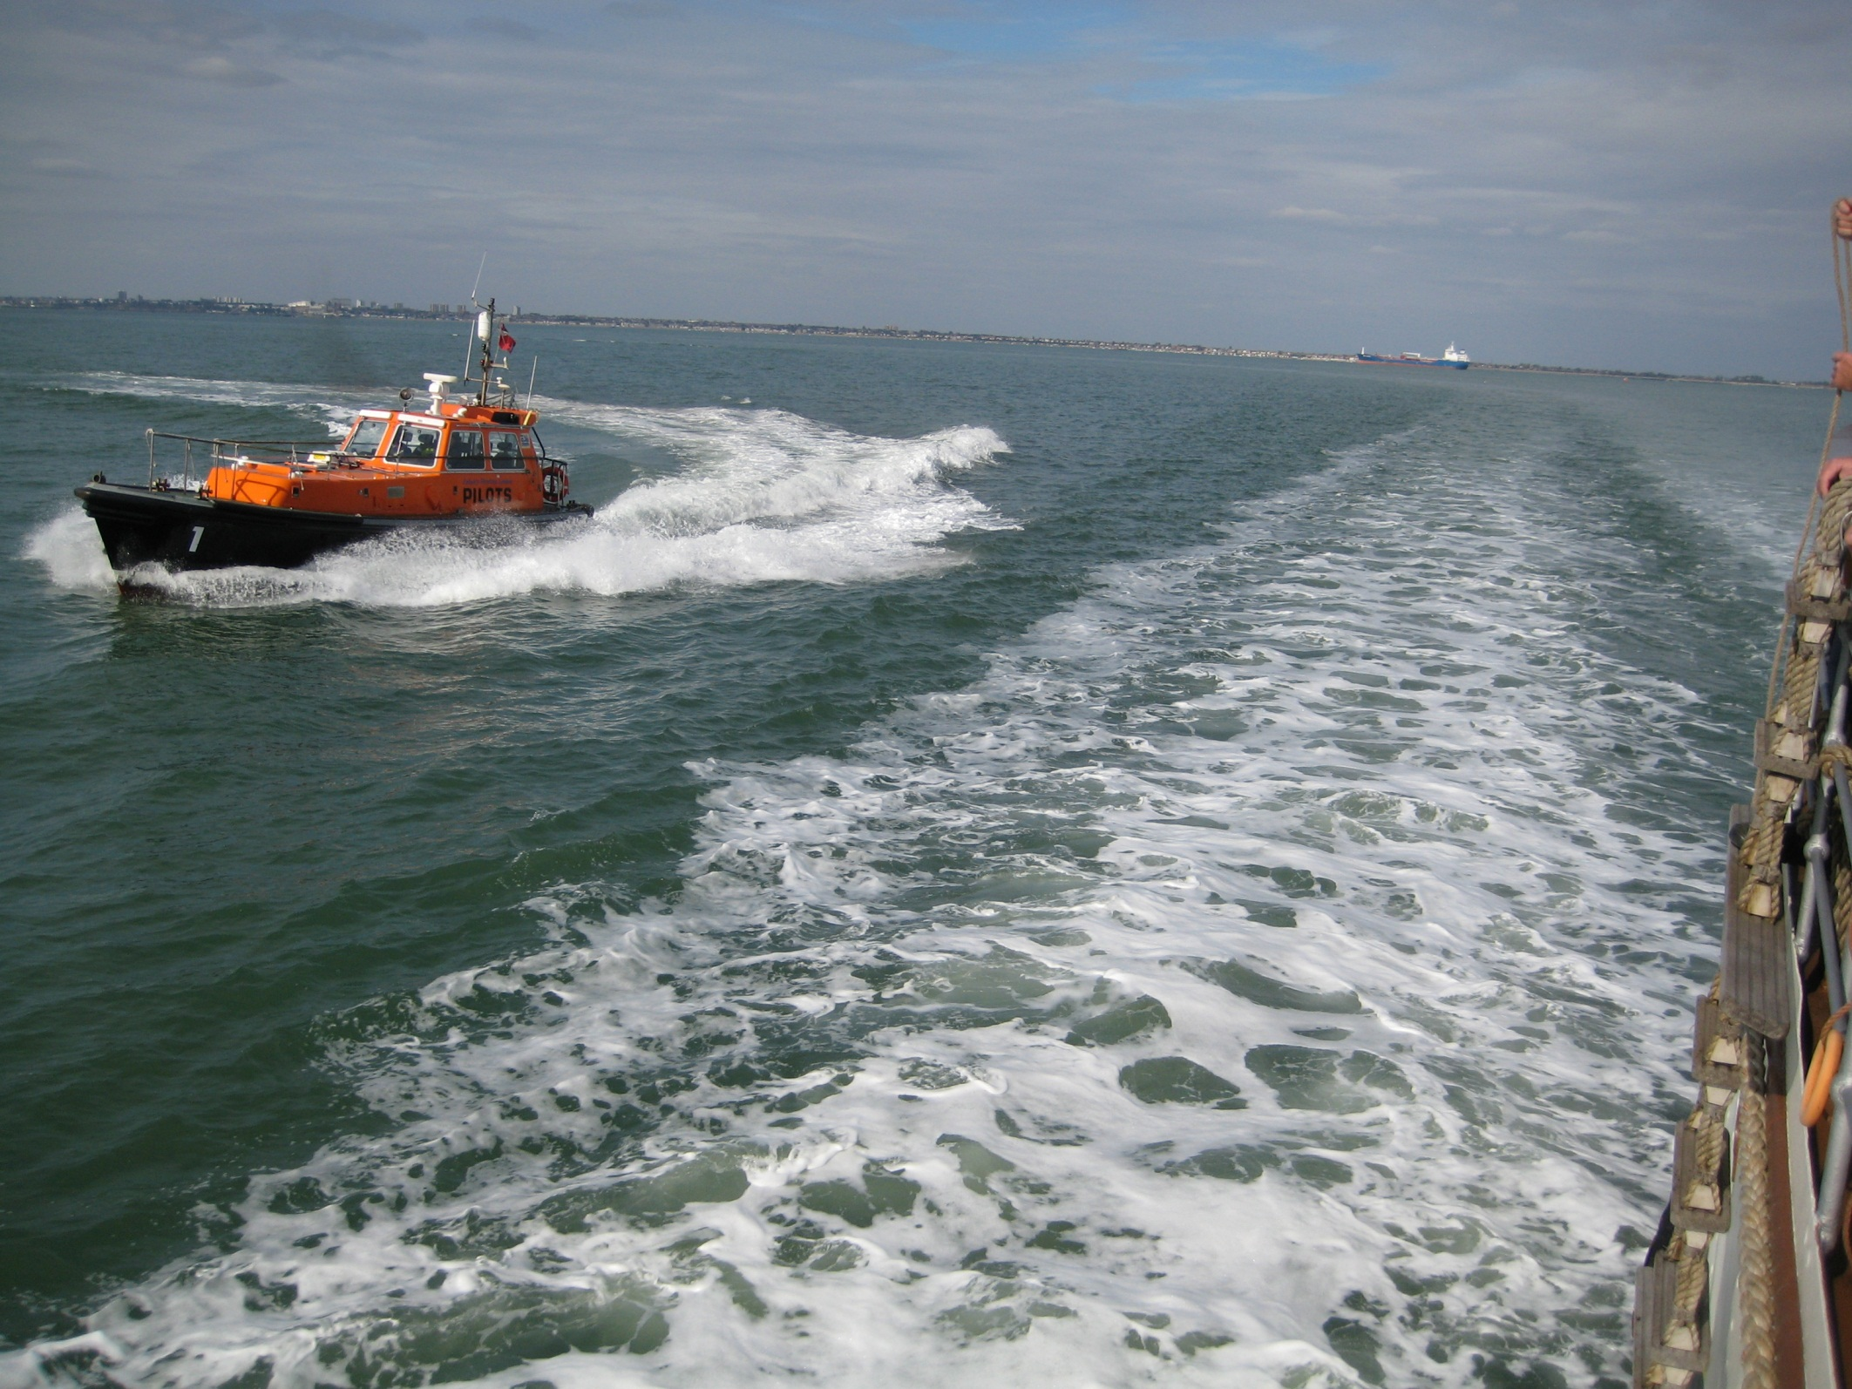
Underway again as a pilot cutter approaches with our pilot for the Medway Estuary.

Slide 25
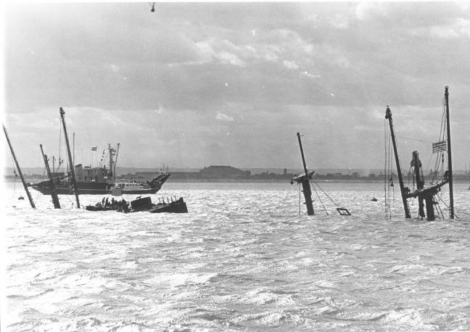
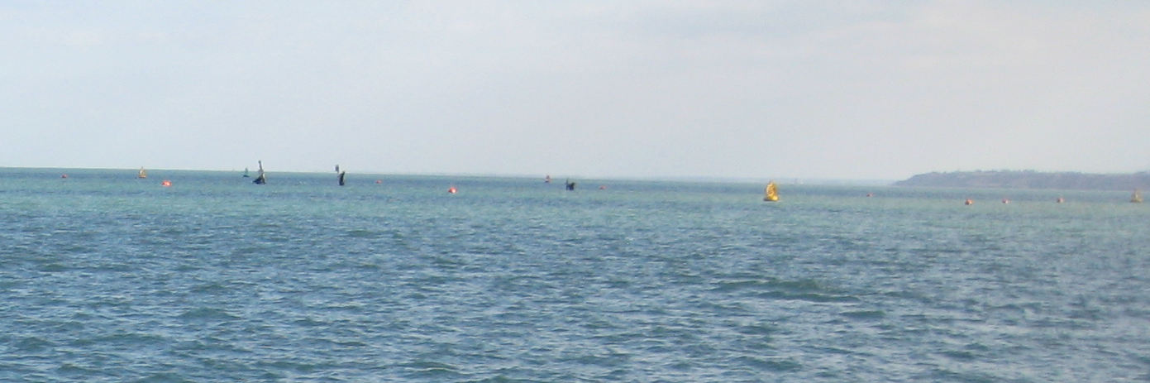
The pilot’s first job is to miss the Richard Montgomery, a wrecked US Liberty Ship still full of wartime explosives, an incredibly dangerous wreck. It’s masts have been lowered since the old black and white photo was taken.

Slide 26
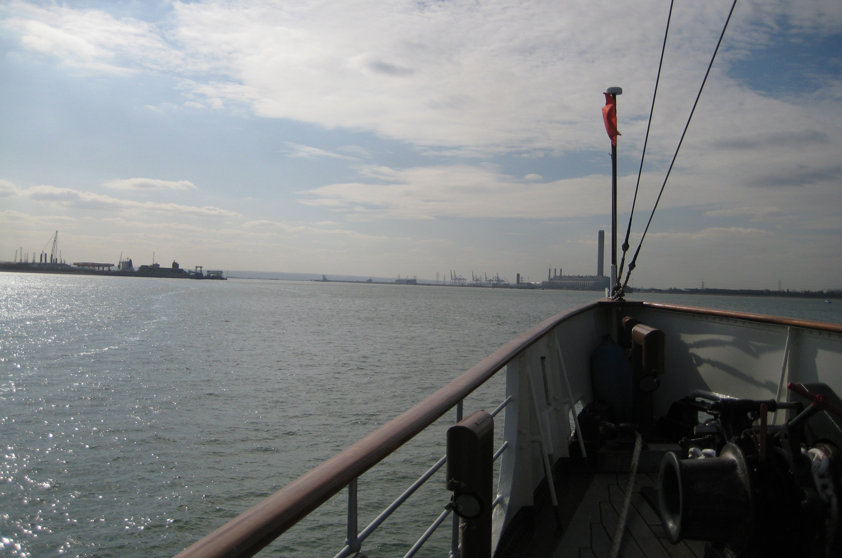
Sheerness Harbour is nearby, as is the Isle of Grain oil refinery. An explosion on the Richard Montgomery is unthinkable!!

Slide 27
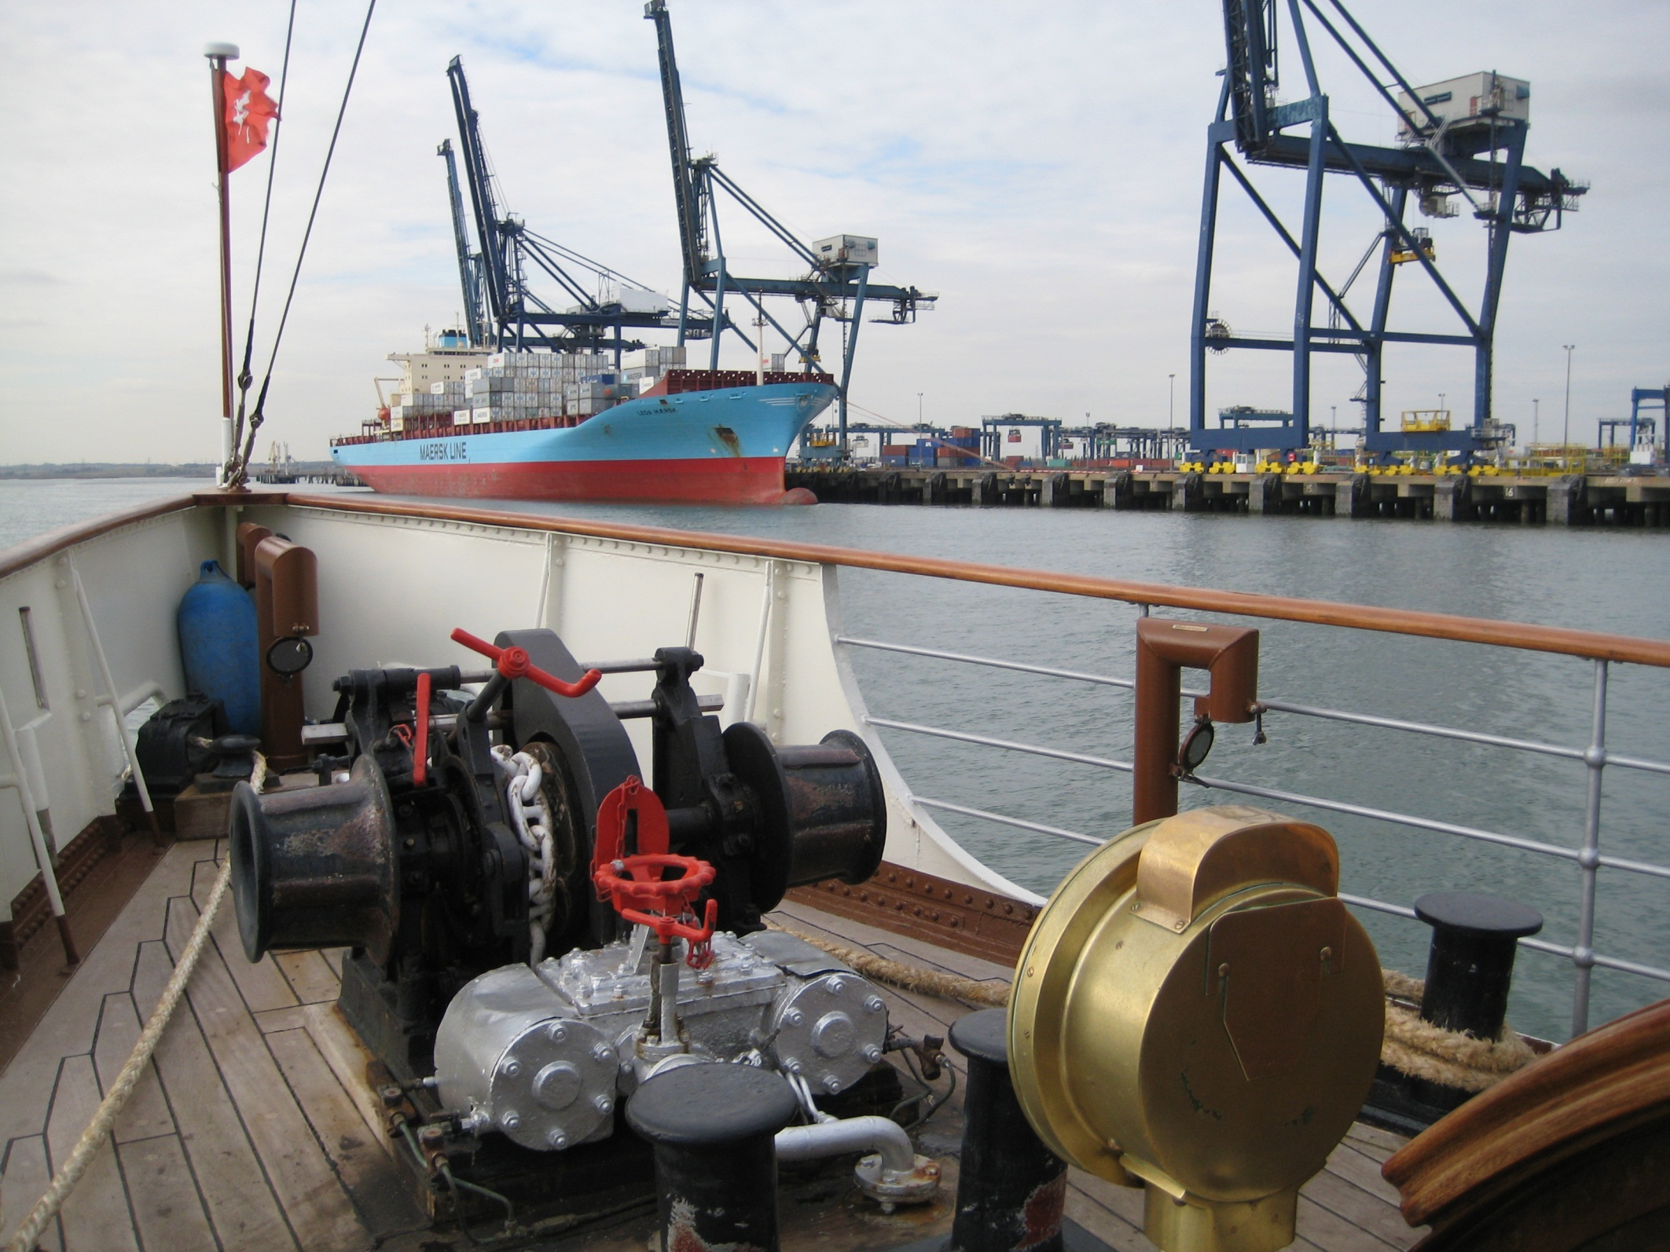
Nudging up the Medway estuary we pass sheltered Thamesport.

Slide 28
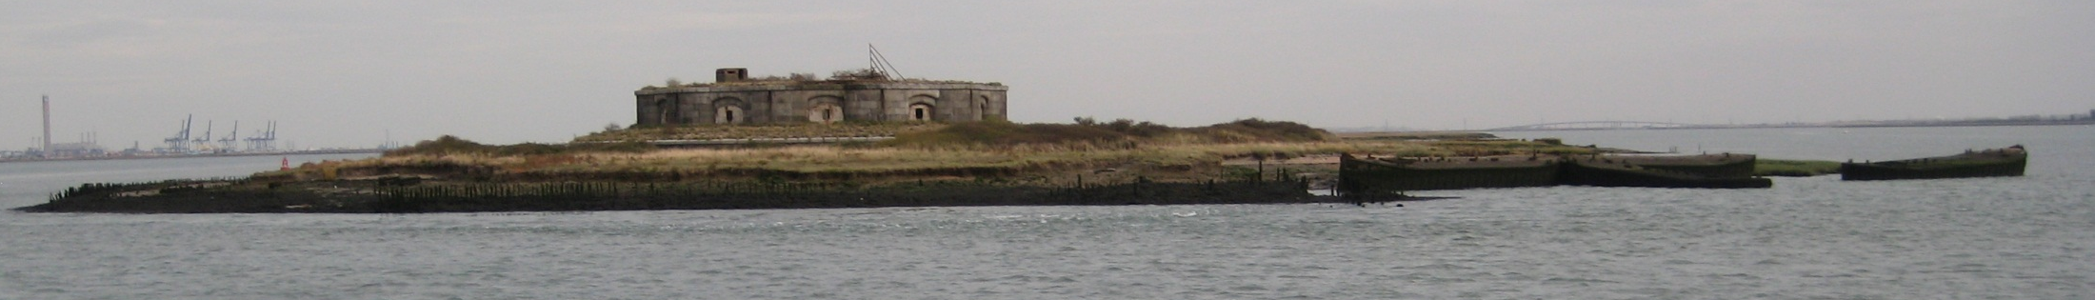
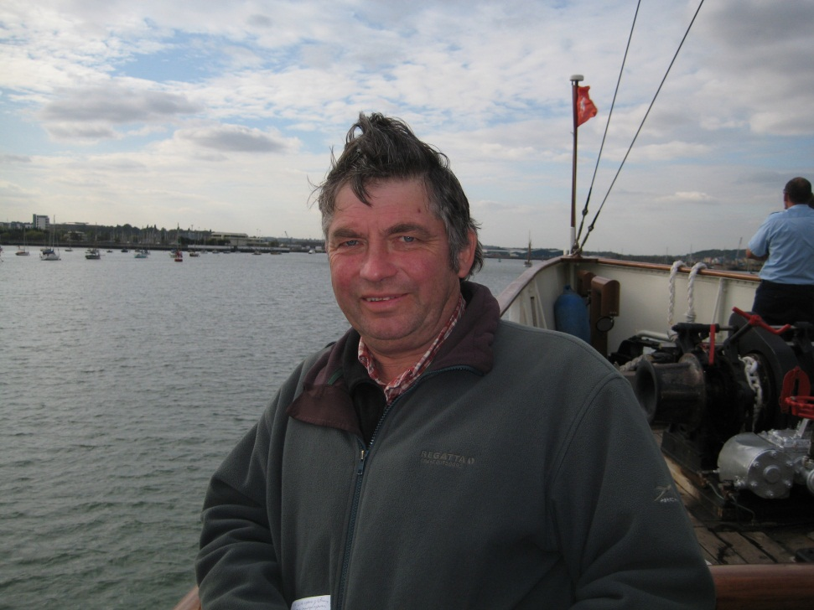
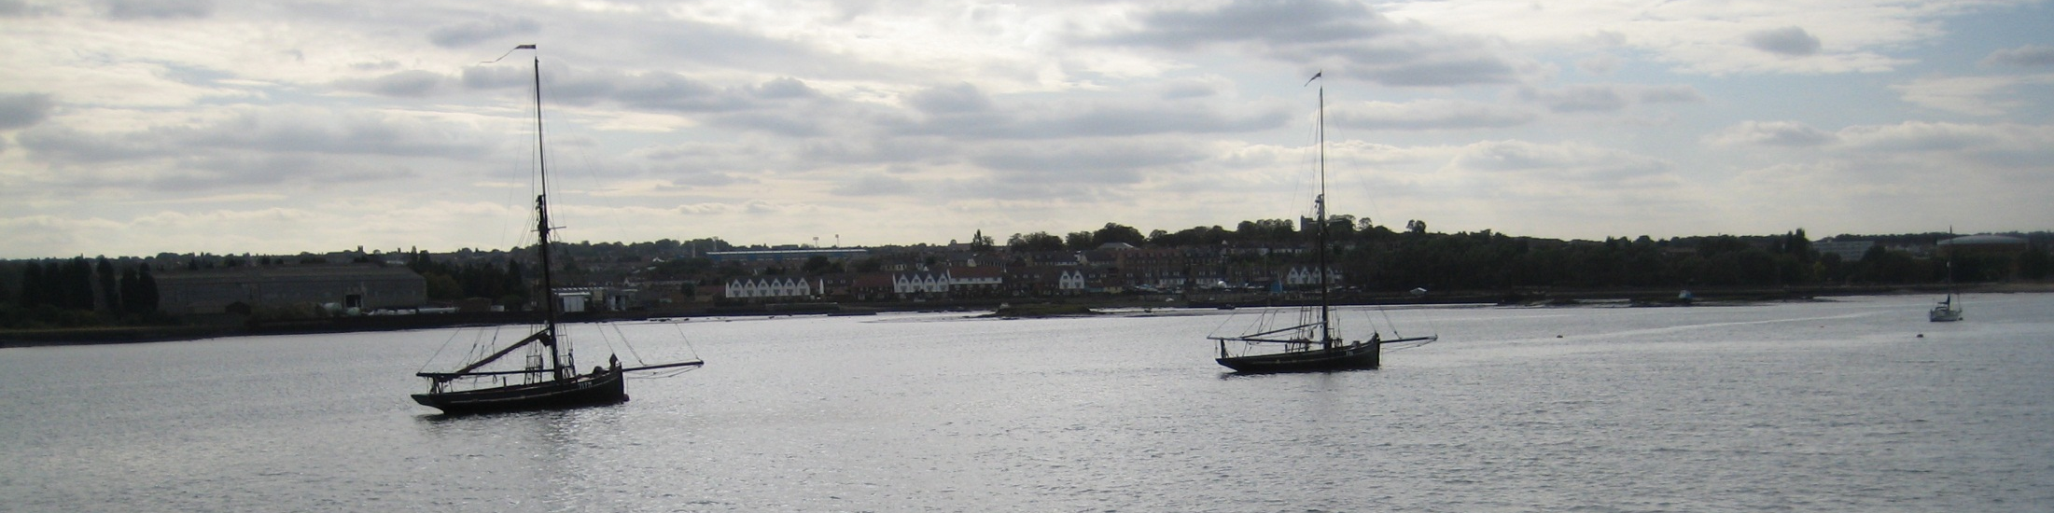
Then reach Darnet fort, built to guard Chatham dockyard.

Slide 29
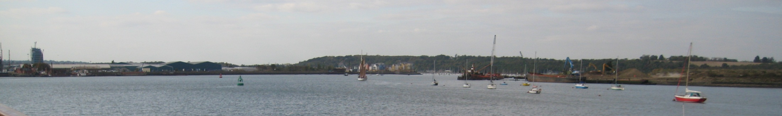
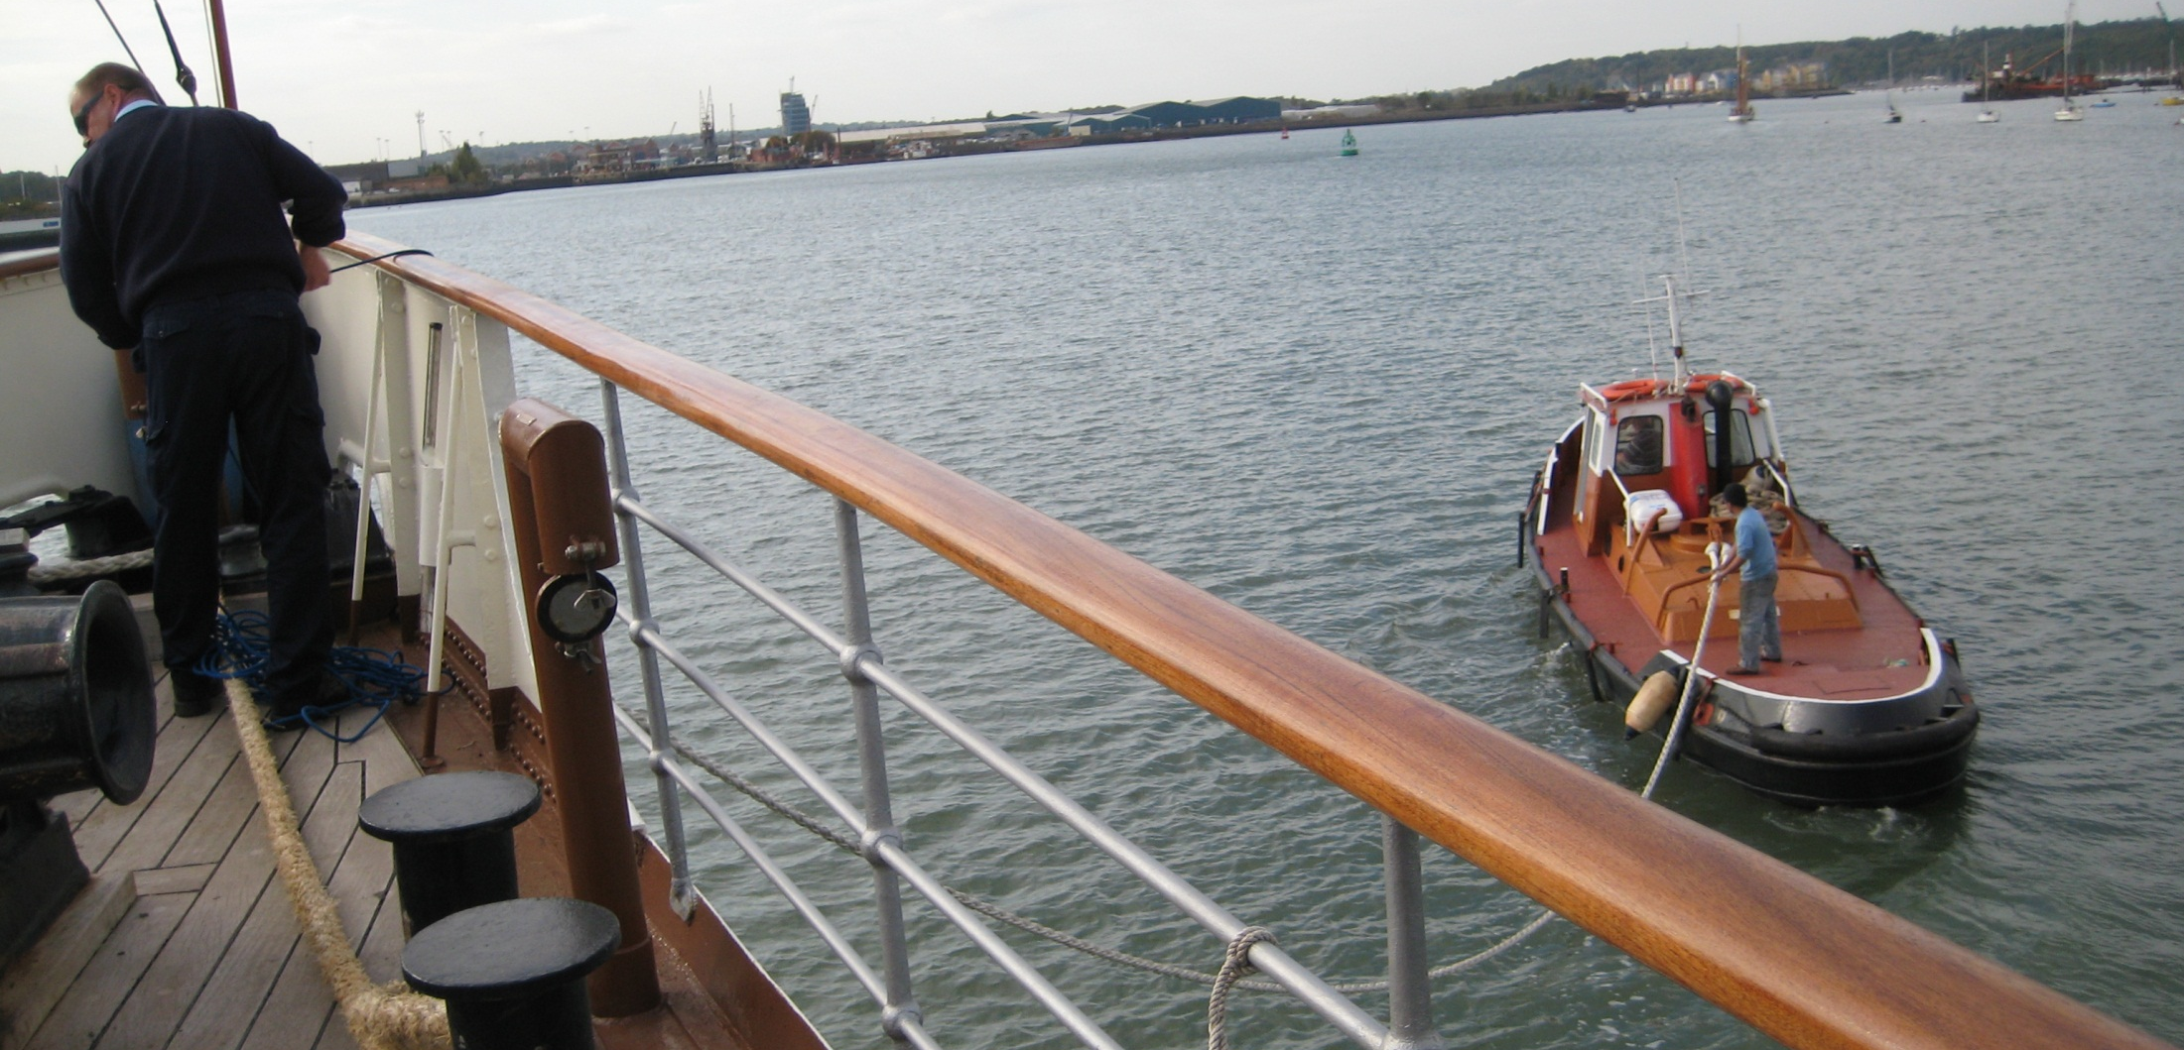
And it is here, with Chatham ahead, that the tug Boa helps us turn as we head back to a London in darkness.

Slide 30
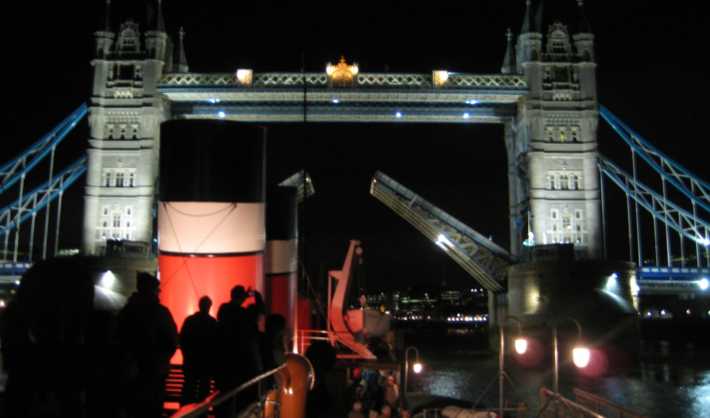
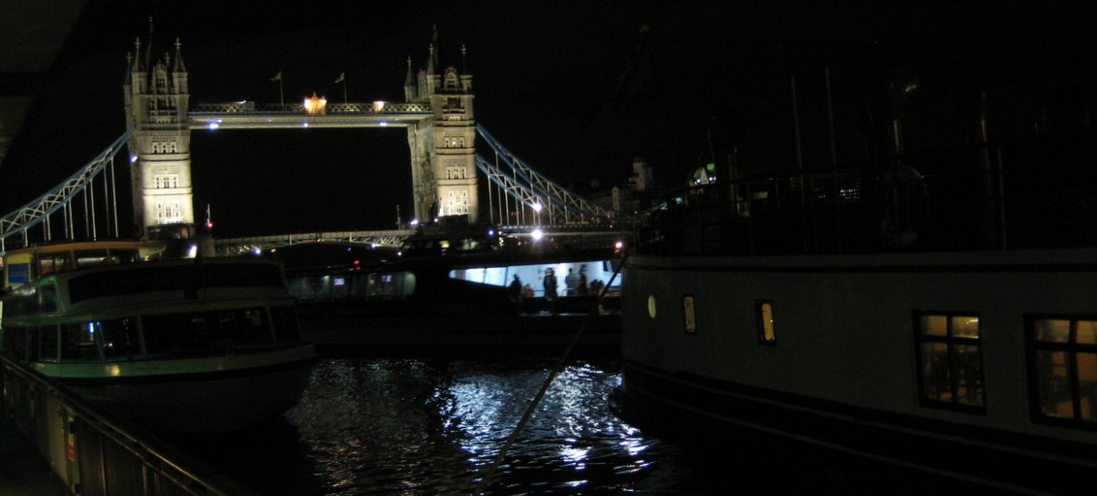
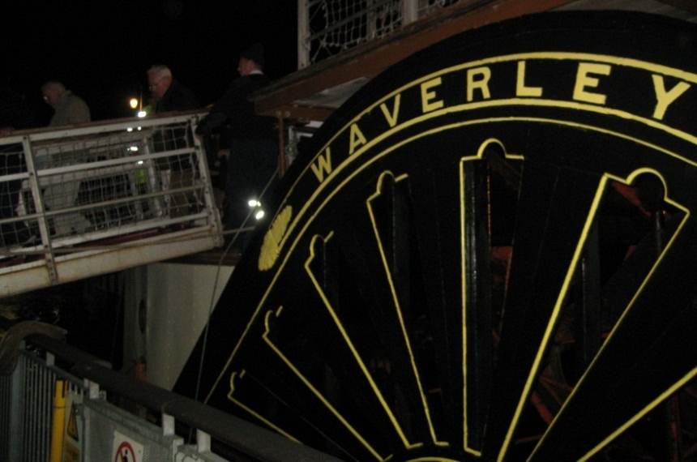
To close a fantastic day out.

Slide 31
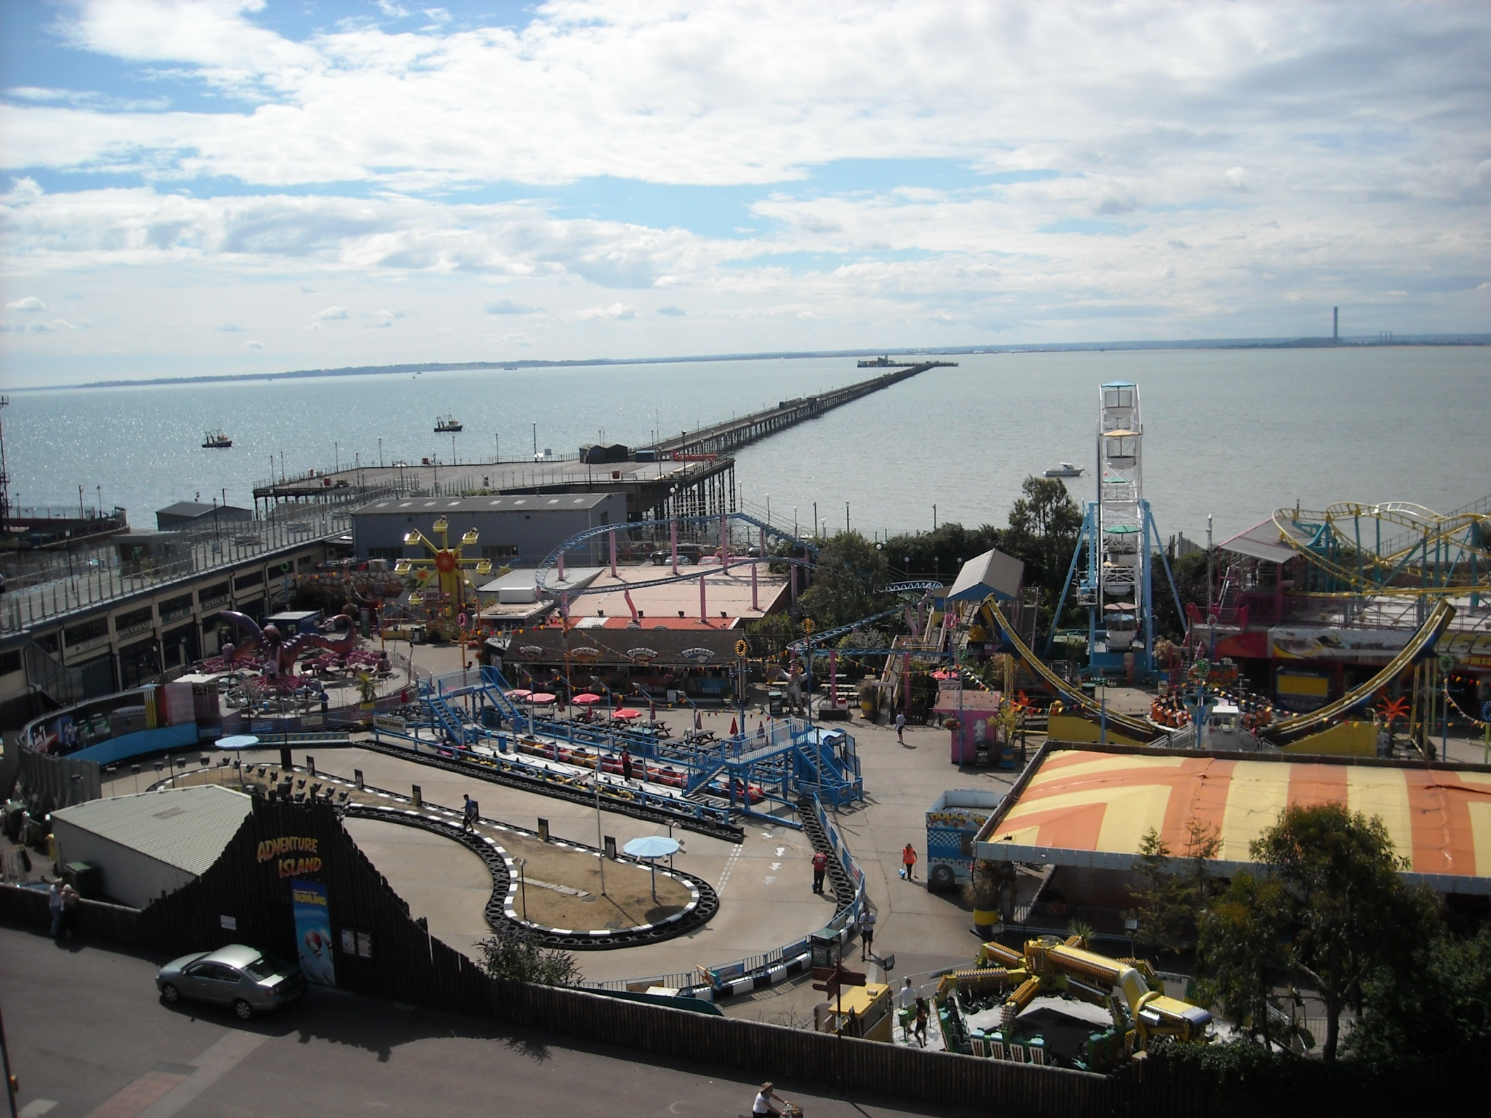
Our next trip is on 2nd July 2010 where, at
Southend Pier, another historic boat is due.

Slide 32
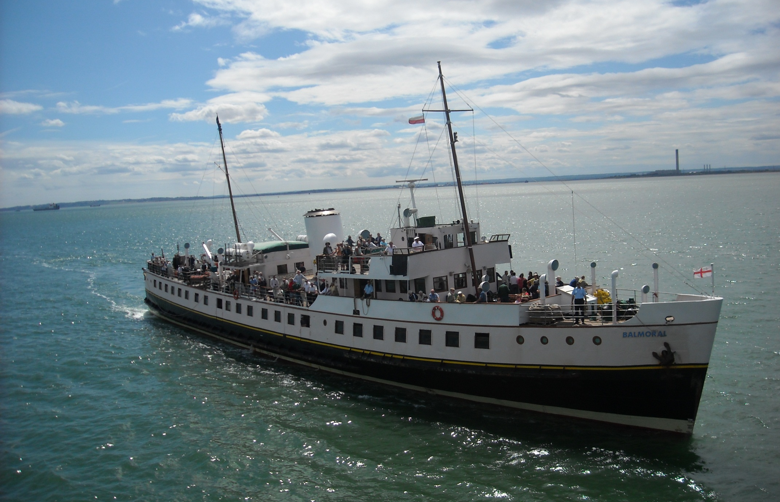
It’s the Balmoral, built in 1949 for Red Funnel Ferries and now the UK’s most versatile, go anywhere, passenger vessel.

Slide 33
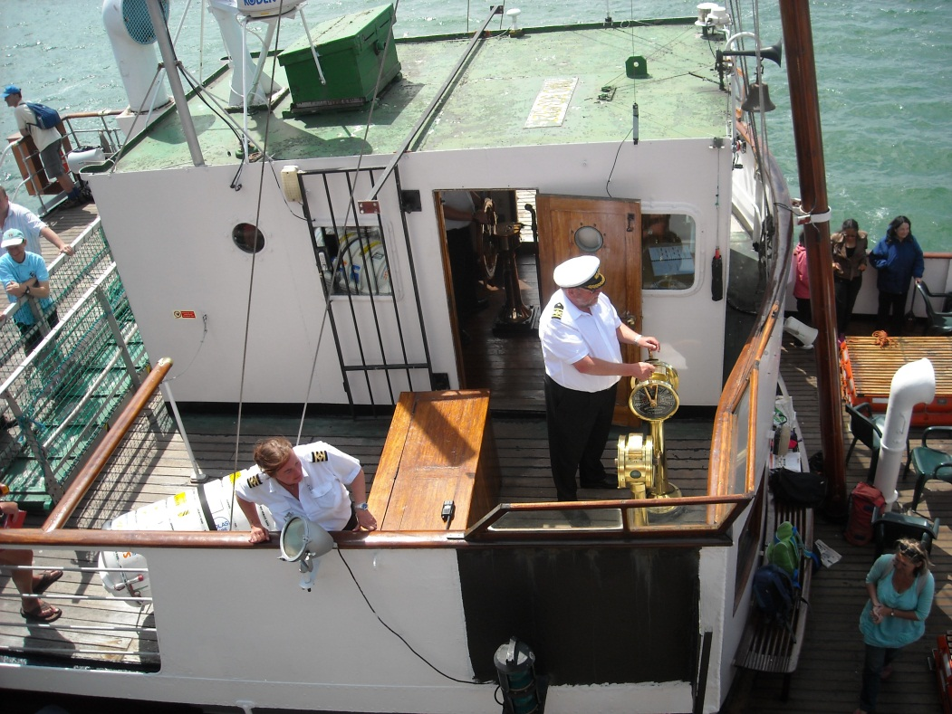
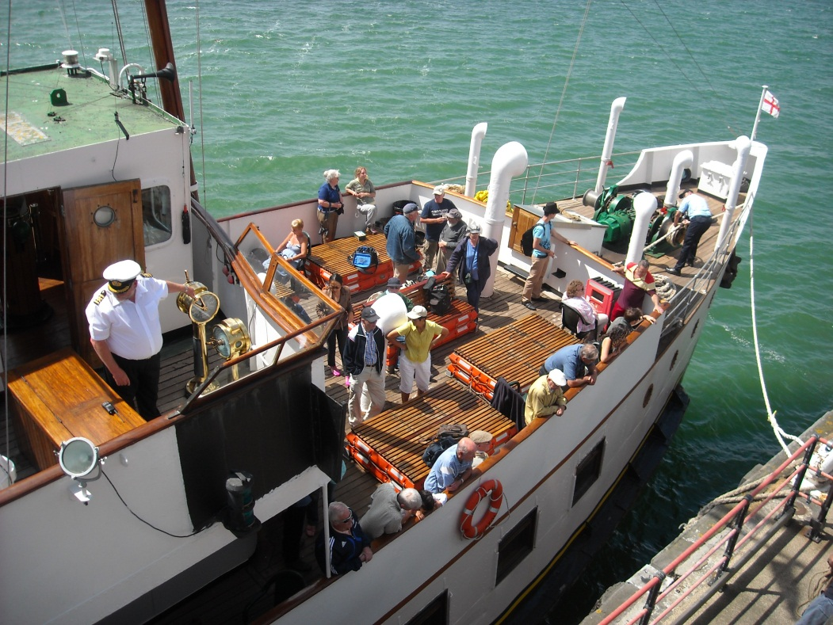
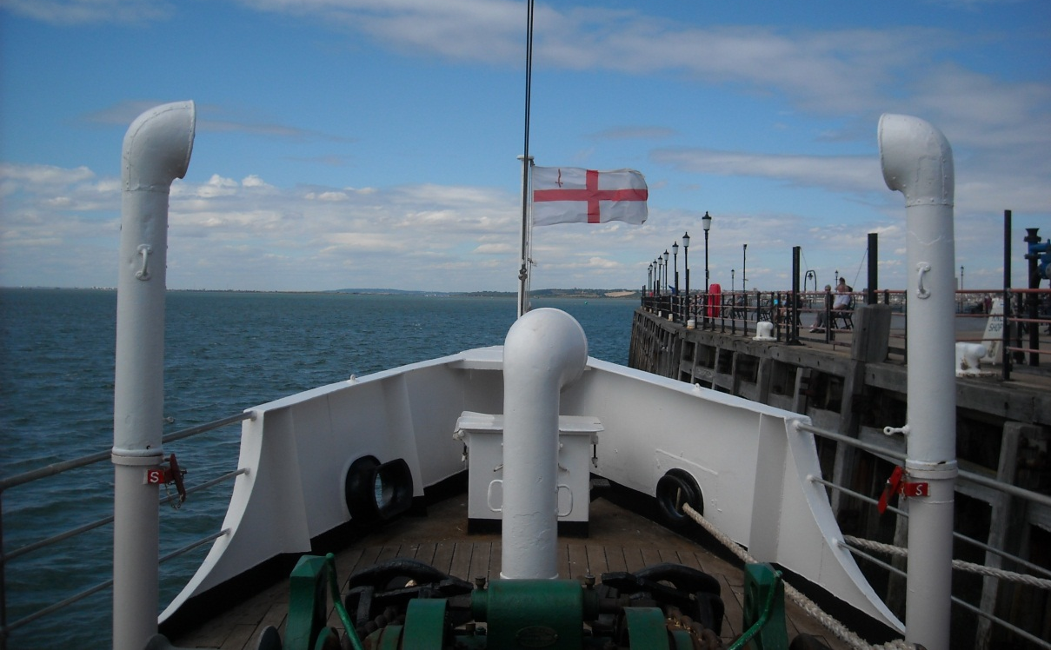
The captain brings Balmoral alongside the pier and passengers clamber aboard.

Slide 34
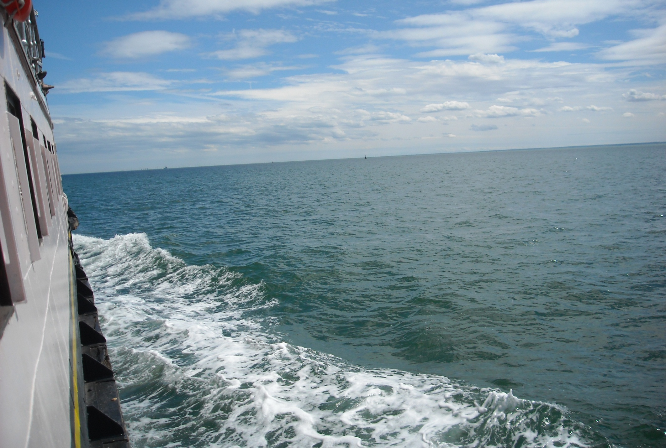
And off we go. This looks like open water but there are obstacles about. Southend Pier is one, a ship sliced right through it in 1986!

Slide 35
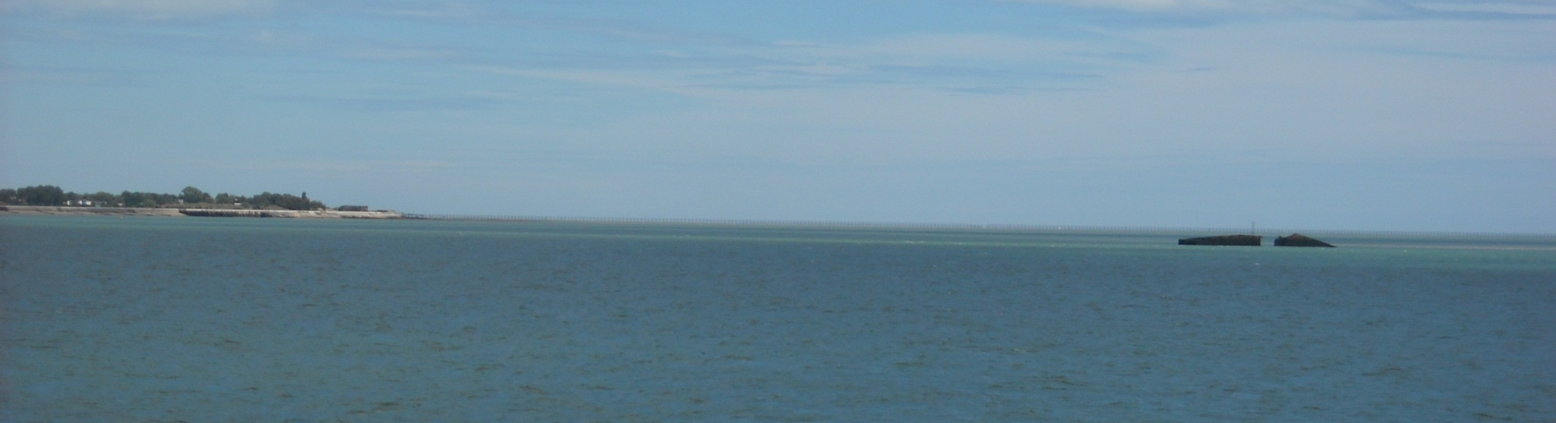
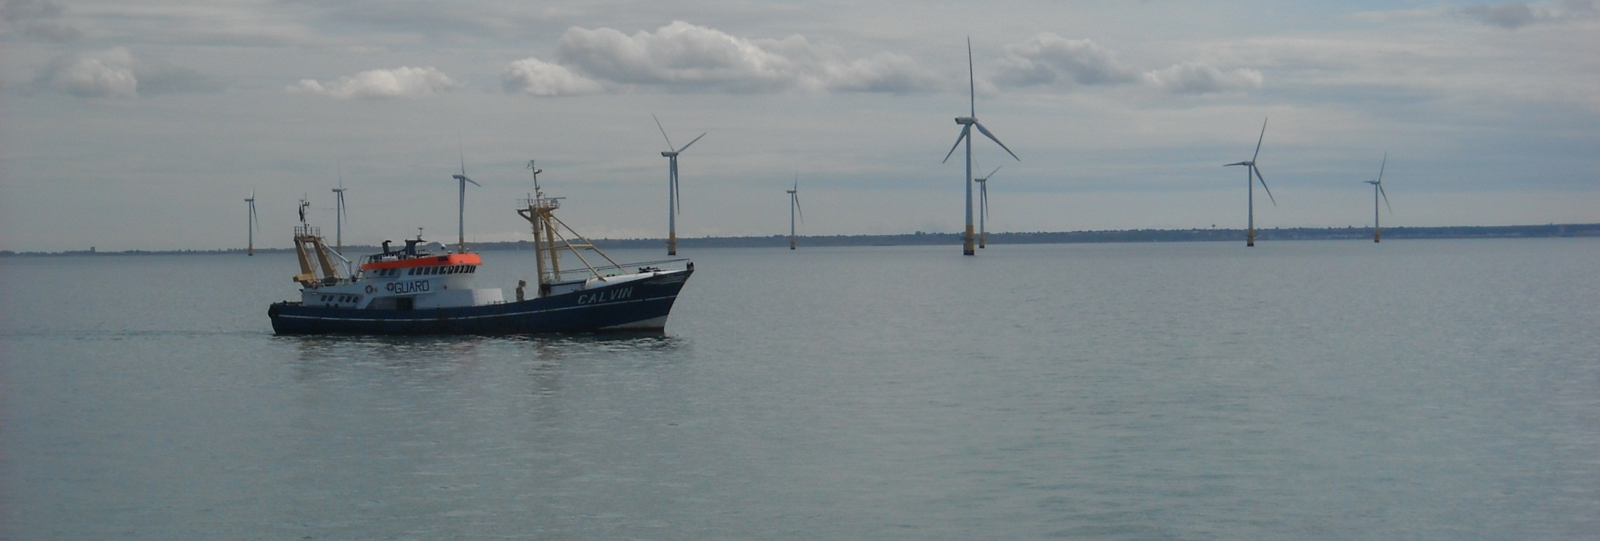
And off Shoeburyness is this piece of Mulberry Harbour, abandoned, leaking, en route to the D-Day beaches. There are also several wind farms to avoid. This one is near Herne Bay.

Slide 36
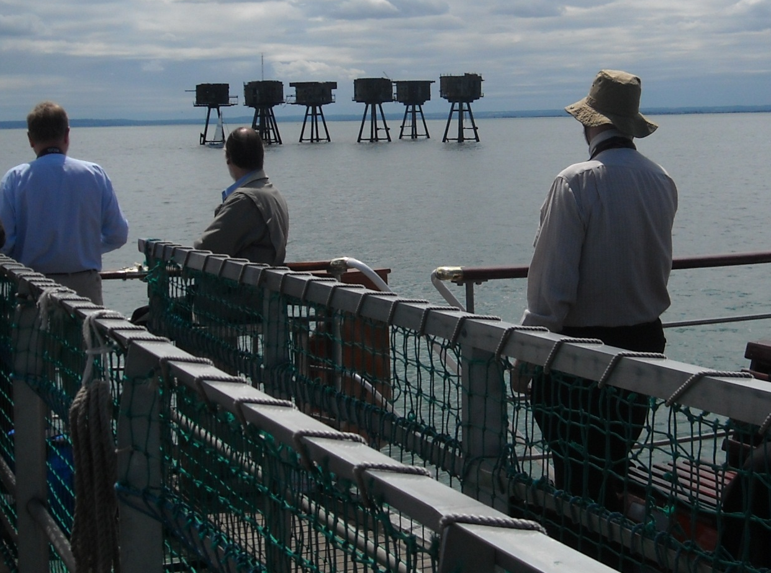
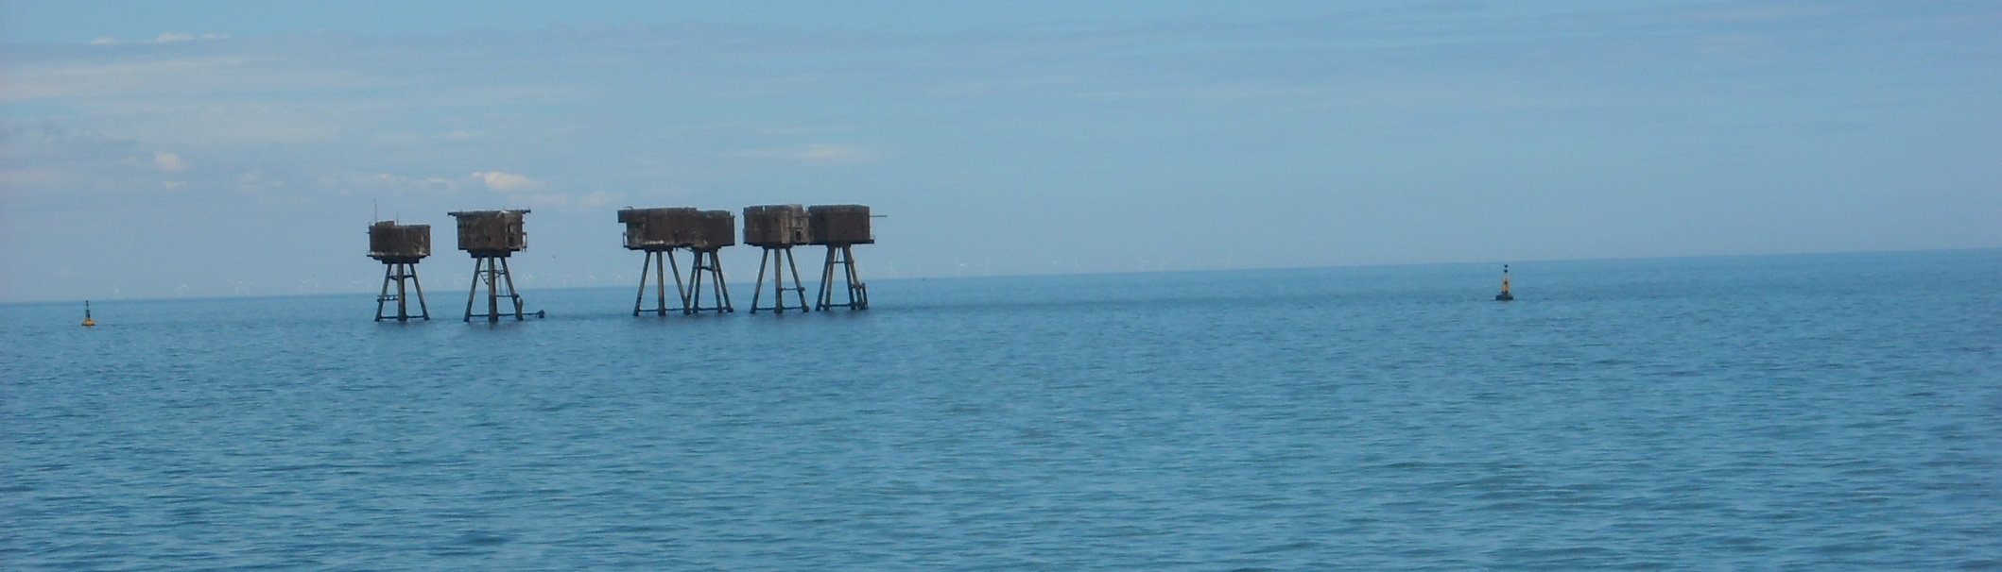
But the most interesting obstacles of all are the 2nd World War forts at Red Sands and Shivering Sands, build to intercept enemy aircraft. Shivering Sands lost a tower when a ship hit it and both were at one time occupied by pirate radio.

Slide 37



Balmoral was originally an
Isle of Wight ferry and was re-engined in 2003.
Maximum passenger capacity is 784.

Slide 38

It was windy off Margate!

Slide 39

And we were near the shore rounding North Foreland and the important light marking the route to London.

Slide 40

Round the headland we find Ramsgate and the remains of Richborough power station, built to burn Kent coal.

Slide 41

We then cross Sandwich Bay and head for Deal.

Slide 42

Calm Deal before a storm.

Slide 43

Which was really brewing approaching the White Cliffs of Dover.

Slide 44


St. Margaret’s Bay, Dover and, on the distant cliff, the South Foreland light as we avoid ferries in the rain.

Slide 45


And a view of the bridge as the helmsman checks his course.

Slide 46

And a wet, empty deck passing Shakespeare Cliff, Folkestone.

Slide 47

But conditions brighten near Hythe for our fascinating final miles.

Slide 48



And by Dungeness power station the deck was busy again!

Slide 49



With Hastings ahead we turn towards Rye Harbour as the Rye pilot comes out to meet us.

Slide 50

To steer us towards the narrow River Rother.

Slide 51

It is quite something bringing a vessel this size along here.

Slide 52



And we continue for quite a way up to Rye Wharf, a rare harbour on the south east coast of England.

Slide 53

Journey’s end in Rye Harbour, fantastic!

Slide 54


The next leg of our journey is aboard Waverley once more as we return to Rye Bay.

Slide 55

As the paddle wheels turn.

Slide 56


And the pistons pound!
And a “Mind your Head” notice on the crankshaft drive to the paddlewheels.

Slide 57

On this grey day it was brighter around Beachy Head.

Slide 58

Whilst out to sea the former South Goodwin lightship is now this unmanned light. There have been over 2000 wrecks around here!

Slide 59

Eastbourne now, in choppy waters. Sadly Eastbourne pier is no longer in a good enough repair for Waverley to call.

Slide 60

As we reach the chalk cliffs of Beachy Head, an amazing
530ft high.

Slide 61


The famous Seven Sisters next then the inlet of Cuckmere Haven.

Slide 62

And Brighton now…………but only from a distance.

Slide 63

But we get a much closer to Worthing as we call at the pier.

Slide 64



To allow some 250 waiting passengers to board.

Slide 65

We reverse away. Worthing is the only pier between
Portsmouth and Dover at which Waverley can currently call.

Slide 66

Something interesting happened in Bracklesham Bay as the coastguard, on exercise off Selsey Bill, wished to land a man.

Slide 67


And here he comes, swinging in!

Slide 68

To complete the exercise a departing crewman is then lifted off.
This is spectacular stuff when viewed from just yards away from the upper deck of a moving boat.

Slide 69

See what I mean!

Slide 70

Around Portsmouth the weather is poor and the shipping lanes busy.

Slide 71

As we pass No Man’s Land Fort, one of three Solent forts built around 1880. Ryde is behind in the mist.

Slide 72

And Portsmouth Harbour and the Spinnaker Tower.

Slide 73

But even on a grey day Portsmouth is a fascinating place.

Slide 74

Next day is much brighter. This is Warrior, a steam and sail warship of 1860, iron plated but still very traditional on board.

Slide 75

For example 655 men lived on this gun deck in messes of 18, meaning that 18 hammocks were slung around each gun.

Slide 76

Things are different now on the 88 ships currently in the
Royal Navy and 17 of these are in Portsmouth today.

Slide 77



This line up of four includes the aircraft carrier Ark Royal and
D34, the new stealth vessel
Diamond.

Slide 78

And York and Edinburgh head this line up which also includes Invincible, an aircraft carrier of the reserve fleet.

Slide 79

On the other side of the harbour is Gosport and its yacht moorings.

Slide 80

And amongst the sea of masts is a lightship, now a restaurant. Always unpowered, this 1946 lightship was retired in 1991.

Slide 81

Not many places are as varied as Portsmouth.
It is quite simply, all action, all of the time!

Slide 82
End of Chapter 11

